Slide 1
Yielded Faith
January 28

Slide 2
Video Introduction
View Video

Slide 3
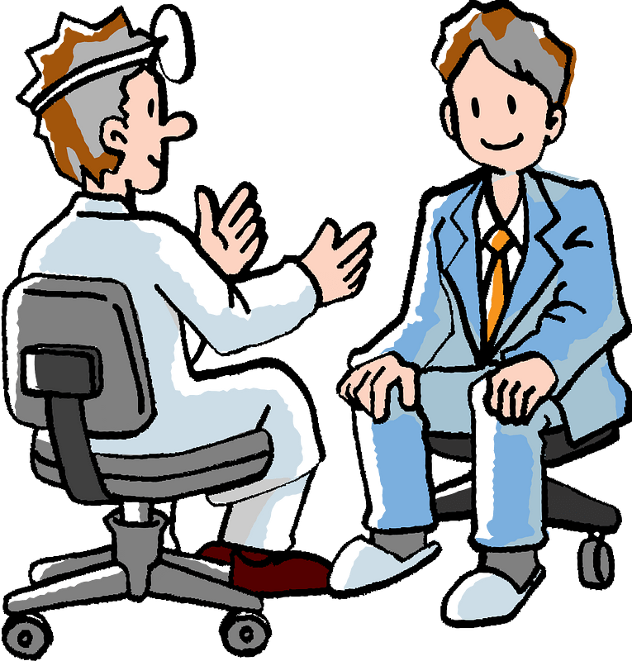
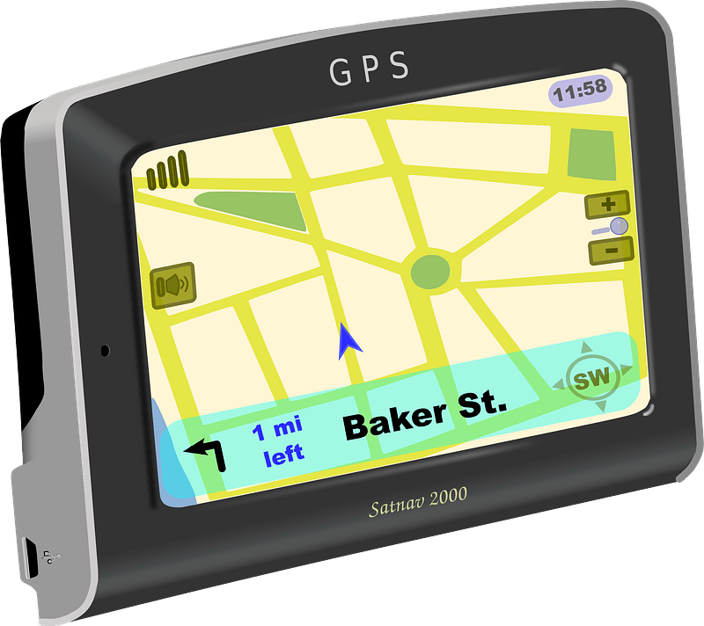
Admit it now …
When have you been glad that you listened to an authority figure?
There are lots of “authorities” around … but …
Jesus is the ultimate authority we should heed.
Faith acknowledges the authority of Jesus.

Slide 4
Listen for a unique request.
Luke 7:1-5 (NIV) When Jesus had finished saying all this in the hearing of the people, he entered Capernaum. 2 There a centurion's servant, whom his master valued highly, was sick and about to die. 3 The centurion heard of Jesus and

Slide 5
Listen for a unique request.
sent some elders of the Jews to him, asking him to come and heal his servant. 4 When they came to Jesus, they pleaded earnestly with him, "This man deserves to have you do this, 5 because he loves our nation and has built our synagogue."

Slide 6
Look to Jesus
What was the situation concerning a centurion’s servant for whom he sought help?
From verse 2 by itself, note the centurion’s level of hope.
The servant was highly valued
The centurion saw him as very near death
Apart from Jesus, he had no hope

Slide 7
Look to Jesus
In making known the centurion’s request for Jesus to intervene, on what basis did the Jewish leaders indicate he was worthy of Jesus’s response?
The centurion presented his request to Jesus through friends; how much is this like (or different from) asking friends to pray for us?

Slide 8
Look to Jesus
How bad does a situation need to be for you to turn to God for help?
Because of his kindness and good deeds, the Jewish elders were willing to intervene on his behalf. How do we earn the trust of people, even those who might otherwise disrespect us?

Slide 9
Listen for the basis of the request.
Luke 7:6-8 (NIV) So Jesus went with them. He was not far from the house when the centurion sent friends to say to him: "Lord, don't trouble yourself, for I do not deserve to have you come under my roof. 7 That is why I did not even consider myself worthy

Slide 10
Listen for the basis of the request.
to come to you. But say the word, and my servant will be healed. 8 For I myself am a man under authority, with soldiers under me. I tell this one, 'Go,' and he goes; and that one, 'Come,' and he comes. I say to my servant, 'Do this,' and he does it."

Slide 11
Acknowledge His Authority
How did Jesus respond to the request of the centurion and the appeal of the elders?
What words and phrases do we see that centurion modified his original request?
Why did he do so? What personal examples did he have?
Why is it difficult for us to be as dependent on God as the centurion was?

Slide 12
Acknowledge His Authority
What characteristics of the centurion’s attitude and request would be helpful to remember when we ask God for help?
So, what are some ways we can demonstrate submission to God’s authority in our lives?
How might our lives change if we yielded more to Jesus’s authority?

Slide 13
Listen for why Jesus was amazed.
Luke 7:9-10 (NIV) When Jesus heard this, he was amazed at him, and turning to the crowd following him, he said, "I tell you, I have not found such great faith even in Israel." 10 Then the men who had been sent returned to the house and found the servant well.

Slide 14
Please the Lord Jesus
So, why was Jesus so amazed?
What was the outcome of this encounter for the delegation of Jews, the centurion, and the servant?
What are the characteristics of a person fully yielded to Christ? How can people tell Jesus has authority over your life?

Slide 15
Please the Lord Jesus
Why is it important to be encouraged about the quality of our faith, even as Jesus affirmed the faith of the centurion?
What should we do when we declare our faith in Jesus for a very important need and it wasn’t met? Is there a problem with our faith or Jesus power?

Slide 16
Application
Thanksgiving.
Spend some time alone reflecting on how God has provided for you in the past.
Give thanks!

Slide 17
Application
Pray.
Ask God to give you a greater faith in His presence and power.
Make a list of the circumstances that challenge your faith.

Slide 18
Application
Pray.
Make a list of the circumstances that challenge your faith.
Ask God to give you a greater faith in His presence and power.

Slide 19
Family Activities
Our consulate in Docrolumayenry has forwarded us this message by diplomatic courier. We need your help to decrypt it. Use the given alphabetic key. Technical assistance and the color page are available at http://tinyurl.com/2p8y2bam When you complete your task, pass the results to your Bible Study leader.

Slide 20
Yielded Faith
January 28

