Slide 1
Yield
May 24

Slide 2

Introduction Video
View Video

Slide 3
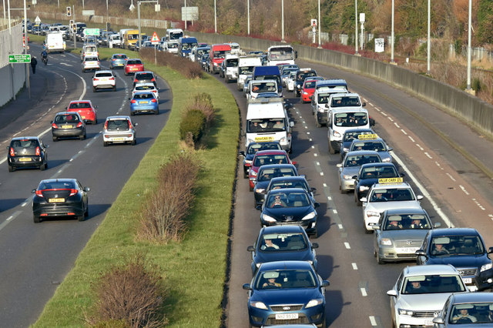
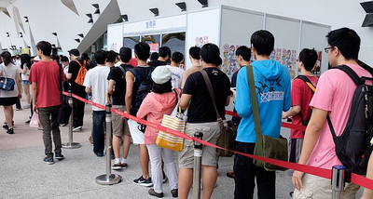
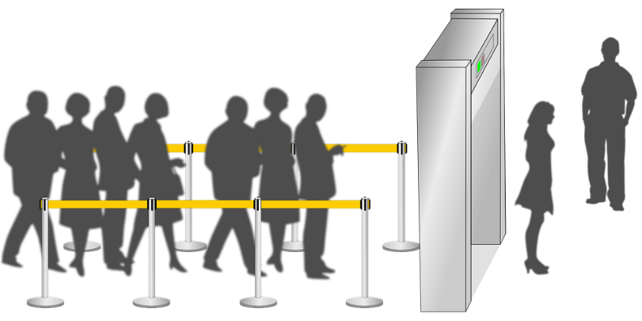
Be honest, now …
When have you wanted to be first in line?
It’s our nature to want to be ahead of everyone else
  Paul wrote that we shouldn’t always want to be first
  Today we look at how to humbly place the needs of others before your own.

Slide 4
Listen for how to act.
Philippians 2:1-4 (NIV) If you have any encouragement from being united with Christ, if any comfort from his love, if any fellowship with the Spirit, if any tenderness and compassion, 2 then make my joy complete by being like-minded, having the same love, being one in spirit and purpose.

Slide 5

Listen for how to act.
Do nothing out of selfish ambition or vain conceit, but in humility consider others better than yourselves. 4 Each of you should look not only to your own interests, but also to the interests of others.

Slide 6
Look Out for Needs of Others
What four spiritual experiences become the basis for humility and unity?
In what way would humility and unity help fulfil Paul’s joy?
How does Paul describe what it means to be like-minded?

Slide 7
Look Out for Needs of Others
What circumstances in life tempt you to ignore the instructions in these verses?
How does humility contribute to unity?
When have you benefited from someone who looked out for your interests?

Slide 8
Look Out for Needs of Others
What does humility look like in relationship to others?
How can we value others over ourselves in practical ways?

Slide 9
Listen for Christ’s attitude.
Philippians 2:5-8 (NIV) Your attitude should be the same as that of Christ Jesus: 6 Who, being in very nature God, did not consider equality with God something to be grasped, 7 but made himself nothing, taking the very nature of a servant, being made in human likeness.

Slide 10
Listen for Christ’s attitude.
And being found in appearance as a man, he humbled himself and became obedient to death-- even death on a cross!

Slide 11
Jesus Is Our Example
How does Christ’s example of humility challenge our natural self-centeredness?
What did Christ set aside when He became a man?
How is Christ the best example of humility and unselfishness for us?

Slide 12
Jesus Is Our Example
Why did Christ take on the limitations of being human even though He was of the same nature as God?
How did Jesus’ submission even to the point of death demonstrate strength?
How does Christ’s example of humility challenge our natural self-centeredness?

Slide 13
Listen for Paul’s admonition.
Philippians 2:12-15 (NIV) Therefore, my dear friends, as you have always obeyed--not only in my presence, but now much more in my absence--continue to work out your salvation with fear and trembling, 13 for it is God who works in you to will and to act according to his good purpose.

Slide 14
Listen for Paul’s admonition.
Do everything without complaining or arguing, 15 so that you may become blameless and pure, children of God without fault in a crooked and depraved generation, in which you shine like stars in the universe

Slide 15
Live without Complaining and Arguing
Who is the energy source for effective Christian living?
What did Paul appeal to the Philippians to avoid?
Instead, how were they to act?
What strategies have helped you fight the urge to grumble, complain, or argue?

Slide 16
Live without Complaining and Arguing
Consider this process of dealing with a problem that causes fear or aggravation …
  “Hold” the problem in your closed hand
  Lift it up and “give it” to God,
  Hold out your hand to “receive” God’s answer or solution,
  Fold your hands in prayer to thank God in advance for His resolution of the problem

Slide 17
Live without Complaining and Arguing
How will NOT complaining and arguing encourage others to be drawn to Him?
How can you help new believers "shine like stars" for God’s kingdom?

Slide 18
Application
Small steps.
  Park in the worst space in the church parking lot next Sunday. (Extra credit if it’s raining.)
  Come early and set up the room for your next small group meeting.
  Tell someone how much you appreciate his or her gifts or skills in a particular area.

Slide 19
Application
Medium steps.
  Share a story of a major failure from your past.
  Confess your need for the gospel.
  Volunteer in a homeless ministry and treat those people as you would treat governors and kings.

Slide 20
Application
Large steps.
  Offer a sincere apology to someone you’ve hurt.
  Share your desire to be forgiven.
  Meet someone’s need with a large sum of money … and do it anonymously

Slide 21


Family Activities
There’s some good words here, if I could just find them. I yield to you to help me out. The Word Search Lady sends her “Humph!” She admits that there is help and other activities at https://tinyurl.com/ycpm9q2x

Slide 22
Yield
May 24

