Slide 1
Worshiping God
May 5

Slide 2


Video Introduction
View Video

Slide 3
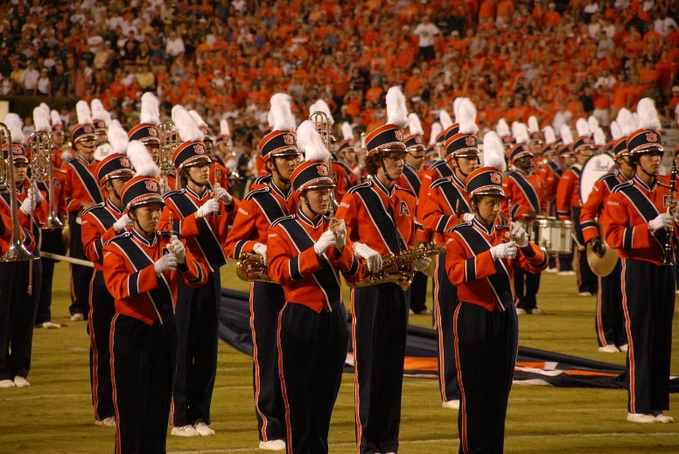


Think about it …
What’s an activity that’s always better with a crowd or a group?
Consider the fact that singing in a group is always more enjoyable than singing by yourself.
  When we worship God together, we all experience joy in His presence

Slide 4
Listen for boasting.
Psalm 34:1-3 (NIV) I will extol the LORD at all times; his praise will always be on my lips. 2 My soul will boast in the LORD; let the afflicted hear and rejoice. 3 Glorify the LORD with me; let us exalt his name together.

Slide 5
Give God Praise
What is an ongoing practice of the psalmist?
I will extol the LORD at all times
What would be some synonyms for “extol”
What are some things we like to boast about?
Verse 2 says, "My soul makes its boast in the Lord." What does it mean to “boast” in the Lord?

Slide 6
Give God Praise
How can we cultivate a heart that naturally boasts in the Lord in all circumstances?
What benefit to others comes from boasting about the goodness of God? What does he hope to accomplish in union with others?

Slide 7
Give God Praise
The psalmist extended to others the experience of worship. What are some benefits of worshiping together?
How can worship help you maintain a proper perspective on life?

Slide 8
Listen for reasons to praise God.
Psalm 34:8-10 (NIV) Taste and see that the LORD is good; blessed is the man who takes refuge in him. 9 Fear the LORD, you his saints, for those who fear him lack nothing. 10 The lions may grow weak and hungry, but those who seek the LORD lack no good thing.

Slide 9
See God’s Goodness
According to these verses, what are the benefits of trusting in the Lord?
List David’s exhortations and the results God provided
Exhortation | Result

Slide 10
See God’s Goodness
How can we intentionally “taste” the goodness of God?
What does this passage reveal to us about prayer, about “seeking” God?
Why did David have such confidence to seek God for his needs?

Slide 11
Listen for why to worship.
Psalm 34:15-18 (NIV) The eyes of the LORD are on the righteous and his ears are attentive to their cry; 16 the face of the LORD is against those who do evil, to cut off the memory of them from the earth.

Slide 12
Listen for why to worship.
The righteous cry out, and the LORD hears them; he delivers them from all their troubles. 18 The LORD is close to the brokenhearted and saves those who are crushed in spirit.

Slide 13
Find God’s Help
What promises or blessings come to the righteous?
What will the Lord do for those who cry out in faith to Him in times of despair?

Slide 14
Find God’s Help
Note some synonyms to the term “crushed spirit”.
  Discouraged Depressed
  Feel defeated Disheartened
  Downcast Hopeless
  Dejected
How would God “save” people who feel “crushed in spirit”?

Slide 15
Find God’s Help
How does worship help those who are brokenhearted or crushed in spirit?
How can praying alongside others enhance a believer’s prayer life?

Slide 16
Application
Target consistency.
  Make joint worship a priority.
  Commit to attending worship every week for the next three months.

Slide 17
Application
Be an influencer.
  Behave as a model of a joyful worshiper.
  Enter worship with enthusiasm and focus.
  Sing with gusto. Listen attentively to the message. Join in prayer with passion.

Slide 18
Application
Participate in prayer.
  Start a prayer group at your church in person or online.
  Invite others to join you in prayer times of thanksgiving and petition.

Slide 19
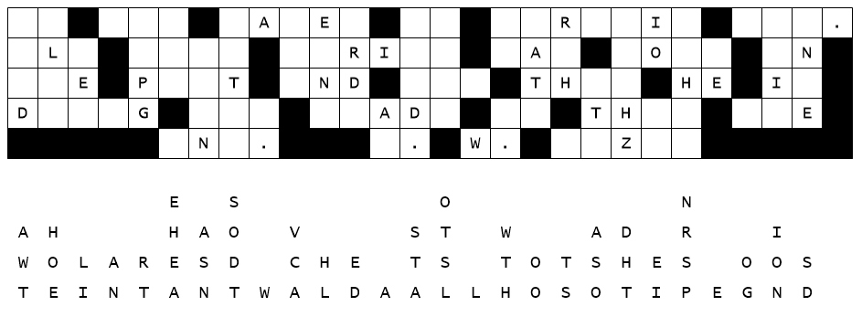

Family Activities
Make my day … fix this decoded message which came from the embassy in Wanratancohong. The decryption staff used the wrong glue and letters slipped straight down. You can do this … report the results to your worship team. Help and the color page can be found at https://tinyurl.com/3cbtyu2p

Slide 20
Worshiping God
May 5

