Slide 1
Why Did Jesus Come?
June 24

Slide 2




Think about it …
When have you recently turned to the Internet for a solution to a problem?
The internet provides easy access for finding solutions and fixing problems
  But how do we fix our worst problem … sin
  Only Jesus can fix the sin problem.
  Today we study the Truth that Jesus came to remove our sin.

Slide 3
Listen for a reason to praise God.
Luke 1:67-71 (NIV) His father Zechariah was filled with the Holy Spirit and prophesied: 68 "Praise be to the Lord, the God of Israel, because he has come and has redeemed his people. 69 He has raised up a horn of salvation for us in the house of his servant David 70 (as he said through his holy prophets of long ago), 71 salvation from our enemies and from the hand of all who hate us--

Slide 4
Christ Came to Redeem
The KJV says “Blessed be the Lord God of Israel” Why is blessed an appropriate adjective to apply to the Lord God?
What two phrases describe this Redeemer and why are they important?
According to Zacharias, what action had God taken on behalf of His people?
What were the people being redeemed/ saved/ rescued from?
Phrase | Importance

Slide 5
Christ Came to Redeem
What are believers today being redeemed /saved /rescued from?
What are we being redeemed /saved /rescued for?
We often focus on what we’ve been saved from. Why is it also important to reflect on what we’ve been saved for?

Slide 6
Listen for why we have been rescued?
Luke 1:72-75 (NIV) to show mercy to our fathers and to remember his holy covenant, 73 the oath he swore to our father Abraham: 74 to rescue us from the hand of our enemies, and to enable us to serve him without fear 75 in holiness and righteousness before him all our days.

Slide 7
Redeemed from Fear
How did Zechariah describe the "covenant" with God?
What results did Zechariah say were guaranteed by God’s oath?
What opportunity or privilege did God grant to those whom He delivered or rescued?

Slide 8
Redeemed from Fear
How would you describe the difference between our proper fear of God and the fear God removes.
What does it look like to serve God without fear?
Proper Fear | Fear God Removes

Slide 9
Listen for John the Baptist’s task.
Luke 1:76-79 (NIV) And you, my child, will be called a prophet of the Most High; for you will go on before the Lord to prepare the way for him, 77 to give his people the knowledge of salvation through the forgiveness of their sins, 78 because of the tender mercy of our God, by which the rising sun will come to us from heaven 79 to shine on those living in darkness and in the shadow of death, to guide our feet into the path of peace."

Slide 10
Redeemed from Sin
To whom does Zacharias refer in verses 76-77?
What was this child’s role in the providence of God and what was his message?
What moved God to act to make possible the forgiveness of sins?
What imagery did Zacharias use in verses 78-79 to describe what the Messiah would do?

Slide 11
Redeemed from Sin
What are some ways you’ve experienced God’s forgiveness and merciful compassion?
How does our culture’s view of sin contrast with God’s view of sin?
How can we, as individual believers or as a group of believers, guide others to the way of redemption and peace?
Cultural View | God’s View

Slide 12
Application
Stop using spiritual duct tape.
  You might be able to “mask” your sin problem, but you can’t fix it.
  Without Christ, you’re lost. Accept the fact that you can’t fix your sin problem and ask Jesus to forgive you.
  If you need help with this step, read the inside front cover of this book.

Slide 13
Application
Live free from fear.
  If worries periodically arise, memorize Romans 8:38-39 For I am convinced that neither death nor life, neither angels nor demons, neither the present nor the future, nor any powers, neither height nor depth, nor anything else in all creation, will be able to separate us from the love of God that is in Christ Jesus our Lord.
  Embed the truth in your mind that nothing you might fear can separate you from Christ and His love.

Slide 14
Application
Share the truth.
  You know others who are spiritually broken.
  Give them hope by sharing what you’ve learned in this study about the redemption Christ offers.

Slide 15
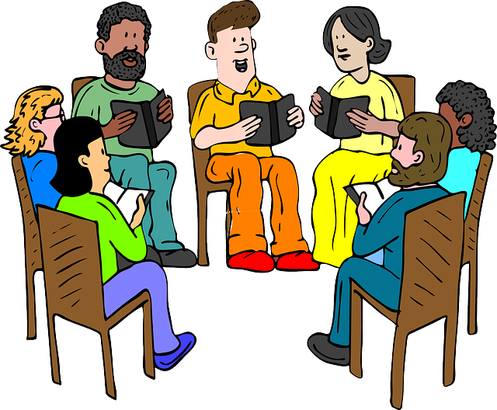
Family Devotional Activities
When you get home, look up the Family Activities web page at https://tinyurl.com/yaezf7pq
There’s fun things there for the whole family – little ones, teens, everyone!

Slide 16
Why Did Jesus Come?
June 24

