Slide 1
Why the Resurrection Matters
April 19

Slide 2
Video Introduction
View Video

Slide 3
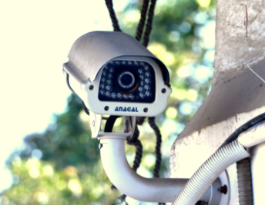
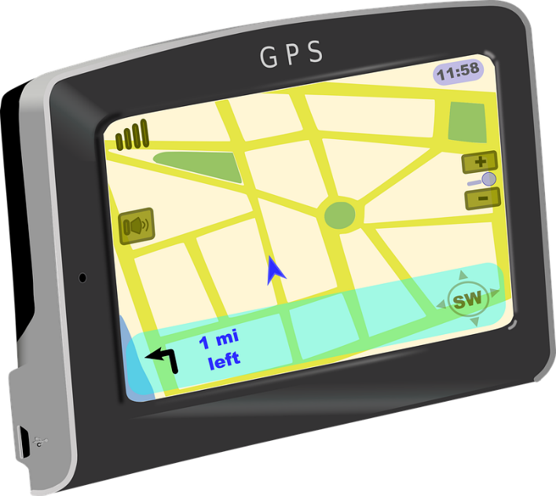
Think about it …
What invention or innovation has been a “game changer” for you?
We live in an age where we’ve come to depend on these innovations.
We can mark our age by what it was like in the “old days”
The one event that has changed people’s lives more than anything else is … the resurrection of Christ

Slide 4
Listen for a comparison.
1 Corinthians 15:20-22 (NIV) But Christ has indeed been raised from the dead, the firstfruits of those who have fallen asleep. 21 For since death came through a man, the resurrection of the dead comes also through a man. 22 For as in Adam all die, so in Christ all will be made alive.

Slide 5
Who Makes Our Resurrection Possible
What is the meaning of the “firstfruits” analogy? Why does Paul use it here, referring to Christ?
What effect did Adam have on all humanity?
What effect can Christ and His resurrection have on all humanity?
What hope does Jesus’ resurrection provide for your daily life?

Slide 6
Listen for truths about Jesus’ rule.
1 Corinthians 15:23-28 (NIV) But each in his own turn: Christ, the firstfruits; then, when he comes, those who belong to him. 24 Then the end will come, when he hands over the kingdom to God the Father after he has destroyed all dominion, authority and power. 25 For he must reign until he has put all his enemies under his feet. 26 The last enemy to be destroyed is death.

Slide 7
Listen for truths about Jesus’ rule.
For he "has put everything under his feet." Now when it says that "everything" has been put under him, it is clear that this does not include God himself, who put everything under Christ. 28 When he has done this, then the Son himself will be made subject to him who put everything under him, so that God may be all in all.

Slide 8
Jesus Reigns as Lord over All
What is the sequence of events described in 15:23-28?
What do you think is the point of the specific sequence?
What does Paul indicate has been subordinated to Christ?

Slide 9
Jesus Reigns as Lord over All
What is the final enemy to be defeated and what does that have to do with resurrection?
In what sense is death “the last enemy”?
What other things besides death try to conquer us?

Slide 10
Jesus Reigns as Lord over All
What kinds of things characterize a life that is totally submitted to Christ’s reign as Lord over all?
How does Christ’s reign over all give you hope in the here and now?

Slide 11
Listen for the culmination of Jesus’ victory.
1 Corinthians 15:54-58 (NIV) When the perishable has been clothed with the imperishable, and the mortal with immortality, then the saying that is written will come true: "Death has been swallowed up in victory." 55 "Where, O death, is your victory? Where, O death, is your sting?" 56 The sting of death is sin, and the power of sin is the law

Slide 12
Listen for the culmination of Jesus’ victory.
But thanks be to God! He gives us the victory through our Lord Jesus Christ. 58 Therefore, my dear brothers, stand firm. Let nothing move you. Always give yourselves fully to the work of the Lord, because you know that your labor in the Lord is not in vain.

Slide 13
What We Do for Christ Matters
How did Paul treat death in these verses; as friend or foe?
What shall happen to death?
Who is the source of our victory over death?
What charge did Paul give his believing friends because of this great assurance? What encouragement can we take from the fact that the work we do for the Lord is not in vain?

Slide 14
Application
Confess.
If there is an area of your life in which you have allowed sin to have power over you, confess that to God.
Acknowledge that sin has no power over you because of Christ.
Choose to live under His lordship.

Slide 15
Application
Serve.
Find an area of ministry where you can get involved.
Do not let hesitancy or fears make you feel inadequate to serve.
Live under the lordship of Christ, knowing that you never serve Him in vain.

Slide 16
Application
Share.
Tell someone how the resurrection of Christ has made a difference in your life.
Lead the person to trust the resurrected Christ for new life

Slide 17
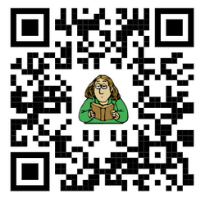
Family Activities
I wish I had something for my family to do while we’re “sheltering-in-place”. Maybe I could find something at https://tinyurl.com/vs94kw2

Slide 18
Why the Resurrection Matters
April 19

