Slide 1
Why We Need God’s Word
October 16

Slide 2
Video Introduction
View Video

Slide 3
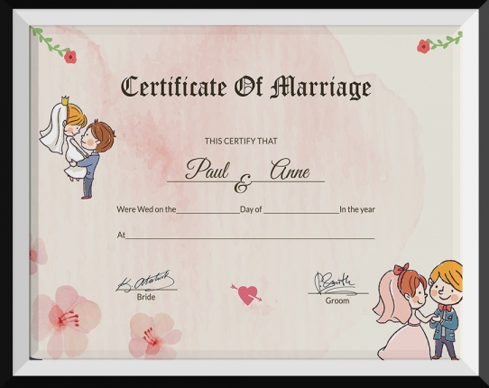
Think About It …
What is something that should come with a set of instructions but doesn’t?
The Bible reveals everything we need to live victoriously.
Today we look at instructions Paul gave to Timothy

Slide 4
Listen for societal problems.
2 Timothy 3:1-5 (NIV) But mark this: There will be terrible times in the last days. 2 People will be lovers of themselves, lovers of money, boastful, proud, abusive, disobedient to their parents, ungrateful, unholy, 3 without love, unforgiving,

Slide 5
Listen for societal problems.
slanderous, without self-control, brutal, not lovers of the good, 4 treacherous, rash, conceited, lovers of pleasure rather than lovers of God-- 5 having a form of godliness but denying its power. Have nothing to do with them.

Slide 6
Sinful Culture
Paul used the expression, “last days”. How do you understand the phrase “last days”?
According to verse 2, what will people be like in the last days ?
According to verse 3, in the last days, what will people lack?

Slide 7
Sinful Culture
Why is it so tempting to be a lover of pleasure rather than a lover of God?
What kind of “godliness” will people have in the last days?
How can someone have a form of godliness yet deny its power?

Slide 8
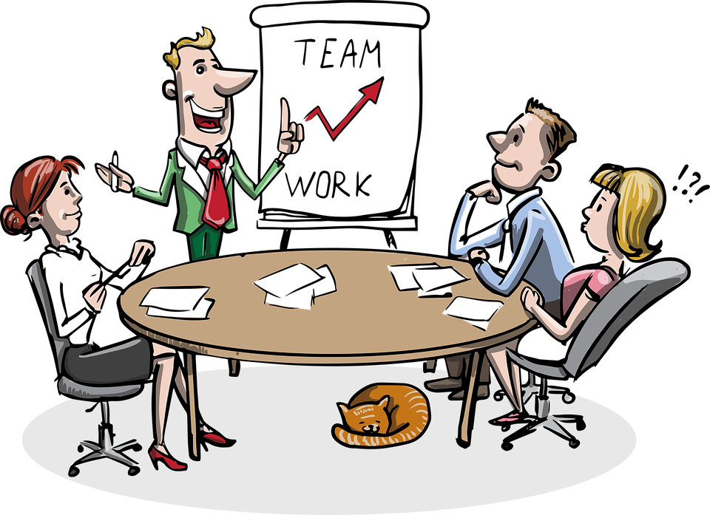
Sinful Culture
Paul says in verse 5 to avoid such people. How do we do that and live and work in today’s world?

Slide 9
Listen for what will get worse.
2 Timothy 3:13-15 (NIV) while evil men and impostors will go from bad to worse, deceiving and being deceived. 14 But as for you, continue in what you have learned and have become convinced of, because you

Slide 10
Listen for what will get worse.
know those from whom you learned it, 15 and how from infancy you have known the holy Scriptures, which are able to make you wise for salvation through faith in Christ Jesus.

Slide 11
Wisdom in God’s Word
What is the irony stated in verse 13?
In what regular practice did Paul urge Timothy to engage?
What could Timothy point to for confidence that what he had been taught was credible and reliable for faithful living?

Slide 12
Wisdom in God’s Word
What is the relationship between studying the Scriptures and salvation through faith in Jesus Christ?
How does knowing God’s Word keep us from being deceived by the world?

Slide 13
Listen for the effects of studying the Bible.
2 Timothy 3:16-17 (NIV) All Scripture is God-breathed and is useful for teaching, rebuking, correcting and training in righteousness, 17 so that the man of God may be thoroughly equipped for every good work.

Slide 14
God, Himself, Is the Source of Scripture
Paul said that Scripture is “God-breathed” … how is that different from dictating to the writers?
⇨God still intends to communicate to all people who He is and what He requires
⇨He has the power to do that through men and women who submit to Him

Slide 15
God, Himself, Is the Source of Scripture
Why is Scripture powerful and authoritative?
What did Paul say that Scripture was useful for?
What kind of encouragements and positive influences did you have as a youngster to read and apply God's Word to your life?

Slide 16
God, Himself, Is the Source of Scripture
How do parents and grandparents instill this attitude and usage of the scriptures in a child?
Consider Deuteronomy 6:6-7 (NIV) These commandments that I give you today are to be upon your hearts. Impress them on your children. Talk about them when you sit at home and when you walk along the road, when you lie down and when you get up.

Slide 17
Application
Join the band.
Perhaps you recognize you’ve never tuned your life to the song of Jesus.
If you’ve never trusted Christ for forgiveness and salvation, do so now.
Talk to a trusted leader or pastor to help you take the next steps.
You can also get help from the inside cover of this book.

Slide 18
Application
Play the same song.
Maybe you’re trying to march to the beat of two different drummers.
If you’ve been walking in unrepentant sin, confess your sin to God.
Make a plan to regularly read God’s Word so that you will consistently hear Him and follow His call on your life.

Slide 19
Application
Lead rehearsal.
If you regularly take in God’s Word and inherently know your need for it, share what you’ve learned this week with someone else.
Perhaps it’s asking a friend to coffee or maybe it’s leading a small group Bible study.
Pass God’s Word on to others.

Slide 20
Family Activities
Spiros needs your help. A secret message got damaged in the diplomatic pouch and the letters slipped down. Technical assistance is available at https://tinyurl.com/4cuxa2pa And there’s a color page there as well for you artists in the back corner of class.

Slide 21
Why We Need God’s Word
October 16

