Slide 1
Why Am I Suffering?
January 26

Slide 2
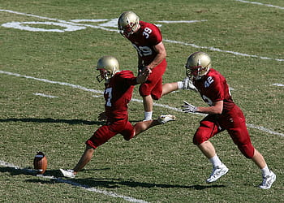
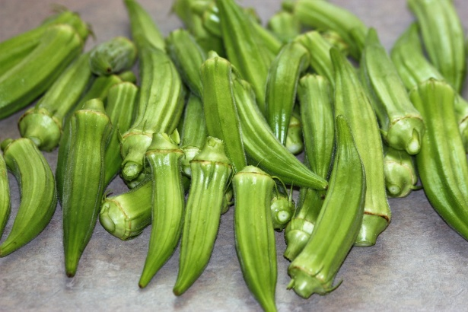
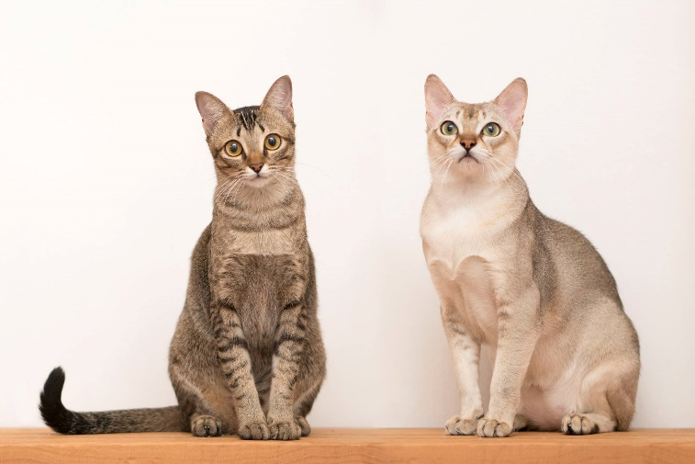
Admit it, now …
What’s something that lots of people enjoy but you can’t stand?

Slide 3
The Point
We might say that if forced, we “suffer” through such things. Although we are usually able to decline, so we really don’t “suffer”.
  Today we look at actual suffering as seen in the life of Job, whose friends incorrectly told him it was due to his sinning.
  We will look at the truth that we should not assume suffering is the direct result of sin in our lives.

Slide 4

Listen for one man’s prescription for relief.
Job 11:13-16 (NIV) "Yet if you devote your heart to him and stretch out your hands to him, 14 if you put away the sin that is in your hand and allow no evil to dwell in your tent, 15 then you will lift up your face without shame; you will stand firm and without fear. 16 You will surely forget your trouble, recalling it only as waters gone by.

Slide 5
Suffering Not Always Due to Disobedience
The speaker is named Zophar, one of Job’s “comforters”. He uses an if/then logic … what does he list for the “if conditions”
What does he list for the “then” results of meeting the “if conditions?”

Slide 6
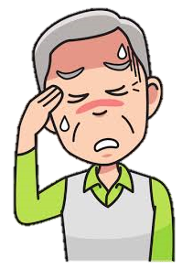
Suffering Not Always Due to Disobedience
Consider how this could not solve Job’s suffering … What are some mistaken ideas people have about the connection between a person’s suffering and sin?

Slide 7
Suffering Not Always Due to Disobedience
Zophar believed that is impossible for suffering to happen for no logical reason. Let’s identify examples of suffering caused by each of the three sources noted.
Caused by Events of Nature | Caused by Actions of Others | Caused by My Own Poor Choices

Slide 8
Suffering Not Always Due to Disobedience
What advice to Job would have been more godly? What advice to anyone who suffers for no logical reason would be more appropriate?
⇨ God enables us to live victoriously through the suffering and trouble.

Slide 9
Listen for Job’s frustration.
Job 23:8-12 (NIV) "But if I go to the east, he is not there; if I go to the west, I do not find him. 9 When he is at work in the north, I do not see him; when he turns to the south, I catch no glimpse of him. 10 But he knows the way that I take; when he has tested me,

Slide 10
Listen for Job’s frustration.
I will come forth as gold. 11 My feet have closely followed his steps; I have kept to his way without turning aside. 12 I have not departed from the commands of his lips; I have treasured the words of his mouth more than my daily bread.

Slide 11
Even the Righteous Suffer
What did Job desire?
How successful was he? What words and phrases describe his efforts?
What does Job say here that hints he was beginning to trust God even though he didn’t have all the information he might have wanted?

Slide 12
Even the Righteous Suffer
What were some professions Job made about his faithfulness to God?
How can suffering “refine” your faith like Job refers to coming “forth as gold”?

Slide 13
Listen for strange logic by the disciples.
John 9:1-3 (NIV) As he went along, he saw a man blind from birth. 2 His disciples asked him, "Rabbi, who sinned, this man or his parents, that he was born blind?" 3 "Neither this man nor his parents sinned," said Jesus, "but this happened so that the work of God might be displayed in his life.

Slide 14
God at Work When We Suffer
What theological debate did the blind man’s presence generate among the disciples? Who did the disciples think was at fault for the man’s blindness?
How did Jesus answer their inquiry?
What principle does it teach us about suffering?

Slide 15
God at Work When We Suffer
Why do we often struggle to explain or understand suffering?
When have you seen God glorified in the midst of suffering?
How can our group help one another when suffering occurs?

Slide 16
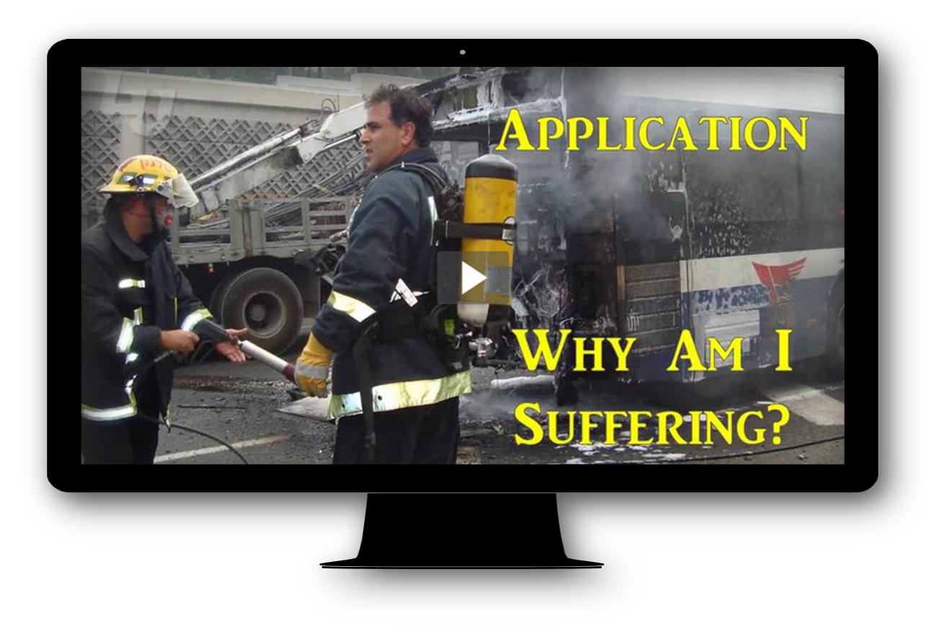
Application Video
View Video

Slide 17
Application
Confess.
  Not all suffering is a result of sin, but sin can lead to suffering.
  Ask God to reveal any sin in your life.
  Confess that and thank Him for His grace and forgiveness.

Slide 18
Application
Honor.
  Ask God to show you how He wants to strengthen you during a time of suffering.
  While dealing with difficulties, look for ways to honor Christ.

Slide 19
Application
Encourage.
  Everyone’s experience with suffering is different.
  But you can share with someone how God helped you, strengthened you, and brought glory to Himself during a time of hardship or suffering.

Slide 20
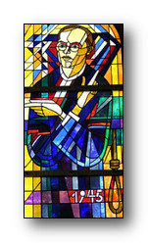
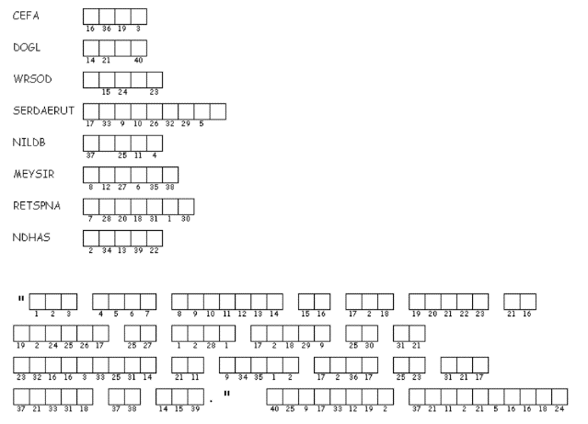
Family Activities
Can vu zolffe zee buzzle? Ja, it is guote of mine. If vu get sduck, ko to https://tinyurl.com/ucjxmwr
Zere are ozer kood family Hactiffidies alzo.

Slide 21
Why Am I Suffering?
January 26

