Slide 1
Does It Really Matter what “Truth” I Believe?
October 15

Slide 2

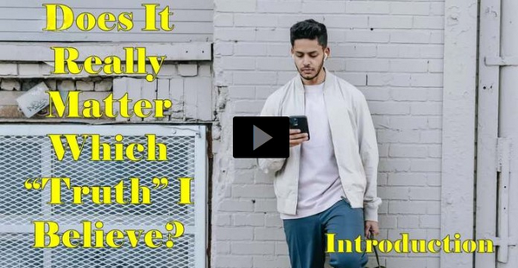
Video Introduction
View Video

Slide 3



Surprising facts … really TRUE!
Tuesday, 5:23 am
Snakes can predict earthquakes.
Lego mini figures have the largest population on earth (more than China).
Astronauts grow taller in space.

Slide 4




Surprising facts … really TRUE!
There’s a 50% chance that two people will share a birthday in a group of 23 people.
Sea lions are the only animals that can clap to a beat.
Glass balls bounce higher than rubber balls.
It snows metal on Venus.

Slide 5
Really True
These are interesting, but somewhat inconsequential to our daily lives.
  Truths about God are much more important.
  Knowing the Truth of Christ is the only way we can experience freedom.

Slide 6
Listen for facts about light.
John 3:19-21 (NIV) This is the verdict: Light has come into the world, but men loved darkness instead of light because their deeds were evil. 20 Everyone who does evil hates the light, and will not

Slide 7

Listen for facts about light.
come into the light for fear that his deeds will be exposed. 21 But whoever lives by the truth comes into the light, so that it may be seen plainly that what he has done has been done through God."

Slide 8
The Light of Jesus
What words and phrases characterize the works of those who love and live in darkness?
Now, what words and phrases characterize those who live by Truth?
What do we mean when we use the word “darkness” in this way?
So, what then is the contrasting meaning of “light”?

Slide 9
The Light of Jesus
Why do some people love darkness rather than light?
How does the loss of truth in our culture produce more darkness?
What is the attitude of those who love and live the Truth and the light manifested in Christ?

Slide 10
Listen for another famous verse.
John 8:31-32 (NIV) To the Jews who had believed him, Jesus said, "If you hold to my teaching, you are really my disciples. 32 Then you will know the truth, and the truth will set you free."

Slide 11
Set Free to Live
What did Jesus say to the Jews who had believed in Him?
What will we experience by faithfully obeying God’s Word?
Just what is this “Truth” Jesus is talking about?

Slide 12
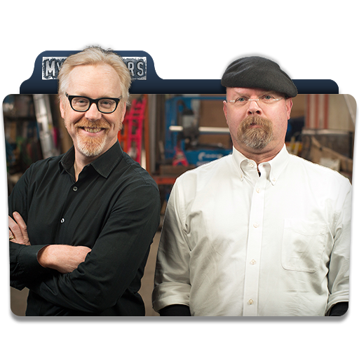
Set Free to Live
What are some ways the truth that Jesus reveals brings freedom to our lives?
What’s the problem with everyone having their own “truth”?
I reject your reality and substitute my own reality,

Slide 13
Listen for how Jesus sets us free.
John 8:33-36 (NIV) They answered him, "We are Abraham's descendants and have never been slaves of anyone. How can you say that we shall be set free?" 34 Jesus replied, "I tell you the

Slide 14
Listen for how Jesus sets us free.
truth, everyone who sins is a slave to sin. 35 Now a slave has no permanent place in the family, but a son belongs to it forever. 36 So if the Son sets you free, you will be free indeed.

Slide 15
Set Free from Sin
What claim did the Jews make to deny their need to be set free? How were the Jewish believers confused about Jesus’ statement of becoming free?
According to Jesus, what kind of slavery was He talking about? What was Jesus’ line of reasoning?

Slide 16
Set Free from Sin
In what way are people enslaved to sin today? Where do we see the enslaving effects of sin?
According to the passage, what will set us free from this kind of slavery?
How does Truth set someone free?

Slide 17
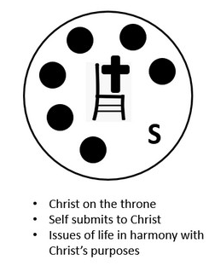
Set Free from Sin
Consider John 16:8 (NIV) When he comes, he will convict the world of guilt in regard to sin and righteousness and judgment:
  The Spirit convicts (convinces) us of the provision of righteousness.
  By God’s power, He offers the possibility to live a life of righteousness, set free from slavery to sin.

Slide 18
Application
Identify.
  Acknowledge any doubts you may have about the truth of the gospel of Christ.
  A lot of people feel uncertain about the objective truth of the gospel, and modern society with its relativistic moral beliefs can amplify those doubts.
  Admit where your struggles lie.

Slide 19
Application
Seek.
  The Christian faith is the truth, thus we need to determine to resolve our personal doubts.
  Find people or resources that can help you think through those doubts and don’t stop until you have found the answers.
  They do exist.

Slide 20
Application
Help.
  Help someone with his or her doubts.
  Talk to your friends about the doubts they may have concerning the truth of the gospel of Christ and help them to get those doubts resolved.

Slide 21


Family Activities
Aiee-ockarocha! What is that? Looks like code. Well, you have the key and Spiros the Spy is depending on you. It’s from our consulate in Tarka Retadesh. The underground church wants us to remember this. Technical help (and the color page) is available at https://tinyurl.com/murbsuhv

Slide 22
Does It Really Matter what “Truth” I Believe?
October 15

