Slide 1
Where Does Comfort Come From?
February 16

Slide 2
Introduction Video
View Video

Slide 3
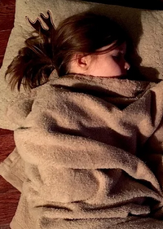
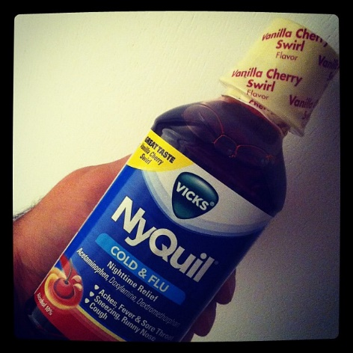
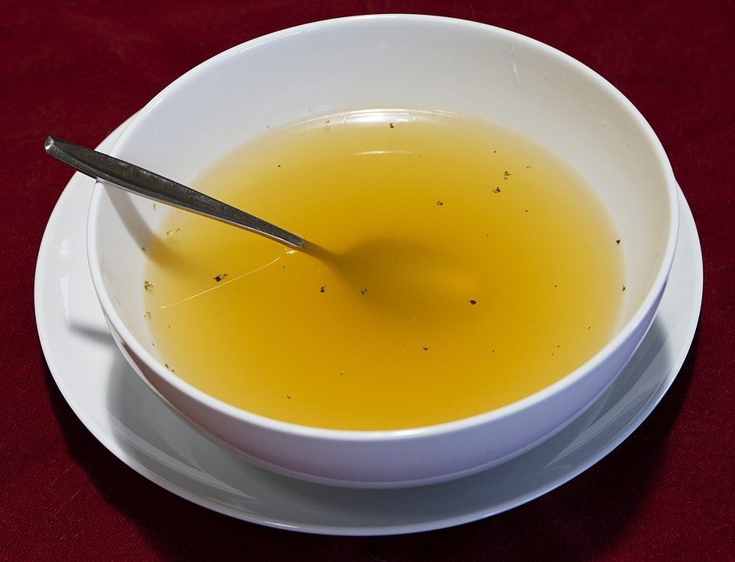
Admit it, now …
What do you find comforting when you’re sick?
When we’re facing life changing troubles, we need God’s comfort.
Everyone faces these kinds of issues in their lives.
As God comforts us, He calls us to comfort others

Slide 4
Listen for reasons to praise God.
2 Corinthians 1:3-4a (NIV) Praise be to the God and Father of our Lord Jesus Christ, the Father of compassion and the God of all comfort, 4 who comforts us in all our troubles,

Slide 5
God Is the Source of Comfort
What appears to have caused Paul to erupt in praise to God?
Definitions of comfort
verb: 1. To soothe in time of affliction or distress.
2. To ease physically; relieve.
noun: 1. A condition or feeling of pleasurable ease, well-being, and contentment. 2. Solace in time of grief or fear.

Slide 6
God Is the Source of Comfort
Why might a Christian as committed as Paul would need comfort?
Apart from God, where do people look for comfort?
Why do these sources of comfort fail to ultimately satisfy?
What are some ways God comforts His people?

Slide 7
Listen for how we comfort others.
2 Corinthians 1:4b-7 (NIV) so that we can comfort those in any trouble with the comfort we ourselves have received from God. 5 For just as the sufferings of Christ flow over into our lives, so also through Christ our comfort overflows. 6 If we are distressed, it is for your comfort and salvation;

Slide 8
Listen for how we comfort others.
if we are comforted, it is for your comfort, which produces in you patient endurance of the same sufferings we suffer. 7 And our hope for you is firm, because we know that just as you share in our sufferings, so also you share in our comfort.

Slide 9
Channels of God’s Comfort
How does God involve Himself in our troubles?
What was Paul’s disposition toward the Corinthians even though he knew they would face suffering?

Slide 10
Use Your Difficulties to Comfort Others
Evaluate whether or not the following action would bring comfort to someone … why or why not?
Just sit with the grieving person without talking

Slide 11
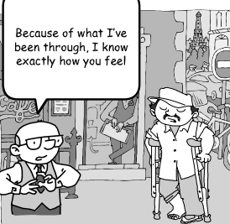
Use Your Difficulties to Comfort Others
Evaluate whether or not the following action would bring comfort to someone … why or why not?
Tell them …

Slide 12
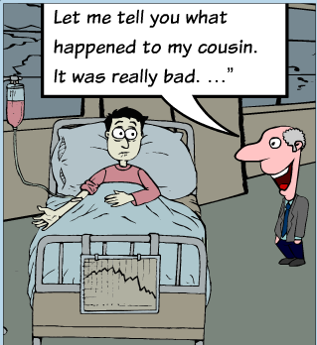
Use Your Difficulties to Comfort Others
Evaluate whether or not the following action would bring comfort to someone … why or why not?
Say …

Slide 13
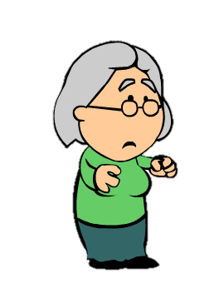
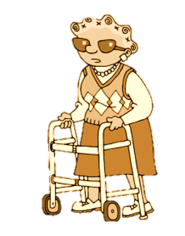
Use Your Difficulties to Comfort Others
Evaluate whether or not the following action would bring comfort to someone … why or why not?
Say …
God comforted me in ways that amaze me, even today.

Slide 14
Pointers on ministering comfort to others:
Things not to say or do
“I know how you feel.”
“This will turn out for good.”
“You shouldn’t feel that way.”
Don’t offer advice.
Don’t be condemning or judgmental.

Slide 15
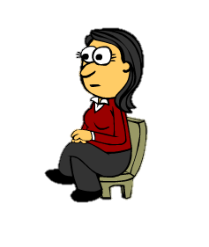
Pointers on ministering comfort to others:
What to say
“I love you.”
“I’m so sorry.”
“I’m here for you.”
“You are not alone.”
What to do
Be silent
Be present.
Listen
Pray

Slide 16
Listen for how prayer helps.
2 Corinthians 1:8-11 (NIV) We do not want you to be uninformed, brothers, about the hardships we suffered in the province of Asia. We were under great pressure, far beyond our ability to endure, so that we despaired even of life. 9 Indeed, in our hearts we felt the sentence of death. But this happened that we might not rely on ourselves but on God,

Slide 17
Listen for how prayer helps.
who raises the dead. 10 He has delivered us from such a deadly peril, and he will deliver us. On him we have set our hope that he will continue to deliver us, 11 as you help us by your prayers. Then many will give thanks on our behalf for the gracious favor granted us in answer to the prayers of many.

Slide 18
Prayer Is A Powerful Help
What words and phrases does Paul use to describe a time of suffering he had faced?
In whom did he trust during that time?
What could the Corinthian believers do to help Paul and his ministry partners?
Why do you think prayer is such an important part of the Christian life?

Slide 19
Prayer Is A Powerful Help
How can you rely more on God instead of yourself in times of hardship?
What can we do to learn to trust God more during struggles and hardships?

Slide 20
Application
Be present.
Allow God to use you to give comfort to someone who is hurting.
Simply being present is sometimes the greatest comfort of all.

Slide 21
Application
Be thankful.
Think of someone who provided comfort in the past when you needed it.
Thank God for using them, and write them a note of thanks for the way they encouraged and supported you.

Slide 22
Application
Be prayerful.
Commit to pray for a missionary, people group, or country.
Pray for God’s comfort and strength in the face of believers’ trials.

Slide 23
Family Activities
Whoa, dude … it’s a class B miracle. The Crossword is back! And there’s other groovy things for the whole family at https://tinyurl.com/udv43bz

Slide 24
Where Does Comfort Come From?
February 16

