Slide 1
When a Time of Inactivity Slows You Down
November 16

Slide 2

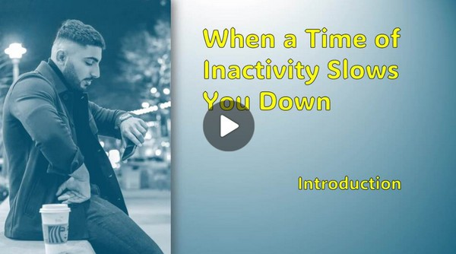
Introduction Video
View Video

Slide 3
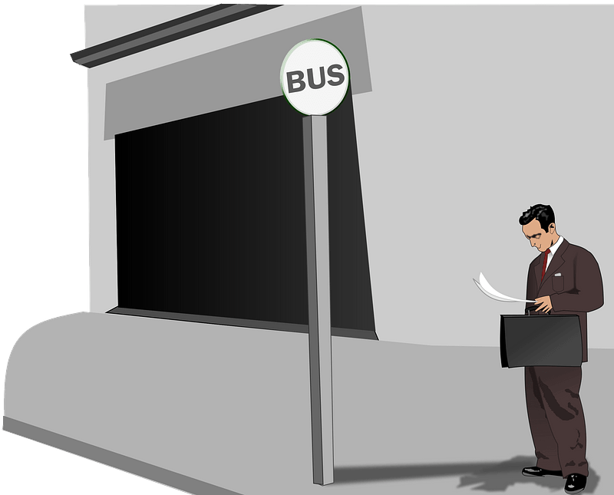

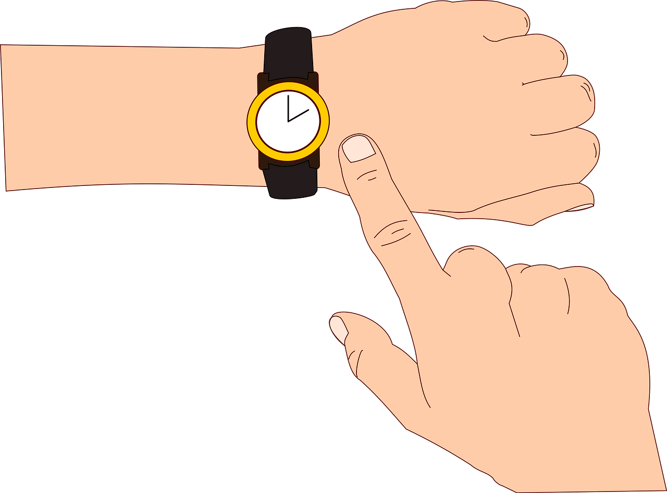
What a pain …
What was a bad unexpected delay you’ve been forced to endure?
Some delays are easier to deal with than others.
  Today we look at a time when Jesus told the disciples to “wait”.
  God can use unexpected downtime to prepare us for what’s next.

Slide 4
Listen for instructions.
Acts 1:4-8 (NIV) On one occasion, while he was eating with them, he gave them this command: "Do not leave Jerusalem, but wait for the gift my Father promised, which you have heard me speak about. 5 For John baptized with water, but in a few days you will be baptized with the Holy Spirit." 6 So when they met together, they asked

Slide 5

Listen for instructions.
him, "Lord, are you at this time going to restore the kingdom to Israel?" 7 He said to them: "It is not for you to know the times or dates the Father has set by his own authority. 8 But you will receive power when the Holy Spirit comes on you; and you will be my witnesses in Jerusalem, and in all Judea and Samaria, and to the ends of the earth."

Slide 6
A Season of Waiting
According to verse 4, who were those who assembled and what instructions were they given?
When have you experienced a season of waiting on the Lord?
What are words and phrases that describe the promise made to His followers.

Slide 7
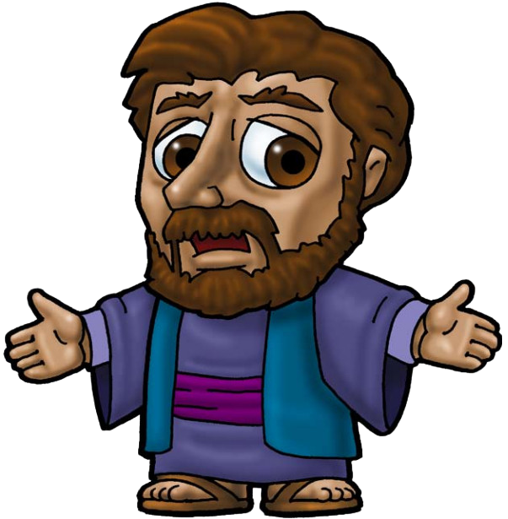
An unrelated question?
Lord, are you at this time going to restore the kingdom to Israel?

Slide 8
A Season of Waiting
How did this question show their misunderstanding about God’s Kingdom that Jesus had talked about?
Why do you think the rule of God within the lives of believers was/is more powerful for God’s purposes than throwing aside Roman rule in Israel?

Slide 9
A Season of Waiting
How does verse 8 of the passage apply to us today?
But you will receive power when the Holy Spirit comes on you; and you will be my witnesses in Jerusalem, and in all Judea and Samaria, and to the ends of the earth."

Slide 10
Listen for who, what, when, where.
Acts 1:12-14 (NIV) Then they returned to Jerusalem from the hill called the Mount of Olives, a Sabbath day's walk from the city. 13 When they arrived, they went upstairs to the room where they were staying. Those present were Peter, John, James and Andrew;

Slide 11
Listen for who, what, when, where.
Philip and Thomas, Bartholomew and Matthew; James son of Alphaeus and Simon the Zealot, and Judas son of James. 14 They all joined together constantly in prayer, along with the women and Mary the mother of Jesus, and with his brothers.

Slide 12
Season of Growing Closer to God
Consider that we can claim those same promises when we face our “gazing into the sky” experiences … and … we already have the indwelling presence of the Holy Spirit
So, then what did they do after Jesus’ ascension?
Notice that prayer was the first thing they did. Why do we sometimes consider prayer as the last thing we try?
What do you suppose they were praying about?

Slide 13
Season of Growing Closer to God
How is praying with others for a common mission different from your personal prayers?
What common mission can our group pray for together?

Slide 14
Listen for physical and spiritual phenomena.
Acts 2:1-4 (NIV) When the day of Pentecost came, they were all together in one place. 2 Suddenly a sound like the blowing of a violent wind came from heaven and filled the whole house where they

Slide 15
Listen for physical and spiritual phenomena.
were sitting. 3 They saw what seemed to be tongues of fire that separated and came to rest on each of them. 4 All of them were filled with the Holy Spirit and began to speak in other tongues as the Spirit enabled them.

Slide 16
A Season of Empowerment
What special, supernatural evidence was displayed in this event?
What was the significance of these phenomena ?
  The wind?
  The fire?
  The speaking in foreign languages?

Slide 17

A Season of Empowerment
In what ways do we need God’s Holy Spirit to help us to witness to others about salvation?

Slide 18
Application
Focus on Scripture.
  Read Isaiah 40:31 and meditate on these words.
  Hide God’s Word in your heart for those future times when you will once again find yourself waiting on the Lord and trusting in Him.

Slide 19
Application
Focus on Christ.
  When you find yourself in a situation when you are forced to wait, intercept negative reactions by directing your thoughts to Christ.
  Develop this response through repetition.
  Open your mind and heart to Him instead of swimming in the circumstances.

Slide 20
Application
Build a cohort.
  Ask God to help you find believers with whom you can share your heart.
  Develop mutual trust by waiting together in prayerful hope.

Slide 21


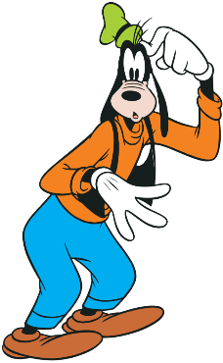
Family Activities
Gawrsh. This is awful. Think ya can foil the plans of that there evil scientist? If y’all need help go to https://tinyurl.com/3epjk3mf

Slide 22
When a Time of Inactivity Slows You Down
November 16

