Slide 1
Leaving a Legacy
October 26

Slide 2
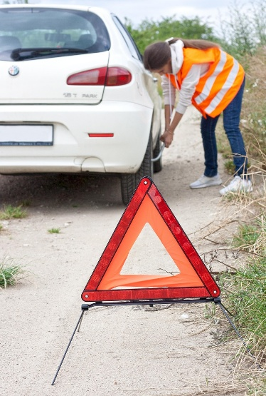
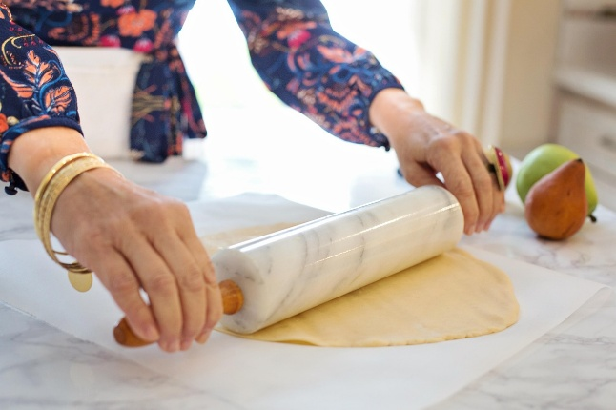
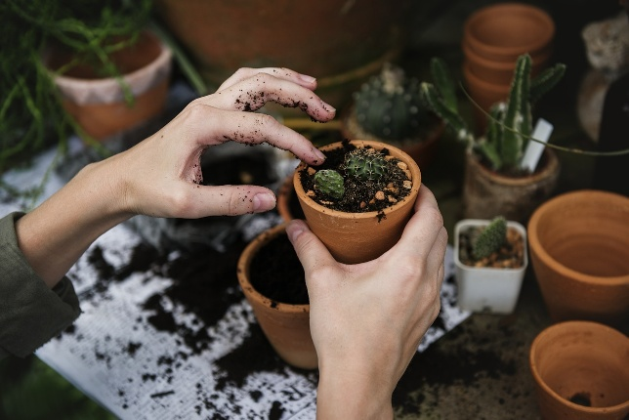
When you are “pushing up daisies” …
When you are gone what would your family say was the most important thing they learned from you?
Today we consider what we are doing with our time, treasure, and talent to leave behind something of lasting impact.

Slide 3
1. The Fruit of Discipleship Is Our Legacy.

Slide 4

Listen for Paul’s Joy
1 Thessalonians 3:8-10 (NIV) For now we really live, since you are standing firm in the Lord. 9 How can we thank God enough for you in return for all the joy we have in the presence of our God because of you? 10 Night and day we pray most earnestly that we may see you again and supply what is lacking in your faith.

Slide 5
Fruit of Discipleship Is Our Legacy
Paul’s joy came from seeing others stand firm in the Lord (v. 8). What kind of legacy does a steadfast, growing faith leave behind for friends, family, or future generations?
In verse 9, Paul gives thanks to God for the Thessalonians. Who in your life has left a spiritual legacy that causes you to thank God?

Slide 6
Fruit of Discipleship Is Our Legacy
What specific qualities did you see in them that you’d like to pass on?

Slide 7
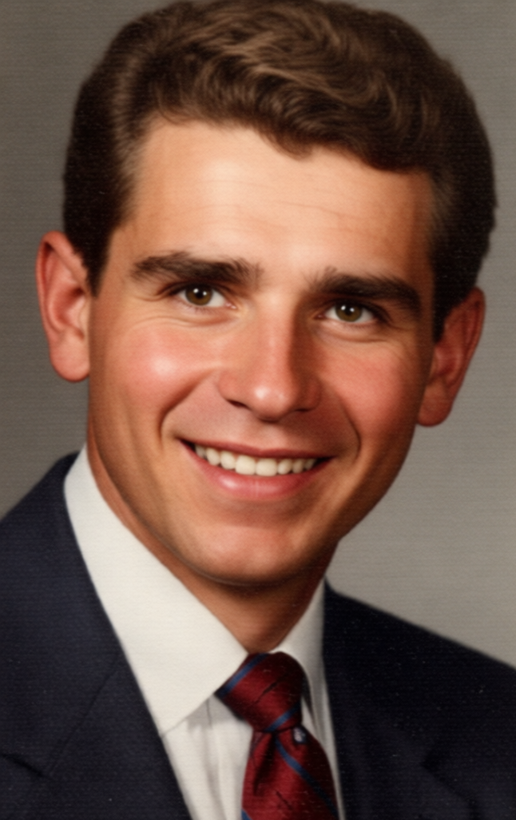
Fruit of Discipleship Is Our Legacy
Harry Koltovich
Youth for Christ director
Lorain, OH - 50’s and 60’s

Slide 8
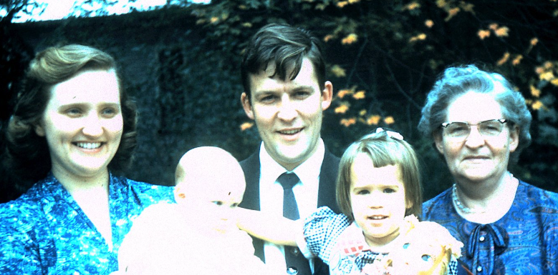
Fruit of Discipleship Is Our Legacy
Rev. Paul Hazlett -- Our pastor for four years in Bowling Green, OH

Slide 9
Fruit of Discipleship Is Our Legacy
Paul prayed “most earnestly night and day” to see them again and strengthen their faith (v. 10). How does investing in others through prayer, encouragement, or teaching build a lasting spiritual legacy?

Slide 10
Fruit of Discipleship Is Our Legacy
Think about your own influence. If someone were to describe the legacy of your faith, what do you hope they would say?
What can you be doing to begin shaping that kind of legacy?

Slide 11
2. The Family of Disciples Is Our Ministry.

Slide 12
Listen for Paul’s activities.
1 Thessalonians 2:7-12 (NIV) but we were gentle among you, like a mother caring for her little children. 8 We loved you so much that we were delighted to share with you not only the gospel of God but our lives as well, because you had become so dear to us.

Slide 13
Listen for Paul’s activities.
Surely you remember, brothers, our toil and hardship; we worked night and day in order not to be a burden to anyone while we preached the gospel of God to you. 10 You are witnesses, and so is God, of how holy, righteous and blameless we were among you who believed. 11 For you

Slide 14
Listen for Paul’s activities.
know that we dealt with each of you as a father deals with his own children, 12 encouraging, comforting and urging you to live lives worthy of God, who calls you into his kingdom and glory.

Slide 15
The Family of Disciples Is Our Ministry.
What are some words and phrases which indicate Paul’s investment in the lives of the people at Thessalonica?
we were delighted to share with you not only the gospel of God but our lives as well, … you remember, brothers, our toil and hardship; we worked night and day in order not to be a burden to anyone while we preached the gospel of God to you. … we dealt with each of you as a father deals with his own children, encouraging, comforting and urging you to live lives worthy of God

Slide 16
The Family of Disciples Is Our Ministry.
In what way was Paul like a father to the Thessalonians?
Remembering we are also leaving a legacy to our church family … how can one lose sight of people’s needs by becoming too focused on church programs?

Slide 17
The Family of Disciples Is Our Ministry.
How does a person’s changed life, a life of faith, affect those around him or her?
What are some areas in our lives where we might need to make choices that demonstrate that changed life of love and concern for others?

Slide 18
3. The Future of Discipleship Is Our Influence.

Slide 19
Listen for how Paul ministered.
1 Thessalonians 1:4-10 (NIV) For we know, brothers loved by God, that he has chosen you, 5 because our gospel came to you not simply with words, but also with power, with the Holy Spirit and with deep conviction. You know how we lived among you for your sake. 6 You became

Slide 20
Listen for how Paul ministered.
a model to all the believers in Macedonia and Achaia. 8 The Lord's message rang out from you not only in Macedonia and Achaia--your faith in God has become known everywhere. Therefore we do not need to say anything about it,

Slide 21
Listen for how Paul ministered.
for they themselves report what kind of reception you gave us. They tell how you turned to God from idols to serve the living and true God, 10 and to wait for his Son from heaven, whom he raised from the dead--Jesus, who rescues us from the coming wrath.

Slide 22
Future of Discipleship Is Our Influence
How had Paul presented the gospel to this audience?
For we know, brothers loved by God, that he has chosen you, because our gospel came to you not simply with words, but also with power, with the Holy Spirit and with deep conviction. You know how we lived among you for your sake.

Slide 23
Future of Discipleship Is Our Influence
What are some ways the lives of the Thessalonians influenced others through their legacy?
You became imitators of us and of the Lord; in spite of severe suffering, you welcomed the message with the joy given by the Holy Spirit. And so you became a model to all the believers in Macedonia and Achaia. 8 The Lord's message rang out from you not only in Macedonia and Achaia--your faith in God has become known everywhere.

Slide 24
Future of Discipleship Is Our Influence
How does demonstrating joy in difficult circumstances make a difference for your legacy?
What obstacles should we overcome to be able to live with a sense of love and joy that will be seen by others?

Slide 25
Application
Write up a spiritual last will and testament … declare elements of the legacy you wish to leave.
Spiritual truths, special Bible verses, or lessons you have learned
Spiritual habits you have tried to model
Reasons by listing how God has made a difference in your life
Assurance to your family that when they read this, you are in heaven with Jesus, based on biblical truths that you list

Slide 26
Application
Meditate on the legacy you received from your parents, grandparents
Thank God for those things which have encouraged and blessed you
If it was a negative legacy, ask God for grace to forgive
Ask God for the strength and wisdom to give a positive legacy to your family members

Slide 27
Application
Consider the elements of this lesson … the godly legacy of …
Building relationships that honor God (not compromise godliness)
Praying about people and decisions
Practice following God’s directions, God’s principles for living

Slide 28
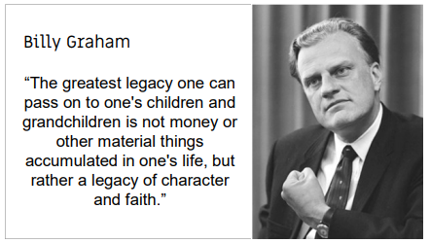
Initiate a Discussion

Slide 29
Leaving a Legacy
October 26

