Slide 1
When Your Understanding Falls Short
December 21

Slide 2

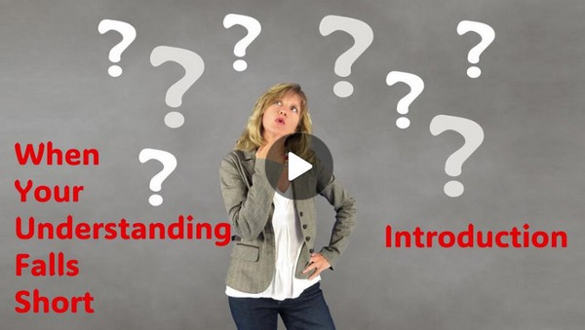
Video Introduction
View Video

Slide 3



How do they do that ?
What are some things you trust to work even though you don’t know how they work?
Even more amazing is how God works in our lives.
No doubt Mary continued to be amazed at God at work through her life.
We can know that God will accomplish great things in our lives.

Slide 4
Listen for a startling revelation.
Luke 1:26-30 (NIV) In the sixth month, God sent the angel Gabriel to Nazareth, a town in Galilee, 27 to a virgin pledged to be married to a man named Joseph, a descendant of David. The virgin's name was Mary. 28 The angel went to her and

Slide 5
Listen for a startling revelation.
said, "Greetings, you who are highly favored! The Lord is with you." 29 Mary was greatly troubled at his words and wondered what kind of greeting this might be. 30 But the angel said to her, "Do not be afraid, Mary, you have found favor with God.

Slide 6
Unexpected Possibilities
How could we describe Mary, based on this passage?
She was described as being “pledged” or “espoused” to Joseph.
A structured year of engagement.
A legal arrangement.
When this angel encounter occurred, she was within this year of engagement.

Slide 7
Unexpected Possibilities
Why was Mary troubled?
On what grounds did Gabriel urge Mary not to be afraid?
Since Luke did not cite any Old Testament reference to a virgin birth, what might have been the significance of Luke’s identifying Mary as a virgin?

Slide 8
Unexpected Possibilities
Since Jesus existed before time, why is it significant that He come as a baby?
How do you think God specifically chose Mary?

Slide 9
Unexpected Possibilities
How about today … how does God choose people today? How does He favor us and choose us for special tasks?
What do you think he meant by declaring her to be “highly favored”?

Slide 10
Listen for titles and descriptions given.
Luke 1:31-34 (NIV) You will be with child and give birth to a son, and you are to give him the name Jesus. 32 He will be great and will be called the Son of the Most High. The Lord God will give

Slide 11
Listen for titles and descriptions given.
him the throne of his father David, 33 and he will reign over the house of Jacob forever; his kingdom will never end." 34 "How will this be," Mary asked the angel, "since I am a virgin?"

Slide 12
God’s Plans Are Not Hampered
What description to we see here about the child Mary would bear?
What is the significance of the names and titles given to this child?
Name | Significance
Jesus Son of the Most High Given Throne of David Kingdom: House of Jacob

Slide 13

God’s Plans Are Not Hampered
The “Kingdom of God” is the realm where God rules. Therefore, in what way is Jesus to be King today?

Slide 14
God’s Plans Are Not Hampered
Note how is this kingdom different from other kingdoms?
Spiritual kingdom … not political, does not possess land or geographical territory
The King has infinite power and authority
The source of the power, is the King, Himself
The subjects of the kingdom choose to obey
The King does not force His authority on believers

Slide 15
Listen for evidence of God’s power.
have a child in her old age, and she who was said to be barren is in her sixth month. 37 For nothing is impossible with God." 38 "I am the Lord's servant," Mary answered. "May it be to me as you have said." Then the angel left her.

Slide 16
God’s Power Can Do Great Things
What are some reactions by the world to the concept of Jesus being born to a virgin?
How did Gabriel explain Mary’s conception?
So, with all those emotions, how did Mary respond to the angels message?

Slide 17
God’s Power Can Do Great Things
Why is Mary’s acceptance of God's plan significant … for her … for others ?
How can we similarly respond to God’s call on our lives?

Slide 18
Application
Pray.
Ask God to strengthen the faith of a discouraged friend.

Slide 19
Application
Journal.
Write your testimony of how God has surprised you through unique circumstances that strengthened your faith.
Share your gratefulness to God and His mercy with a friend or post your story on social media.

Slide 20
Application
Retreat.
Both Mary’s and Zechariah’s encounters with God happened in solitude.
Plan a silent retreat where you get away from all the noise of your life and enter into fellowship with God.
Read Luke 1–2 to discover how the stories of Zechariah, Elizabeth, and Mary align as related to the births of John and Jesus. Listen closely for His guidance.

Slide 21
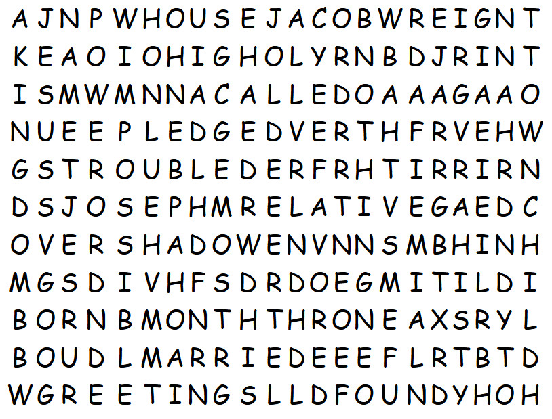

Family Activities
GREETINGS
IMPOSSIBLE
MARRIED
Help at https://tinyurl.com/47suf286

Slide 22
When Your Understanding Falls Short
December 21

