Slide 1
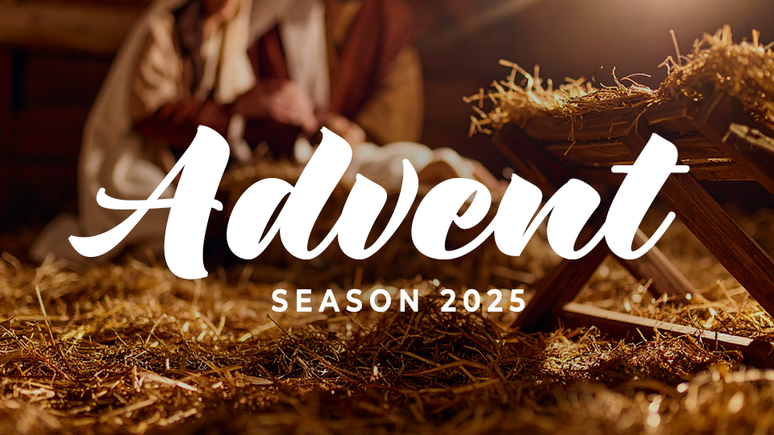
Peace

Slide 2

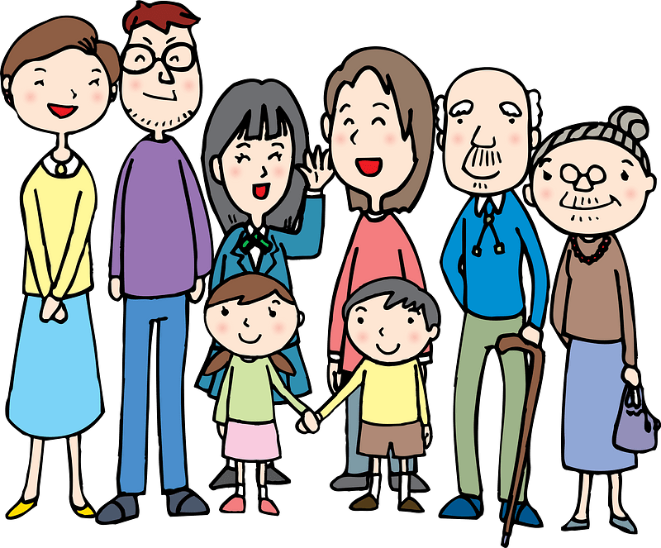
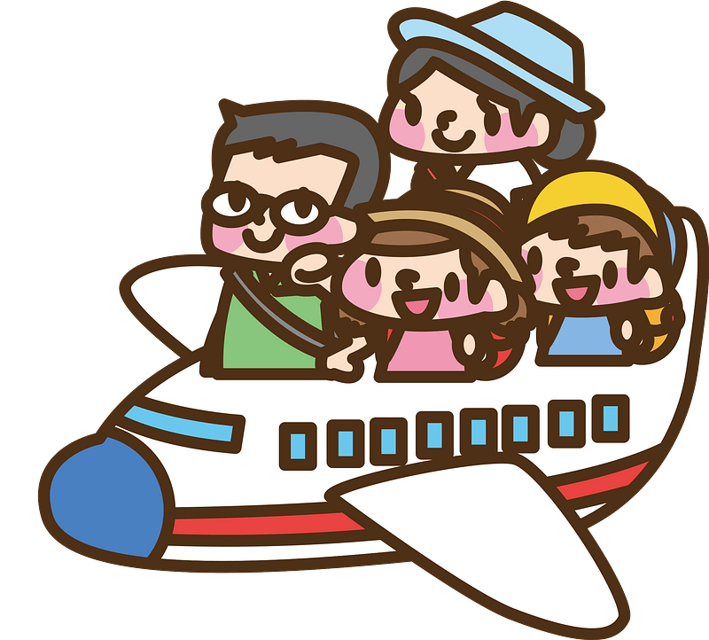
Be honest, now …
What is there about the Christmas season makes it difficult for you to experience peace?
At Christmas we celebrate Christ’s coming …
Jesus came to be the Prince of Peace
He brings to provide Peace with God and peace with one another.

Slide 3
1. We Experience Peace When We Look To Jesus.

Slide 4
Listen for a prophecies.
Micah 5:1-4 (NIV) Marshal your troops, O city of troops, for a siege is laid against us. They will strike Israel's ruler on the cheek with a rod. 2 "But you, Bethlehem Ephrathah, though you are small among the clans of Judah, out of

Slide 5
Listen for a prophecies.
you will come for me one who will be ruler over Israel, whose origins are from of old, from ancient times." 3 Therefore Israel will be abandoned until the time when she who is in labor gives birth and the rest of his brothers

Slide 6

Listen for a prophecies.
return to join the Israelites. 4 He will stand and shepherd his flock in the strength of the LORD, in the majesty of the name of the LORD his God. And they will live securely, for then his greatness will reach to the ends of the earth.

Slide 7
Look to Jesus for Peace
What is the historical significance of Bethlehem Ephratah?
What prophecies does the Lord make about Israel?
Bethlehem … out of you will come for me one who will be ruler over Israel, whose origins are from of old, from ancient times." Therefore, Israel will be abandoned until the time when she who is in labor gives birth and the rest of his brothers return to join the Israelites. He will stand and shepherd his flock in the strength of the LORD, in the majesty of the name of the LORD his God. And they will live securely, for then his greatness will reach to the ends of the earth

Slide 8
Look to Jesus for Peace
What are some ways we need to see peace?
What distinguishes the new kind of king the Lord promises?
How is this ruler still at work in our lives today?
whose origins are from of old, from ancient times … He will stand and shepherd his flock in the strength of the LORD, in the majesty of the name of the LORD his God. And they will live securely, for then his greatness will reach to the ends of the earth

Slide 9
Look to Jesus for Peace
Bethlehem was a small, ordinary town—but God chose it to bring forth the greatest source of peace. Why do you think God often brings His peace through unexpected or humble places and people?
What does it mean that Jesus’ peace is not just personal but global?

Slide 10
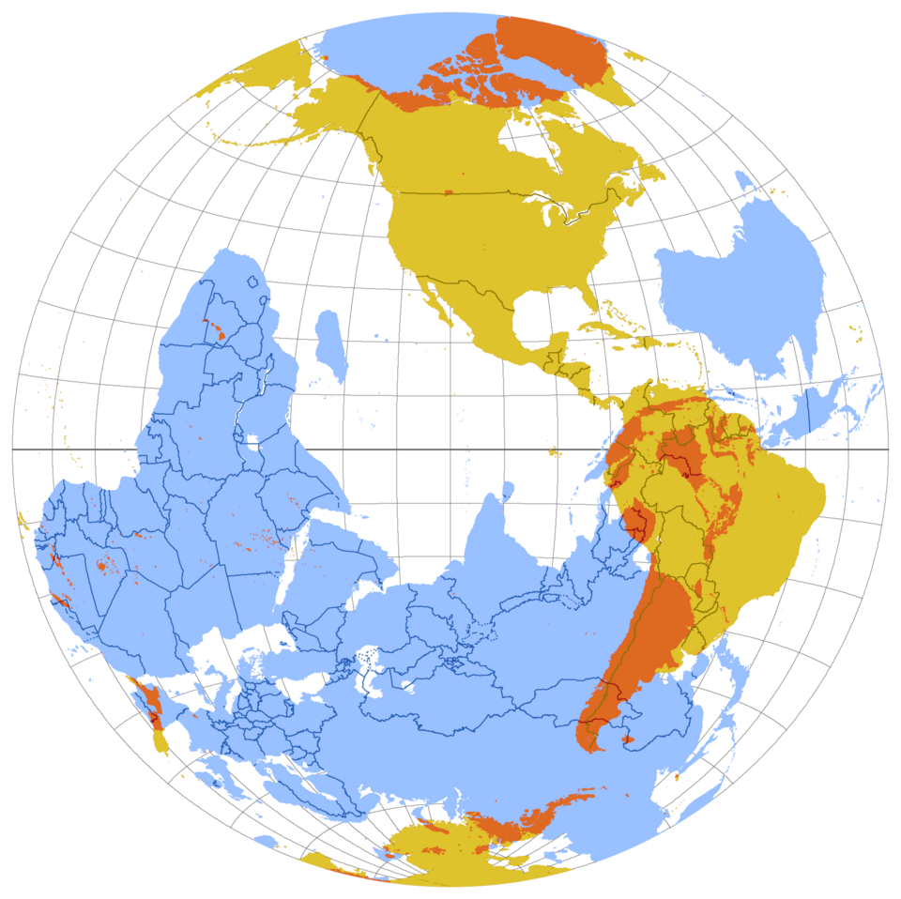
“To the Uttermost Parts of the Earth”
Jerusalem

Slide 11
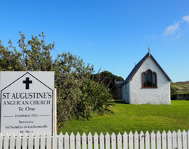
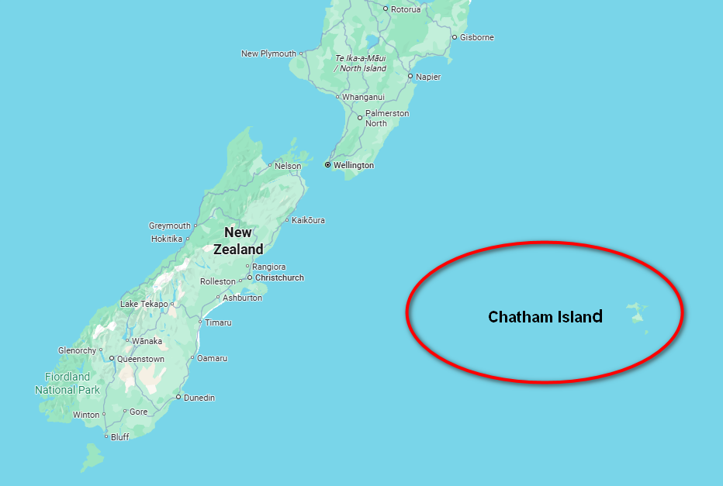
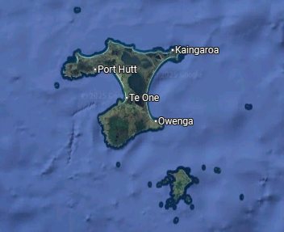
“To the Uttermost Parts of the Earth”

Slide 12
2. We Experience Peace Because Of The Incarnation.

Slide 13
Listen for unusual circumstances.
Luke 2:1-7 (NIV) In those days Caesar Augustus issued a decree that a census should be taken of the entire Roman world. 2 (This was the first census that took place while Quirinius was governor of Syria.) 3 And everyone went to his own

Slide 14
Listen for unusual circumstances.
town to register. 4 So Joseph also went up from the town of Nazareth in Galilee to Judea, to Bethlehem the town of David, because he belonged to the house and line of David. 5 He went there to register with Mary, who was pledged to be married to him and

Slide 15
Listen for unusual circumstances.
was expecting a child. 6 While they were there, the time came for the baby to be born, 7 and she gave birth to her firstborn, a son. She wrapped him in cloths and placed him in a manger, because there was no room for them in the inn.

Slide 16
The Incarnation Brings Peace
According to this passage, several elements of the story are extraordinary for birthing a baby. What unusual things do you see?
How can the way Mary managed her challenges help us to handle our difficulties?
What specific actions of or interventions by God do you see in the overall aspects of this story?
Joseph also went to Bethlehem … He went there to register with Mary, who was pledged to be married to him and was expecting a child. While they were there, the time came for the baby to be born, and she gave birth to her firstborn, a son. She wrapped him in cloths and placed him in a manger, because there was no room for them in the inn.

Slide 17
The Incarnation Brings Peace
For each of the situations below, how might God be at work, intervening, arranging timing and events in our lives that are hard to realize when they are happening?
Life Event | How God Could Accomplish Something
Loss of a Job
Delayed by flat tire
Meet old H.S. classmate

Slide 18
3. We Experience Peace When We Anticipate Eternity With Jesus.

Slide 19
Listen for how to have peace.
Romans 5:1-8 (NIV) Therefore, since we have been justified through faith, we have peace with God through our Lord Jesus Christ, 2 through whom we have gained access by faith into this grace in which we now stand. And we rejoice in the hope of the glory of God. 3 Not only so, but

Slide 20
Listen for how to have peace.
we also rejoice in our sufferings, because we know that suffering produces perseverance; 4 perseverance, character; and character, hope. 5 And hope does not disappoint us, because God has poured out his love into our hearts by the Holy Spirit, whom he has given us. 6 You see, at just

Slide 21
Listen for how to have peace.
the right time, when we were still powerless, Christ died for the ungodly. 7 Very rarely will anyone die for a righteous man, though for a good man someone might possibly dare to die. 8 But God demonstrates his own love for us in this: While we were still sinners, Christ died for us.

Slide 22
Peace with Jesus
How will other people see both the peace with God and peace of God in the life of a believer?
Verses 3 & 4 describe a seeming contradiction: “Rejoice in sufferings” What is the progression, starting with suffering?
we also rejoice in our sufferings, because we know that suffering produces perseverance; perseverance, character; and character, hope

Slide 23
Peace with Jesus
What kinds of situations can you think of where God gives peace and suffering leads you to rejoice?
Verse 8 says God loves us even when we were dirty, despicable sinners!! How can this kind of love be reflected in our lives towards others around us?
But God demonstrates his own love for us in this: While we were still sinners, Christ died for us.

Slide 24
Application
Trust your Shepherd.
Trust Jesus to guide you with care. Consider if there is an area where He is calling you to obedience, but you are resisting.
If so, acknowledge Jesus as your caring shepherd and trust His guidance.

Slide 25
Application
Acknowledge your King.
The wise men bowed down in recognition of the King.
Bow or kneel when you pray this week as a physical sign that you recognize Jesus as King.
Consider setting up a prayer place where you can make this a regular part of your quiet time with Him.

Slide 26
Application
Share about your Shepherd King.
Use a concordance or online Bible to find occurrences of the word “shepherd” throughout the Bible.
Note how this increases your understanding of the ways Jesus cares for His people.
Find someone you can share this with.

Slide 27
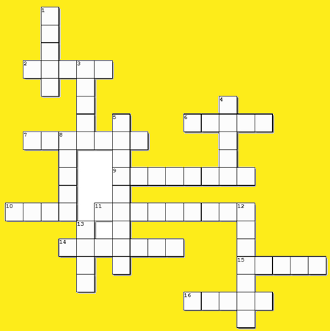
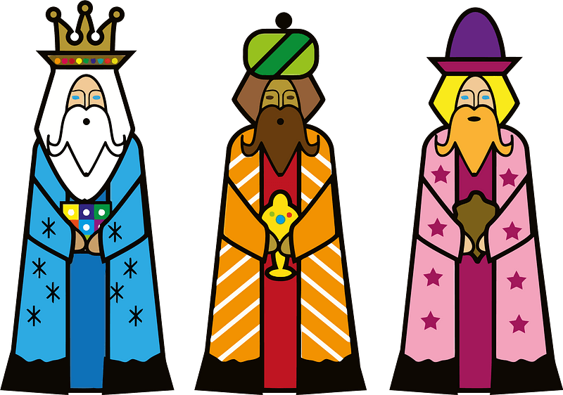
Crossword
Matt 2:9-11 Don’t tell Herod!
Micah 5:2-5a
Matt 2:1-6

Slide 28
Peace

