Slide 1
When Your Faith Falls Short
December 7

Slide 2

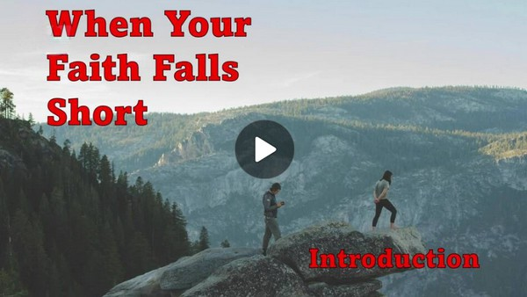
Video Introduction
View Video

Slide 3


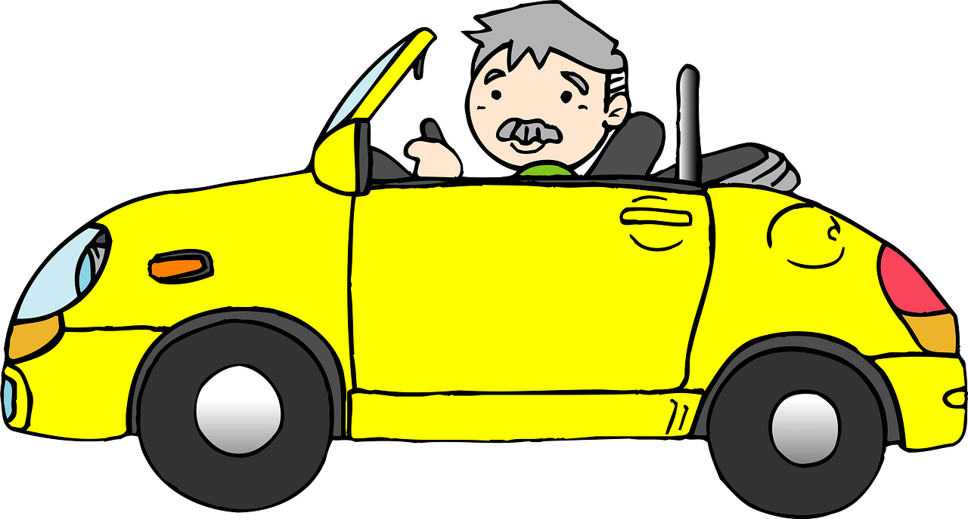
It was close …
What is the closest you’ve come to running out of Gas?

Slide 4
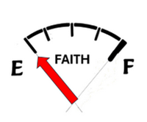
It was close …
What is the closest you’ve come to running out of Gas?
Sometimes our “faith meter” seems to be stuck on E
Today we consider that “how much” faith we have is not the issue.
The concern is who or what is the object of where we place our trust.

Slide 5
Listen for failure.
Matthew 17:14-16 (NIV) When they came to the crowd, a man approached Jesus and knelt before him. 15 "Lord, have mercy on my son," he said. "He has seizures and is suffering greatly. He often falls into the fire or into the water. 16 I brought him to your disciples, but they could not heal him."

Slide 6
Helpless Without Jesus
What do you notice about the father's approach to Jesus?
How does his desperation reflect faith?
From a physical point of view, what was his son’s affliction?
Why was the man frustrated, and why did he feel helpless?

Slide 7
Helpless Without Jesus
What are some situations where we might feel helpless, unable to change a situation in our lives?
How do we navigate the tension between being self-sufficient and relying on God?

Slide 8
Helpless Without Jesus
Why do you think the disciples were unable to heal the boy?
What does this reveal about the nature of faith and dependence on Jesus?

Slide 9
Listen for disappointment.
Matthew 17:17-18 (NIV) "O unbelieving and perverse generation," Jesus replied, "how long shall I stay with you? How long shall I put up with you? Bring the boy here to me." 18 Jesus rebuked the demon, and it came out of the boy, and he was healed from that moment.

Slide 10
Doubt Reflects Lack of Faith
To whom might Jesus’s reply in verse 17 apply?
Why was Jesus frustrated with His disciples?
What did Jesus do for the child?
What did Jesus establish about Himself by healing the child and exorcising the demon?

Slide 11
Doubt Reflects Lack of Faith
Jesus says, “Because you have so little faith.” What does this tell us about the relationship between faith and spiritual authority?

Slide 12
Listen for a botany comparison.
Matthew 17:19-20 (NIV) Then the disciples came to Jesus in private and asked, "Why couldn't we drive it out?" 20 He replied, "Because you have so little faith. I tell you the truth, if you have faith as small as a mustard seed, you can say to this mountain, 'Move from here to there' and it will move. Nothing will be impossible for you.

Slide 13
Faith in Jesus Makes Little Faith Great Faith
What was Jesus’s core explanation for their inability?
Jesus mentions that faith as small as a mustard seed can move mountains. What “mountains” in our lives, our society feel immovable right now?

Slide 14
Faith in Jesus Makes Little Faith Great Faith
A gardener knows that a tiny seed grows into a big plant. How can someone with “little faith” believe that God can accomplish such a big result?

Slide 15
Faith in Jesus Makes Little Faith Great Faith
What does it look like to act in faith rather than just believe in theory?
Faith in Theory | Act in Faith

Slide 16

Faith in Jesus Makes Little Faith Great Faith
If you were the boy in this story, what would you want others to believe about Jesus?

Slide 17

Faith in Jesus Makes Little Faith Great Faith
How in our daily lives can we cultivate deeper faith and be more strongly convinced of who Jesus and what He has done—especially when prayers seem unanswered or challenges persist?
https://tinyurl.com/Reasons-to-Praise-God

Slide 18
Application
Pray.
What challenges face you this week?
Make a list and pray for faith to deal with these issues.

Slide 19
Application
Engage.
We all have experienced difficult situations and broken people.
It’s sometimes easier to try to avoid them.
Commit to engage actively with these complicated problems rather than avoiding them.

Slide 20
Application
Dare.
Perhaps you’ve stopped believing a breakthrough is possible in some area of life, even to the extent that you’ve stopped praying about it.
Ask Jesus to change your posture from doubt to faith.
Commit to reengage by taking your requests to God.

Slide 21
When Your Faith Falls Short
December 7

