Slide 1
When Your Confidence
Falls Short
January 11

Slide 2


Video introduction
View Video

Slide 3
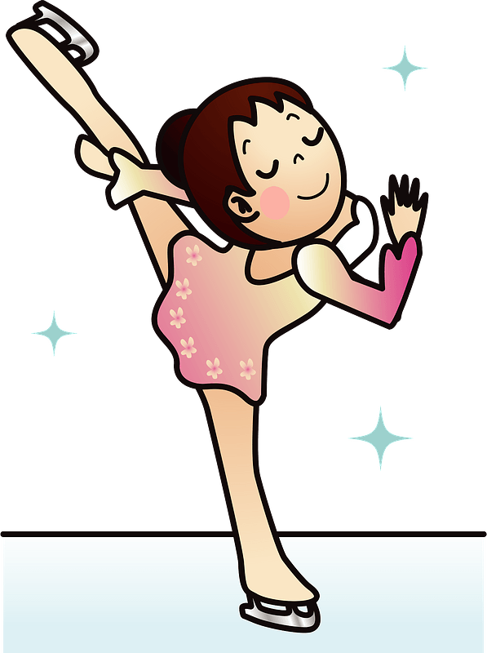
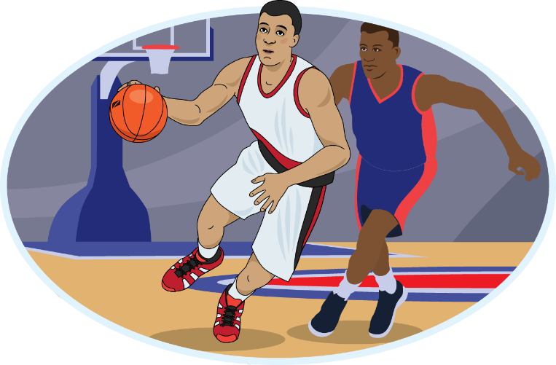

Remember that time?
What is the toughest competition you’ve ever participated in?

Slide 4
Remember that time?
What is the toughest competition you’ve ever participated in?
Our confidence can also waver when facing temptations.
  Today we look at what John has to say about confidence.
  We can stand victoriously because of Christ.

Slide 5
Listen for Jesus’ command.
1 John 3:21-24 (NIV) Dear friends, if our hearts do not condemn us, we have confidence before God 22 and receive from him anything we ask, because we obey his commands and do what pleases him. 23 And this is his command:

Slide 6
Listen for Jesus’ command.
to believe in the name of his Son, Jesus Christ, and to love one another as he commanded us. 24 Those who obey his commands live in him, and he in them. And this is how we know that he lives in us: We know it by the Spirit he gave us.

Slide 7
Remain and Obey
Verse 21 says our confidence is affected by our heart. Can you think of a time when feelings lagged behind truth?
Dear friends, if our hearts do not condemn us, we have confidence before God

Slide 8
Remain and Obey
John distinguishes between condemnation from our own hearts and confidence before God. What is the danger of letting our feelings define our standing with God?
Dear friends, if our hearts do not condemn us, we have confidence before God

Slide 9
Remain and Obey
What does it mean to “believe in the name of Jesus Christ”?
How is it possible to keep these and any other commandment of God?
And this is his command: to believe in the name of his Son, Jesus Christ, and to love one another as he commanded us.

Slide 10

Remain and Obey
This diagram illustrates how God dwells in the life of the believer in the person of the Holy Spirit. How do we dwell/live in Him as it also says in verse 24?

Slide 11
Listen for criteria to judge.
1 John 4:1-3 (NIV) Dear friends, do not believe every spirit, but test the spirits to see whether they are from God, because many false prophets have gone out into the world. 2 This is how you can recognize the Spirit of God: Every spirit that

Slide 12
Listen for criteria to judge.
acknowledges that Jesus Christ has come in the flesh is from God, 3 but every spirit that does not acknowledge Jesus is not from God. This is the spirit of the antichrist, which you have heard is coming and even now is already in the world.

Slide 13
Walk in the Truth
What did John instruct his readers to do?
Dear friends, do not believe every spirit, but test the spirits to see whether they are from God, because many false prophets have gone out into the world.

Slide 14
Walk in the Truth
According to this passage, what is the so called “litmus test” to recognize the Spirit of God?
This is how you can recognize the Spirit of God: Every spirit that acknowledges that Jesus Christ has come in the flesh is from God, but every spirit that does not acknowledge Jesus is not from God.

Slide 15
Walk in the Truth
How does this tie in with the verses we just looked at from end of chapter 3?
We believe in who Jesus is
  He is both God and man … both at the same time
And this is his command: to believe in the name of his Son, Jesus Christ, and to love one another as he commanded us.

Slide 16
Walk in the Truth
Why is this fact important … what if Jesus was only God or only man?
If Only God | If Only Man

Slide 17
Walk in the Truth
Note some modern examples of groups who spread false teachings regarding the full humanity and full divinity of Jesus:
  Mormons (Latter Day Saints)
  Jehovah’s Witnesses
  Islam
  Hindu
  Humanism

Slide 18
Walk in the Truth
Common characteristics of cults – false spirits … symbolized by math symbols
+ They add to Scripture
- They subtract from the deity of Christ
× They multiply the importance of works
÷ They are divisive, causing divisions in families, among friends, separating their adherents from other belief systems

Slide 19
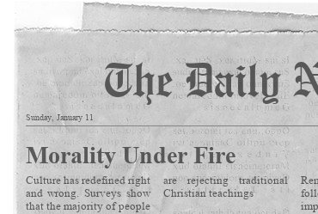
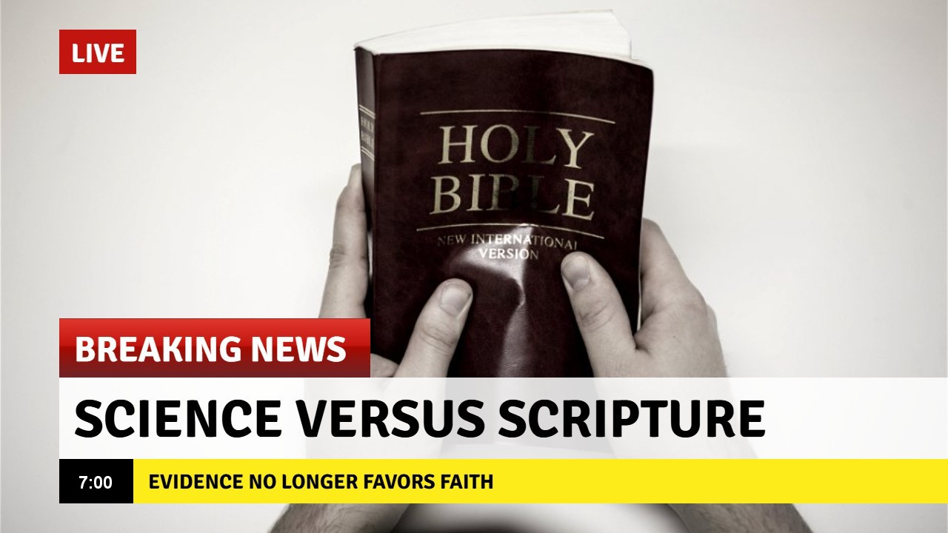
Walk in the Truth
What spirits should we be testing today? What false prophets are in the world today?

Slide 20
Listen for words of hope.
1 John 4:4-6 (NIV) You, dear children, are from God and have overcome them, because the one who is in you is greater than the one who is in the world. 5 They are from the world and therefore speak from the viewpoint

Slide 21
Listen for words of hope.
of the world, and the world listens to them. 6 We are from God, and whoever knows God listens to us; but whoever is not from God does not listen to us. This is how we recognize the Spirit of truth and the spirit of falsehood.

Slide 22
Stand Victorious in Jesus
Between what two spirits must we choose in considering the direction of our lives?
How does our confidence in Christ (3:21–24) prepare us to test the spirits (4:1–6)? What happens to discernment when assurance is weak?

Slide 23
Stand Victorious in Jesus
Contrast the two philosophies … that of the world and those who belong to God. How does the world decide what sounds true? How does God’s truth often run counter to popular opinion?
World’s View | Believer’s View

Slide 24
Stand Victorious in Jesus
Verse 4 is one of the most encouraging statements in Scripture. What does “He who is in you is greater than he who is in the world” mean in daily life?
Jesus is greater than those who oppose us. How will this truth influence your life this coming week?
You, dear children, are from God and have overcome them, because the one who is in you is greater than the one who is in the world.

Slide 25
Application
Read.
  God’s Word is filled with encouraging words for us when our confidence fails.
  Take a few minutes to look up and meditate on Exodus 15:2; Psalm 28:7-8; and 2 Corinthians 12:9-10.

Slide 26
Application
Correspond.
  Write a note to someone in your life who is experiencing stress, exhaustion, or bewilderment.
  Let that person know that you are in his or her corner.

Slide 27
Application
Fast.
  When you fast, God strengthens your spirit and gives you clarity.
  If you are able, plan to fast from food, entertainment, social media, or some other thing you enjoy
  This can clear away distractions and connect you more strongly with God.

Slide 28
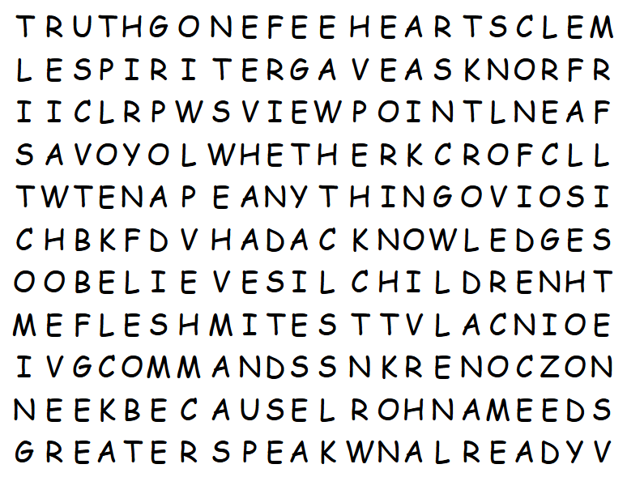
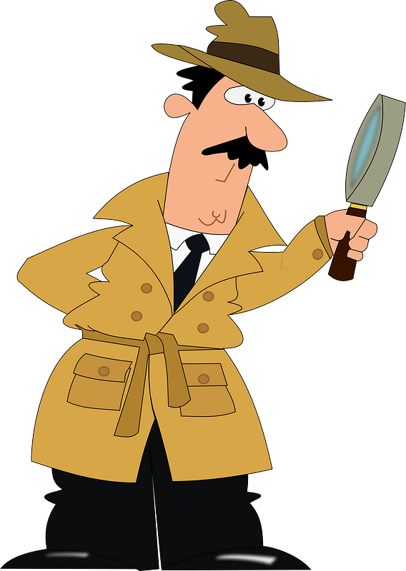
Family Activities
Hmm … The Word Search Lady said, “no backwards words.” Looks like we’ve got “KEEN” going the wrong way. Oh … wait … that’s not on the list. OK, I think you can do this. See if you can find more words than “that other class”. Don’t tell them, but you can get help and other Fun Family Activities at https://tinyurl.com/5n79hxtz

Slide 29
When Your Confidence
Falls Short
January 11

