Slide 1
When Your Circumstances Fall Short
December 14

Slide 2


Video Introduction
View Video

Slide 3

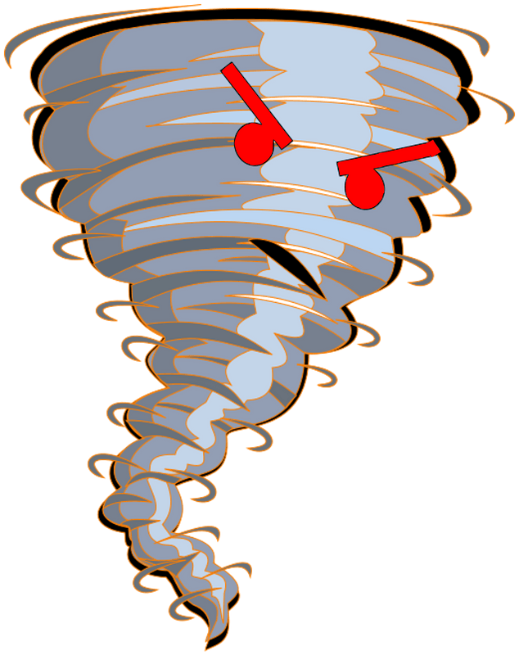

It was scary !
What’s the scariest weather event you’ve ever seen or experienced?
Sometimes our scary experiences are not weather related.
  God’s grace will sustain you through any of life’s circumstances.

Slide 4
Listen for dire circumstances
2 Corinthians 1:8-10 (NIV) We do not want you to be uninformed, brothers, about the hardships we suffered in the province of Asia. We were under great pressure, far beyond our ability to endure, so that we despaired even of life. 9 Indeed, in our hearts we felt the sentence

Slide 5
Listen for dire circumstances
of death. But this happened that we might not rely on ourselves but on God, who raises the dead. 10 He has delivered us from such a deadly peril, and he will deliver us. On him we have set our hope that he will continue to deliver us,

Slide 6
Rely on God
What words and phrases does Paul use to describe a time of suffering he had faced?
How did Paul’s confidence in God enable him to rise above his despair?
What did Paul want his readers (including us) to know?

Slide 7
Rely on God
Why do you think prayer is such an important part of the Christian life?
How can you rely more on God instead of yourself in times of hardship?

Slide 8
Rely on God
Paul says to set our hope on God. How is this more than so called “wishful thinking”?
What can we do to learn to trust God more during struggles and hardships?
Hope in God | Wishful Thinking

Slide 9
Listen for a physical problem.
2 Corinthians 12:6-8 (NIV) Even if I should choose to boast, I would not be a fool, because I would be speaking the truth. But I refrain, so no one will think more of me than is warranted by what I do or say. 7 To keep me

Slide 10
Listen for a physical problem.
from becoming conceited because of these surpassingly great revelations, there was given me a thorn in my flesh, a messenger of Satan, to torment me. 8 Three times I pleaded with the Lord to take it away from me.

Slide 11
Stay Humble before God
Paul says he could have been tempted to brag. What could he have bragged about?
What did Paul say was given to him to keep him humble?
How did Paul understand Satan intended to use the thorn in the flesh?

Slide 12
Stay Humble before God
What was Paul’s response to his "thorn"?
What Satan may intend for harm, God can use for good. What good can there be?

Slide 13
Listen for what Paul would boast about.
2 Corinthians 12:9-10 (NIV) But he said to me, "My grace is sufficient for you, for my power is made perfect in weakness." Therefore I will boast all the more gladly about my weaknesses, so that

Slide 14
Listen for what Paul would boast about.
Christ's power may rest on me. 10 That is why, for Christ's sake, I delight in weaknesses, in insults, in hardships, in persecutions, in difficulties. For when I am weak, then I am strong.

Slide 15
By God’s Grace, Endure
What promise did the Lord give to Paul concerning times of hardship?
What is grace?
What did Paul mean in saying that he preferred that the power of Christ may rest upon him?

Slide 16
By God’s Grace, Endure
How does the Christian perspective on power and weakness differ from that of the world?
How can you allow the Lord’s power to take over where you are weak?
Christian Perspective | Worldview

Slide 17
Application
Reflect.
  Make a list of some struggles you’ve endured over the past ten years.
  Reflect on the ways God has brought you through them.

Slide 18
Application
Share.
  We all are struggling with something!
  This week, find an opportunity to share some struggles you are having with a friend.
  Invite him or her to pray for you as you continue to persevere.

Slide 19
Application
Serve.
  This is the season when we sing those immortal words, “Truly He taught us to love one another.”
  Find an opportunity to bless a struggler in a sacrifice of time or money.

Slide 20
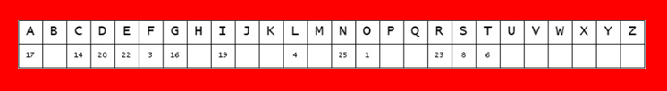
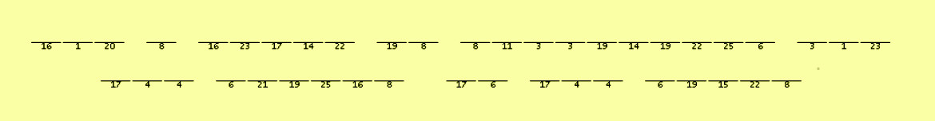
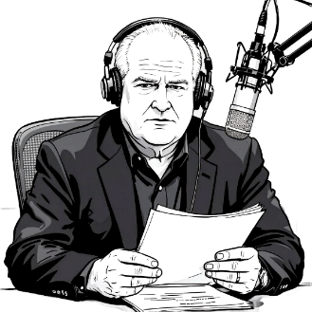
Family Activities
“Ladies and gentlemen, we have just received—get this—a number-coded communiqué straight from our brave Baptist consulate in Wayri Kongtiascot, working hand-in-hand with the underground church. We need your help for the decryption. This is important, folks. Time to step up.” Our staff has found help and even more Family Activities at https://tinyurl.com/4b4rftet

Slide 21
When Your Circumstances Fall Short
December 14

