Slide 1

The How-Tos of Disciple-Making

Slide 2



Think about it …
What actions by another person let you know you can trust them?
Today we consider some of the How-To’s of being a disciple maker.
One of these essentials is noting how Jesus built up trust with someone by the way He acted

Slide 3
1. Jesus Met People Where They Were.

Slide 4
Listen for how people followed Jesus.
Matthew 4:18-22 (NIV) As Jesus was walking beside the Sea of Galilee, he saw two brothers, Simon called Peter and his brother Andrew. They were casting a net into the lake, for they were fishermen. 19 "Come, follow me," Jesus said, "and I will make you fishers of men." 20 At once they

Slide 5
Listen for how people followed Jesus.
left their nets and followed him. 21 Going on from there, he saw two other brothers, James son of Zebedee and his brother John. They were in a boat with their father Zebedee, preparing their nets. Jesus called them, 22 and immediately they left the boat and their father and followed him.

Slide 6
Meet People where They Are
What exactly did Jesus say to Simon and Andrew?
What do we mean when we say we “follow” a sports team, a TV program, a musical group, or an author?
So what would it mean when Jesus says “follow me”?
They were casting a net into the lake, for they were fishermen. "Come, follow me," Jesus said, "and I will make you fishers of men."

Slide 7
Meet People where They Are
What does it mean to be a “fisher of men”?
Jesus had worked as a carpenter with His earthly father. What metaphor might He have used to call carpenters to be disciples with Him?

Slide 8
Meet People where They Are
What about other professions?
Profession | Metaphor to Call Disciples
Shepherd Merchant Restaurant owner Tax Collector

Slide 9
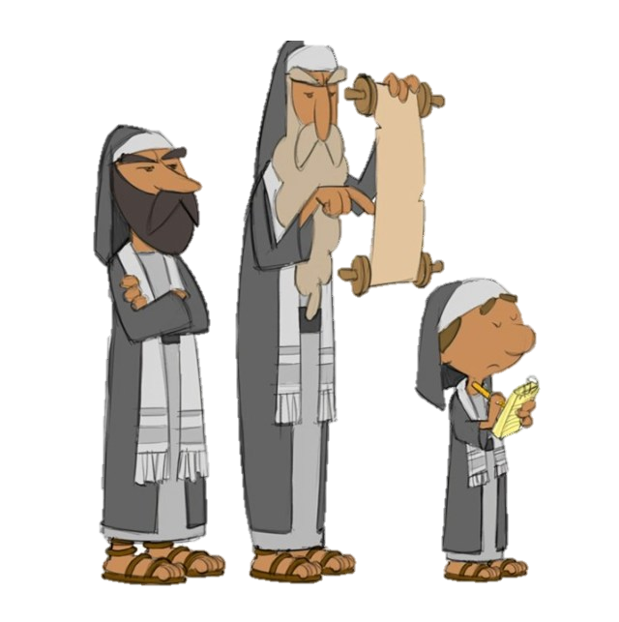
Meet People where They Are
They “immediately left their boats” and followed Him—what does that say about their priorities or trust?
Why did Jesus handpick blue-collar fishermen to be the leaders of the Christian church? (rather than scribes or pharisees)

Slide 10
Meet People where They Are
What are we being asked to leave behind to follow Jesus more fully?
What do you think it means to be “called”? Is calling always as dramatic as in this story or can it be quiet and gradual? What do you think?

Slide 11
2. Jesus Taught For Life Change.

Slide 12
Jesus Taught for Life Change
After an initial request for a drink of water, note the interchange with a woman at a well:
The Samaritan woman said to him, "You are a Jew and I am a Samaritan woman. How can you ask me for a drink?" (For Jews do not associate with Samaritans.) Jesus answered her, "If you knew the gift of God and who it is that asks you for a drink, you would have asked him and he would have given you living water."

Slide 13
Jesus Taught for Life Change
How can you tell the woman misunderstood what Jesus was saying?
She is taking Jesus literally – at least at first.
"Sir," the woman said, "you have nothing to draw with and the well is deep. Where can you get this living water? Are you greater than our father Jacob, who gave us the well and drank from it himself, as did also his sons and his flocks and herds?"

Slide 14
Listen for Jesus’ response.
John 4:13-15 (NIV) Jesus answered, "Everyone who drinks this water will be thirsty again, 14 but whoever drinks the water I give him will never thirst. Indeed, the water I give him will

Slide 15
Listen for Jesus’ response.
become in him a spring of water welling up to eternal life." 15 The woman said to him, "Sir, give me this water so that I won't get thirsty and have to keep coming here to draw water."

Slide 16
Jesus Taught for Life Change
How is the world’s need for salvation and eternal life like thirst?
How can confusion about spiritual things open the door for more discussion?
Note Jesus’ use of water as a metaphor to teach about salvation. He also used bread, light, and breath.
Jesus provides all that is needed to sustain (spiritual) life.

Slide 17
3. Jesus Developed Future Leaders And Empowered Them To Serve.

Slide 18
Listen for traveling instructions.
Luke 9:1-6 (NIV) When Jesus had called the Twelve together, he gave them power and authority to drive out all demons and to cure diseases, 2 and he sent them out to preach the kingdom of God and to heal the sick. 3 He told them: "Take nothing for the journey--no staff, no bag, no bread, no money, no

Slide 19
Listen for traveling instructions.
extra tunic. 4 Whatever house you enter, stay there until you leave that town. 5 If people do not welcome you, shake the dust off your feet when you leave their town, as a testimony against them." 6 So they set out and went from village to village, preaching the gospel and healing people everywhere.

Slide 20
Empowered to Serve
What specific instructions did Jesus give the disciples in verses 1-2, and how might those shape a leader’s mindset today?
When Jesus had called the Twelve together, he gave them power and authority to drive out all demons and to cure diseases, and he sent them out to preach the kingdom of God and to heal the sick.

Slide 21
Empowered to Serve
What were his instructions for verses 3-5?
"Take nothing for the journey--no staff, no bag, no bread, no money, no extra tunic. Whatever house you enter, stay there until you leave that town. If people do not welcome you, shake the dust off your feet when you leave their town, as a testimony against them."

Slide 22
Empowered to Serve
What does it mean to “proclaim the kingdom of God and heal the sick” in our context today?
What fears or hesitations might cause someone (like either the disciples or us) to hold off from stepping into service or ministry to others?
How can we as a group support and empower one another to step into leadership or ministry roles?

Slide 23
Application
Jesus is still offering the living water of eternal life today
The Samaritan woman’s response was one of acceptance not rejection
People today are thirsting for the Living Water
We should take initiative to offer them eternal life

Slide 24
Application
When you talk to people, listen to what they have to say
Answer their questions
Deal briefly with their excuses
Return their focus to Jesus … who he is, what he has done for them

Slide 25
Application
Pray for specific people in your circle of acquaintances who are not believers
Pray for opportunities to share with them
Pray that you will be aware “divine appointments” which God provides to share with others
Pray for God’s wisdom in using Jesus’ model for sharing the gospel

Slide 26


Crossword Puzzle
I heard that the clues and words were taken from from Romans 10:9 – 17 (in the NIV) !

Slide 27
The How-Tos of Disciple-Making

