Slide 1
When Your Actions Cause an Interruption
November 2

Slide 2

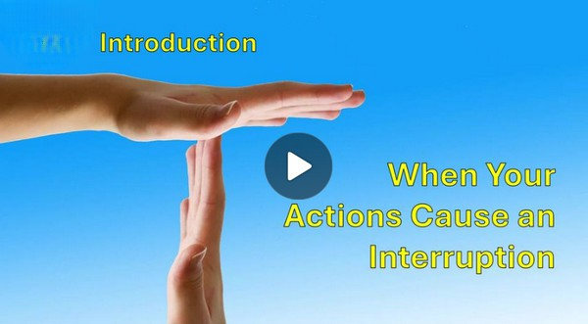
Video Introduction
View Video

Slide 3


That was the time …
What is a mistake you made that you still laugh about today?
Some of our mistakes we are not able to laugh about.
But … God can redeem our mistakes
Would you welcome please Dr. … um … er .. (what was your name”)?
You mean it’s not your birthday or our anniversary?

Slide 4
Listen for intrigue.
Exodus 2:11-15 (NIV) One day, after Moses had grown up, he went out to where his own people were and watched them at their hard labor. He saw an Egyptian beating a Hebrew, one of his own people. 12 Glancing this way and that and seeing no one, he killed the

Slide 5
Listen for intrigue.
Egyptian and hid him in the sand. 13 The next day he went out and saw two Hebrews fighting. He asked the one in the wrong, "Why are you hitting your fellow Hebrew?" 14 The man said, "Who made you ruler and judge over us? Are you thinking of killing me as

Slide 6

Listen for intrigue.
you killed the Egyptian?" Then Moses was afraid and thought, "What I did must have become known." 15 When Pharaoh heard of this, he tried to kill Moses, but Moses fled from Pharaoh and went to live in Midian, where he sat down by a well.

Slide 7
Unintended Consequences
What did Moses see that troubled him?
What actions in verse 12 suggest that what Moses did was intentional but wrong?
What might this reveal about Moses’ sense of justice and identity at that point in his life?
How did his murderous action catch up with him?

Slide 8
Unintended Consequences
What were the consequences he faced that appeared to interrupt his good life and threaten his future?
Why do you think Moses took matters into his own hands instead of seeking God’s direction?
When has taking matters into your own hands made a situation worse?

Slide 9
Listen for another intervention by Moses.
Exodus 2:16 – 22 (NIV) Now a priest of Midian had seven daughters, and they came to draw water and fill the troughs to water their father's flock. 17 Some shepherds came along and drove them away, but Moses got up and came to their rescue and watered their

Slide 10
Listen for another intervention by Moses.
flock. 18 When the girls returned to Reuel their father, he asked them, "Why have you returned so early today?" 19 They answered, "An Egyptian rescued us from the shepherds. He even drew water for us and watered the flock." 20 "And where is he?" he asked his daughters.

Slide 11
Listen for another intervention by Moses.
"Why did you leave him? Invite him to have something to eat." 21 Moses agreed to stay with the man, who gave his daughter Zipporah to Moses in marriage. 22 Zipporah gave birth to a son, and Moses named him Gershom, saying, "I have become an alien in a foreign land."

Slide 12
God Uses Unintended Consequences
What ordinary, daily event became the means of a new opportunity for Moses?
How did Moses once again stand in defense of the abused or helpless ones?
What conversation did Reuel and his daughters have that opened a door for Moses to a new way of life?

Slide 13
God Uses Unintended Consequences
In what ways do you think God used Moses’ years in Midian to prepare him for the greater mission ahead?
How does seeing God’s provision for Moses give us hope in spite of our mistakes?
How can we learn to wait on God’s timing instead of rushing ahead with our own plans?

Slide 14
Listen for God’s purposes.
Exodus 3:5-10 (NIV) "Do not come any closer," God said. "Take off your sandals, for the place where you are standing is holy ground." 6 Then he said, "I am the God of your father, the God of Abraham, the God of Isaac and the God of

Slide 15
Listen for God’s purposes.
Jacob." At this, Moses hid his face, because he was afraid to look at God. 7 The LORD said, "I have indeed seen the misery of my people in Egypt. I have heard them crying out because of their slave drivers, and I am concerned about their suffering.

Slide 16
Listen for God’s purposes.
So I have come down to rescue them from the hand of the Egyptians and to bring them up out of that land into a good and spacious land, a land flowing with milk and honey--the home of the Canaanites, Hittites, Amorites, Perizzites, Hivites and

Slide 17
Listen for God’s purposes.
Jebusites. 9 And now the cry of the Israelites has reached me, and I have seen the way the Egyptians are oppressing them. 10 So now, go. I am sending you to Pharaoh to bring my people the Israelites out of Egypt."

Slide 18
God Benefits Others
How did God identify Himself, and why would that be important?
How did Moses respond? What does that indicate?
How would Moses know that God does care for His people, even though Moses had wondered.

Slide 19
God Benefits Others
Moses had two basic options … accept or reject God’s call. What would have been the consequences of each option?
How does this story show that God’s calling is not canceled by our failures—but often refined through them?
Consequences: Accept God’s Call | Consequences: Reject God’s Call

Slide 20
Application
Ask God’s forgiveness.
If sin put you in the wilderness, confess your sin and receive God’s forgiveness.
Read Psalm 103:10-14; Ephesians 1:7; Colossians 1:14; and 1 John 1:9.

Slide 21
Application
Recall wilderness times from your past.
Reflect on the wilderness seasons of your life.
Look back to times of unexplained waiting and try to determine if God used those times to refine you, from the inside and out.
In God’s hands, consequences aren’t just for correcting but for cultivating.

Slide 22
Application
Follow God’s call.
Moses felt disqualified, just like we do.
Ask the Holy Spirit to guide you as you seek to be obedient to His call.
Following Him is always what is best at every stage of life.

Slide 23
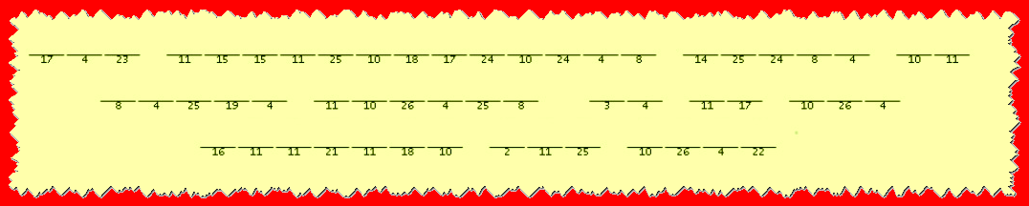
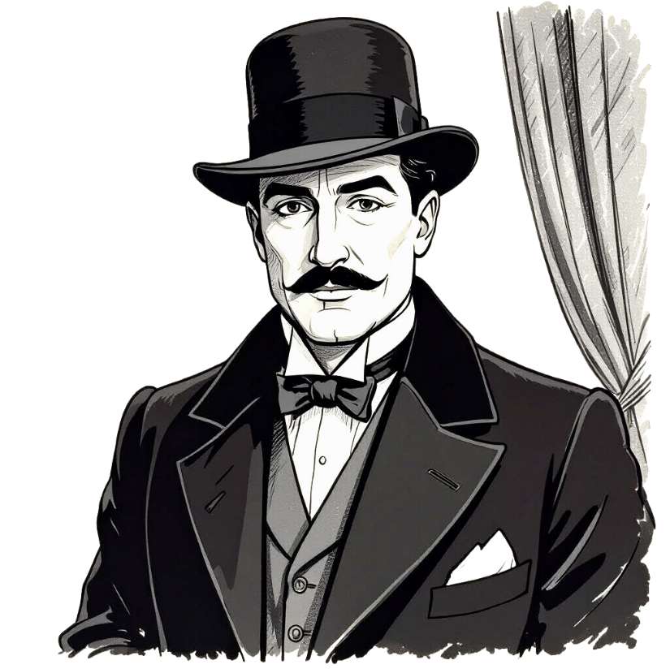
Family Activities
"Mon ami, the Baptist consulate in Kirat Guaybar has received, by a most curious delivery, the fragment of a secret message. It appears that our friends in the underground church wish for you to remember a truth of great importance. And so, it is to you that we turn for the little grey cells! You can find help and the ever-popular color picture at https://tinyurl.com/2s3svswc

Slide 24
When Your Actions Cause an Interruption
November 2

