Slide 1
Disciple Making
Marching Orders

Slide 2

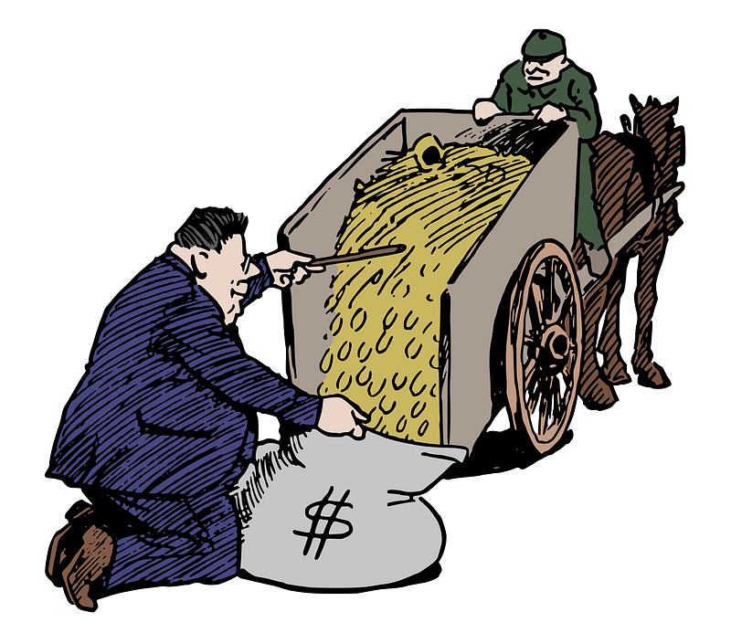
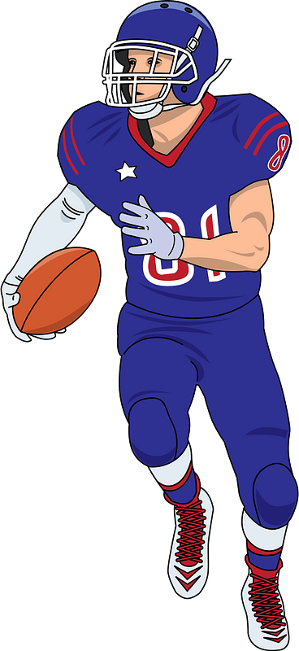
What do you suppose?
If you were to ask someone who calls himself a Christian to describe their his goals, what kind of answers do you think you would get?

Slide 3
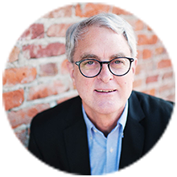
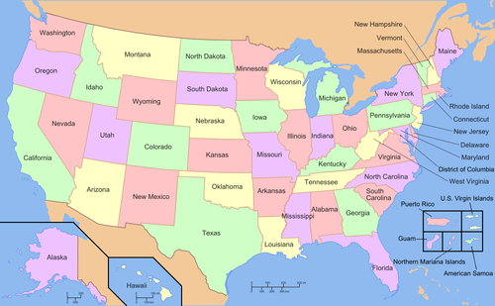


Slide 4


Slide 5
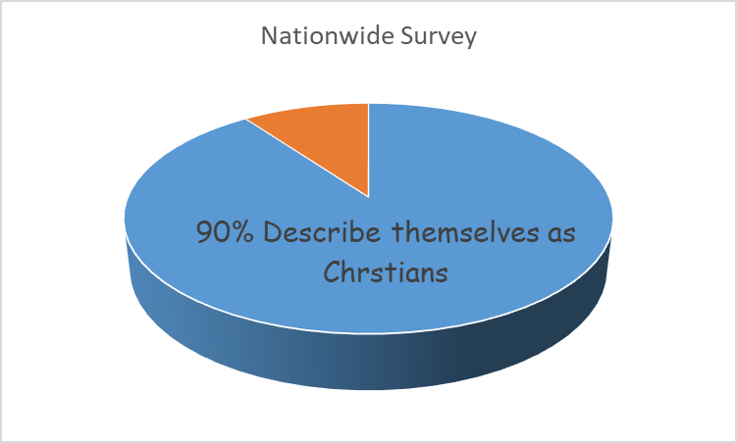

Slide 6
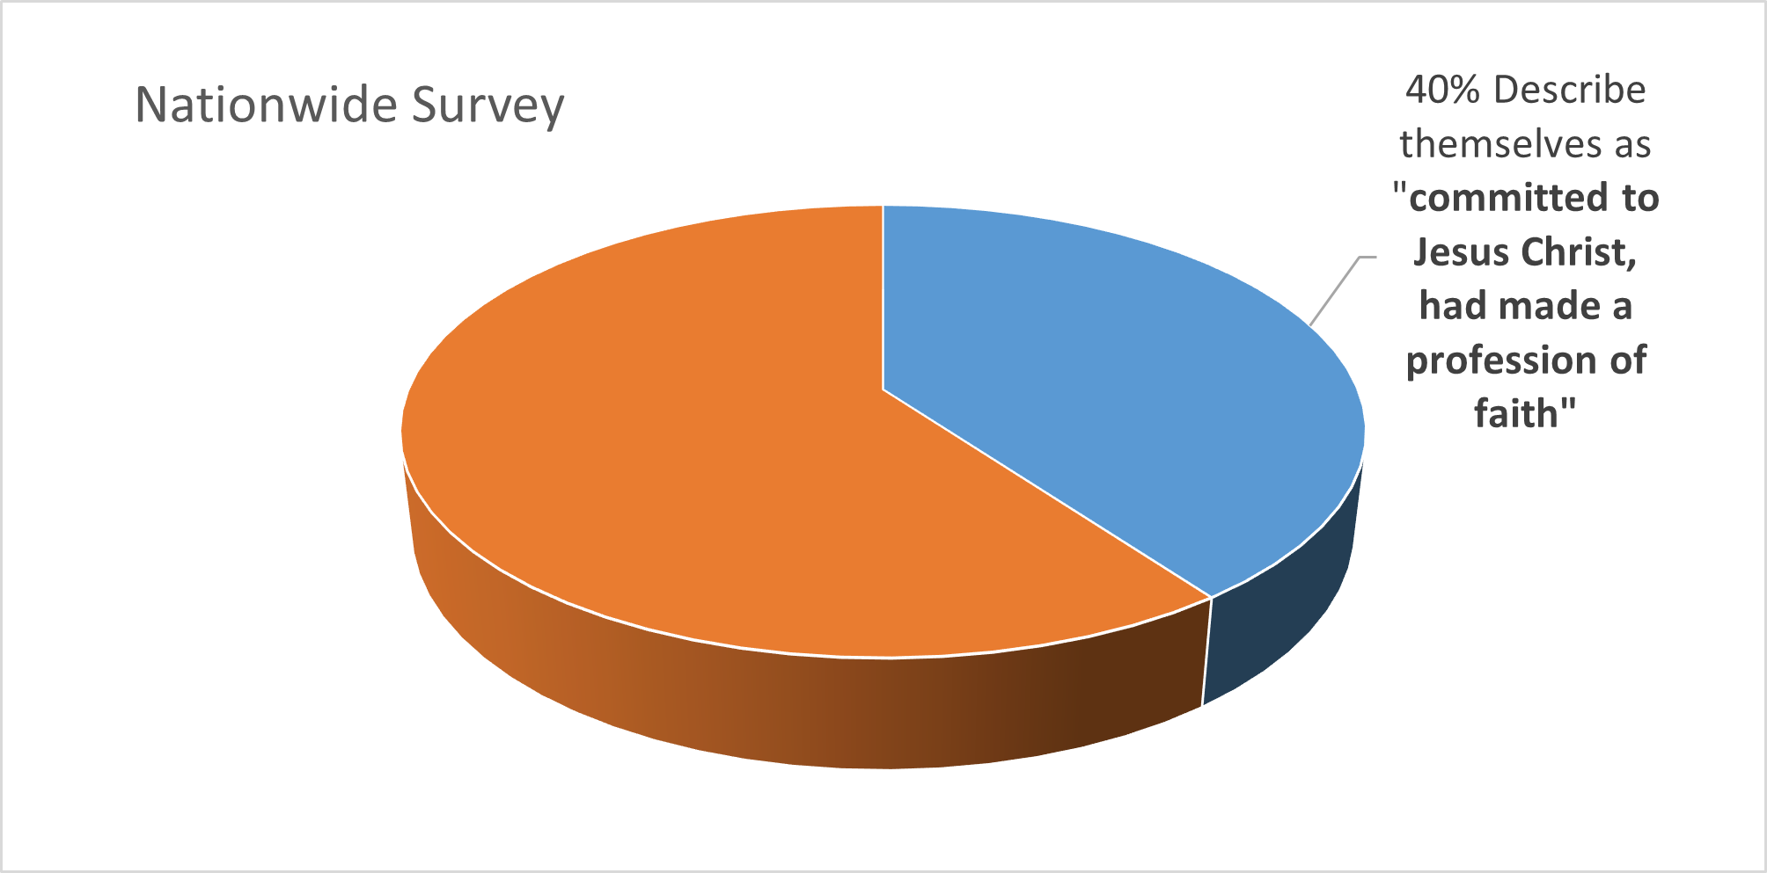

Slide 7
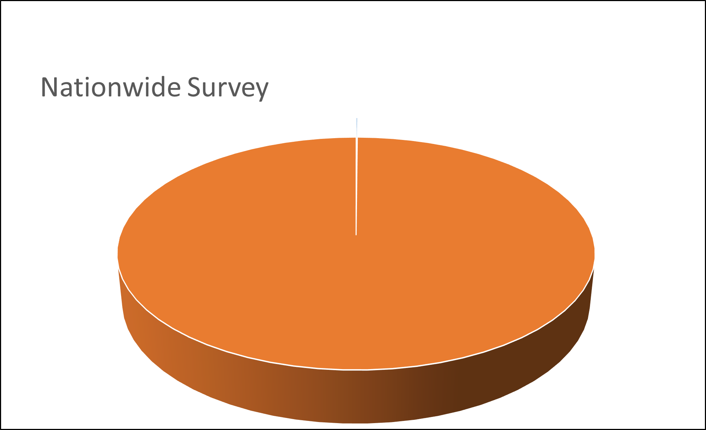
0% Say “life goal” is committed to be a committed follower of Christ or to make disciples

Slide 8
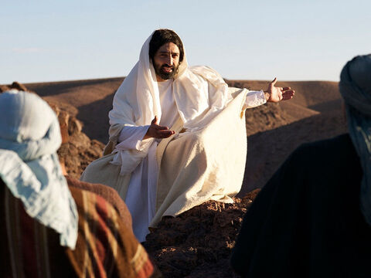
Go and make disciples of all nations

Slide 9
1. Jesus Is Our Authority.

Slide 10

Listen for resulting emotions
Matthew 28:16-18 (NIV) Then the eleven disciples went to Galilee, to the mountain where Jesus had told them to go. 17 When they saw him, they worshiped him; but some doubted. 18 Then Jesus came to them and said, "All authority in heaven and on earth has been given to me.

Slide 11
Jesus Is Our Authority
the eleven disciples went to Galilee, to the mountain where Jesus had told them to go. When they saw him, they worshiped him; but some doubted.
What kind of emotions do you think they felt as they realized Jesus’ physical presence with them may be ending?
What actions did the disciples take?
Why did they feel they should/must worship Him?
Worship is to be experienced corporately with the body of Christ and individually as each person grows as a follower of Christ

Slide 12
Jesus Is Our Authority
What do you think Matthew meant when he said, “But some doubted.” ?
Whatever the case, the turmoil of human emotion to trust Christ and face the challenges of life and ministry is being experienced by the disciples when this command is given.
How did Jesus statement in verse 18 help their doubt, whatever the cause? What would Jesus power and authority mean to them (and to us)?
Then Jesus came to them and said, "All authority in heaven and on earth has been given to me.”

Slide 13
2. Making Disciples Is Our Mission.

Slide 14
Listen for a command (not a suggestion).
Matthew 28:19-20 (NIV) Therefore go and make disciples of all nations, baptizing them in the name of the Father and of the Son and of the Holy Spirit, 20 and teaching them to obey everything I have commanded you.

Slide 15
Making Disciples Is Our Mission
"All authority in heaven and on earth has been given to me.”
Therefore go and make disciples of all nations, baptizing them in the name of the Father and of the Son and of the Holy Spirit, and teaching them to obey everything I have commanded you.
Verse 19 starts with the word “Therefore” … what is that word there for??
What specific commands does Jesus give?

Slide 16
Making Disciples Is Our Mission
Why do you suppose the disciples might not have felt equipped for the task given?
Now days we can go to all nations … we know it includes all cultures, not just Jews. Why do we similarly feel unequipped?

Slide 17
Making Disciples Is Our Mission
So what can we do if due to age or family responsibilities we cannot go overseas?
Where our Bible says “Go and make disciples”, the verb used really is better understood “As you are going …”. What do you think that implies?

Slide 18
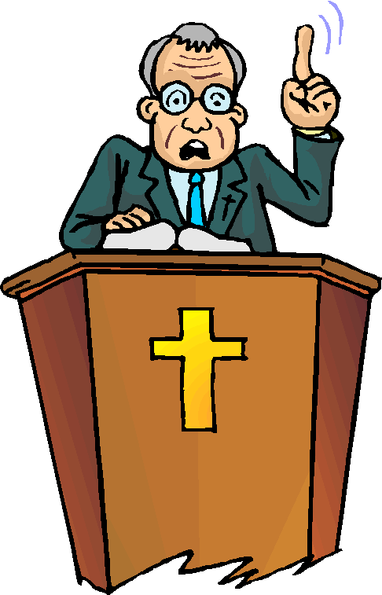


Making Disciples Is Our Mission
What would look different about your church experience if you saw daily ministry in the local church as part of fulfilling the Great Commission?

Slide 19
3. Eternity Is Our Promise.

Slide 20

Listen for a limit.
Matthew 28:20b (NIV) And surely I am with you always, to the very end of the age.“
What two time references do you see here?
How would the disciples (how do we) receive encouragement from this promise?

Slide 21
Eternity Is Our Promise
The NASB translation says, “And behold, I am with you always, to the end of the age.” What do you think it means that we would “behold” Jesus “always” in everyday life?
What kinds of things from every day life get in the way of seeing or “beholding” what he is doing?

Slide 22



Eternity Is Our Promise
What kinds of things can excite us about participating in the Great Commission

Slide 23
Application
Write.
Take time this week to write out your testimony.
Being committed to the mission of God to take the message of the gospel to those who haven’t heard it must begin with a clear understanding of your own story.
Write it down so that when you’re given the opportunity you can share it with clarity.

Slide 24
Application
Share.
This week share the gospel with someone.
Pray that the Holy Spirit would give you an opportunity and then look for that door to open.
When presents itself, simply share your story of how Jesus changed your life.
Invite them to call on the name of the Lord and be saved.

Slide 25
Application
Go.
Pray about being part of God’s mission around the world.
For some of you that might mean giving financially to missions.
For others that might mean actively supporting a missionary with your time, prayers, and support.
Still others might sense the call to go yourselves.
Pray that God will use you, and that you will have the courage to answer His call.

Slide 26
Disciple Making
Marching Orders

