Slide 1
When Well Meaning People Interrupt Your Plans
November 9

Slide 2


Video Introduction
View Video

Slide 3

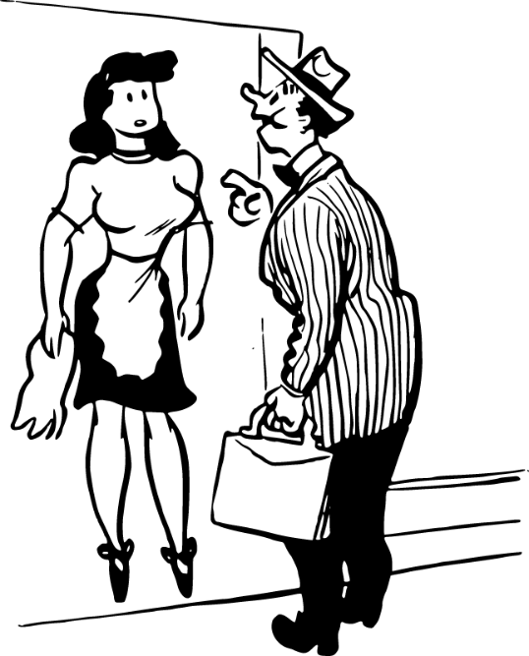
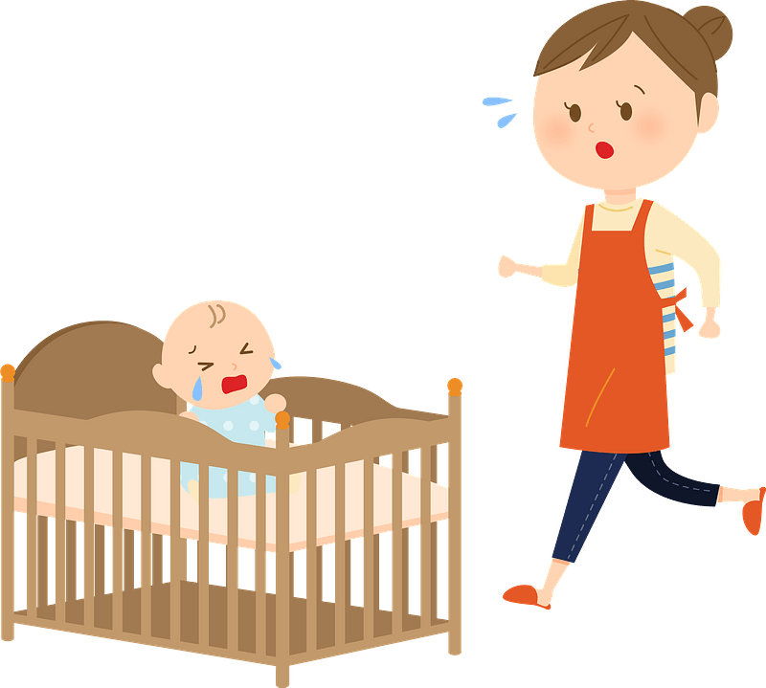
What a pain …
What is a common interruption you face in your daily life?
Today we study a man who had a family health crisis.
Once he got Jesus’ attention they were repeatedly interrupted.
We will consider how God-ordained interruptions call for a sensitive heart.
We need that report by noon

Slide 4
Listen for desperation.
Luke 8:40-42 (NIV) Now when Jesus returned, a crowd welcomed him, for they were all expecting him. 41 Then a man named Jairus, a ruler of the synagogue, came and fell at Jesus' feet, pleading with him to come to his house 42 because his only daughter, a girl of about twelve, was dying. As Jesus was on his way, the crowds almost crushed him.

Slide 5
Serve Others in Need
Jarius was a ruler of a local synagogue. What mixed feelings might he have had as he approached Jesus for help regarding his daughter’s illness?
When problems do come along, what might keep us from bringing our needs to Jesus?
How do people typically respond to an unplanned request to help someone?

Slide 6
Serve Others in Need
How did Jesus respond to his appeal?
Jairus was an important person. He was probably quite religious. But he had a tragic situation. What does that tell us about how life happens?

Slide 7

Serve Others in Need
Why do delays like the pressing crowd put our faith to the test?
Why do delays like the pressing crowd put our faith to the test?

Slide 8
Listen for power going out.
Luke 8:43-50 (NIV) And a woman was there who had been subject to bleeding for twelve years, but no one could heal her. 44 She came up behind him and touched the edge of his cloak, and immediately her bleeding stopped. 45 "Who touched me?" Jesus asked. When they all denied it, Peter said, "Master, the people are crowding and pressing against

Slide 9
Listen for power going out.
you." 46 But Jesus said, "Someone touched me; I know that power has gone out from me." 47 Then the woman, seeing that she could not go unnoticed, came trembling and fell at his feet. In the presence of all the people, she told why she had touched him and how she had been instantly healed. 48 Then he said to her, "Daughter, your faith has healed you. Go in peace."

Slide 10
Interruptions Become Opportunities
How were Jairus and Jesus interrupted on the way to minister to the daughter?
Note that it was ceremonially illegal for her to touch someone … in her condition, it made the other person ceremonially “unclean.” This means that she was quite brave or forward to seek help
What are some other reasons we sometimes reluctant to seek help?

Slide 11
Interruptions Become Opportunities
Despite the legality issue, the woman touched Jesus’ garment … the man wanted Jesus to come and “place your hand” on the little girl … why do you think the touch was important?
Jesus does not make a big deal about the problem of ceremonial cleanness … why do you suppose He reacted that way?

Slide 12
Interruptions Become Opportunities
Jesus is not physically present for us to reach out and touch His garment. So, what can we do?
How can believers distinguish between a God-ordained interruption and a worldly distraction?
Worldly Distraction | God Ordained Interruption

Slide 13
Listen for a miracle.
Luke 8:49-50, 54-56 (NIV) While Jesus was still speaking, someone came from the house of Jairus, the synagogue ruler. "Your daughter is dead," he said. "Don't bother the teacher any more." 50 Hearing this, Jesus said to Jairus, "Don't be afraid; just believe, and she

Slide 14
Listen for a miracle.
will be healed." … 54 But he took her by the hand and said, "My child, get up!" 55 Her spirit returned, and at once she stood up. Then Jesus told them to give her something to eat. 56 Her parents were astonished, but he ordered them not to tell anyone what had happened.

Slide 15
Stay on Track
What dire message came to Jairus concerning his daughter? What emotions do you think Jarius probably had?
What in the passage indicates that people with Jairus were limited in what they believed about Jesus?

Slide 16
Stay on Track
Upon hearing the message, what encouragement did Jesus give to him?
How did Jesus’ manner and words stand in sharp contrast to the mood outside and inside Jairus’s house?
How can God use an interruption for His glory and our good?

Slide 17
Application
Become radically people-oriented.
Create a list of people you know who are facing some type of personal crisis Including physical, spiritual, emotional, familial, relational needs.
Pray that Jesus will go out of His way to meet their needs and make God’s love real for them.

Slide 18
Application
Receive a heart transplant.
Ask God to give you a heart of compassion for people who are hurting.
For people who are desperately in need of what only Jesus can provide.

Slide 19
Application
When you’re afraid, trust Him.
Receive Jesus’s word, “Don’t be afraid. Only believe.”
Reflect on the following verses: Psalm 23:4; 56:3 and Hebrews 13:5b-6.
Trust Him when fear grips your heart when you face the unknown.
Know that He is near to you right now.

Slide 20
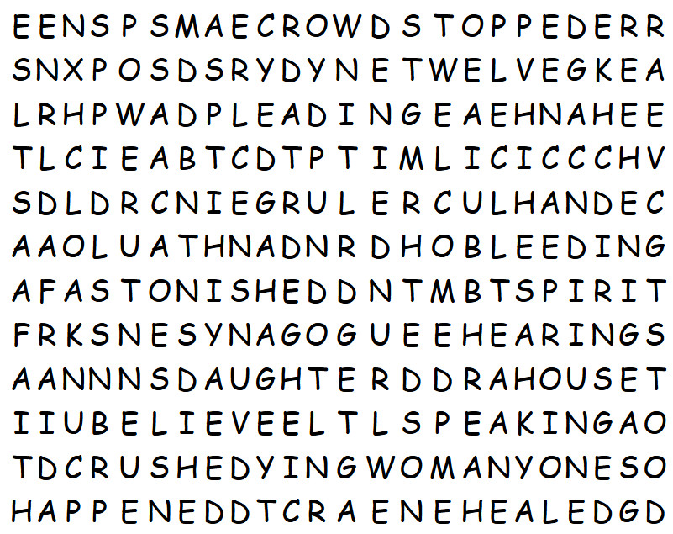
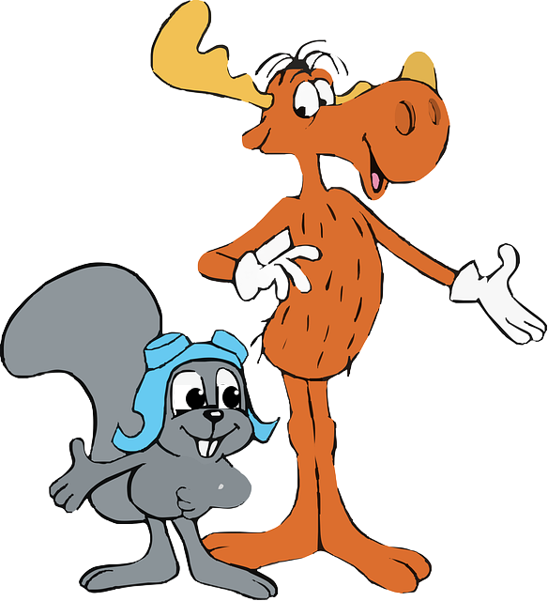
Family Activities
"Hey Rocky! The word search lady says our class gots ta find all the words in this here grid! And get this—there’s a rumor that the other class has been sayin’ we’re slower than a moose in molasses! I betcha we can prove ‘em wrong, though!"

Slide 21
When Well Meaning People Interrupt Your Plans
November 9

