Slide 1
When Materialism Consumes
February 17

Slide 2
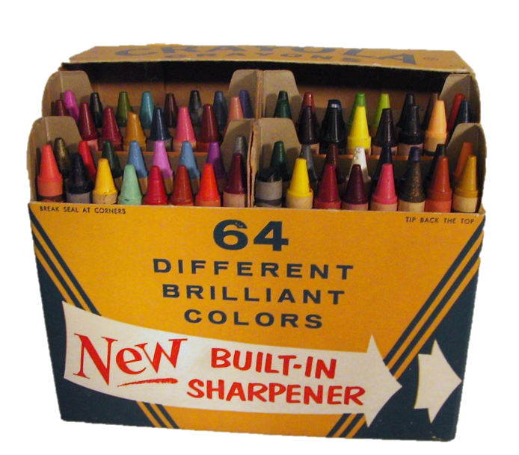
Remember when?
What’s the first thing you remember buying with your own money?
We’re conditioned to value our “stuff” from an early age.
Today we will consider a warning from Scripture about loving our possessions too much.
Possessions never satisfy or last, But, the love of God does

Slide 3
Listen for categories of believers.
1 John 2:12-14 (NIV) I write to you, dear children, because your sins have been forgiven on account of his name. 13 I write to you, fathers, because you have known him who is from the beginning. I write to you, young men, because you have overcome the evil one. I write to you, dear children,

Slide 4
Listen for categories of believers.
because you have known the Father. 14 I write to you, fathers, because you have known him who is from the beginning. I write to you, young men, because you are strong, and the word of God lives in you, and you have overcome the evil one.

Slide 5
Know and Love God
Name the three groups of believers John addresses.
What messages did he give to each group he addresses?
Children | Fathers | Young Men

Slide 6
Know and Love God
Let’s note the phrases in these messages that John used to describe what it means to be part of the family of God
If John meant the titles of the groups to be in a spiritual sense, what do you think he was saying about their spiritual status?

Slide 7
Know and Love God
How has your faith deepened over the years?
So, what would these verses have to do with the theme of our lesson, dealing with the problem of materialism?

Slide 8
Listen for description of “the world”.
1 John 2:15-17 (NIV) Do not love the world or anything in the world. If anyone loves the world, the love of the Father is not in him. 16 For everything in the world--the cravings of sinful man, the lust of his eyes and the boasting

Slide 9
Listen for description of “the world”.
of what he has and does--comes not from the Father but from the world. 17 The world and its desires pass away, but the man who does the will of God lives forever.

Slide 10
Loving the World vs. Loving God
What prohibition does John give to his readers?
What is John talking about when he refers to the “world”?
What does love for the world indicate about a person’s love for God?
What worldly things or values do we substitute for God?

Slide 11
Loving the World vs. Loving God
Why are the things and values of the world so enticing to us?
How can we differentiate between love for God and love for the world?

Slide 12
Loving the World vs. Loving God
What can we expect if we choose the way of the world?
How do we navigate the tension between enjoying our possessions and being consumed by them?

Slide 13
Listen for a definition, description of love.
1 John 3:16-18 (NIV) This is how we know what love is: Jesus Christ laid down his life for us. And we ought to lay down our lives for our brothers. 17 If anyone has material possessions and sees his brother in need but has no pity on him, how can the love of God be in him? 18 Dear children, let us not love with words or tongue but with actions and in truth.

Slide 14
Show that You Love God
So according to this passage, how do we know what love is?
How then should Christians love? If God’s loves dwells with us, what ought we to be willing to do with the resources we have at our disposal?
Why is it easier to love with words rather than actions?

Slide 15
Show that You Love God
What are some not-so-apparent needs of different age groups in our church?
Why do we sometimes fail to help these groups meet their needs, even if we are aware?
What steps can we take to overcome reluctance to help those we see in need?

Slide 16
Application
View Application Video

Slide 17
Application
Pray.
Ask the Lord to help you love Him more than anything.
Pray that others would see your love and heart for Christ through your actions.

Slide 18
Application
Evaluate.
Chart the many ways you use your money.
List the possessions you own and their relative value.
Consider what your possessions and finances reveal about your priorities and goals in life.
Is it evident that you love the Lord by what you do with what you have?

Slide 19
Application
Give.
Think about tangible ways you can help someone in need.
Find ways to use your possessions for the benefit of others.
Give things away as necessary as you seek to express the love of Christ to others.

Slide 20
Family Activities
Don’t get all crazy! The Family Activities web site has a crossword and other fun things for the whole gang. Go to
https://tinyurl.com/ydz8jcz9
What do you mean there’s no crossword on the handout ! ? ?

Slide 21
When Materialism Consumes
February 17

