Slide 1
When Life Is Expendable
January 20

Slide 2
View Video

Slide 3
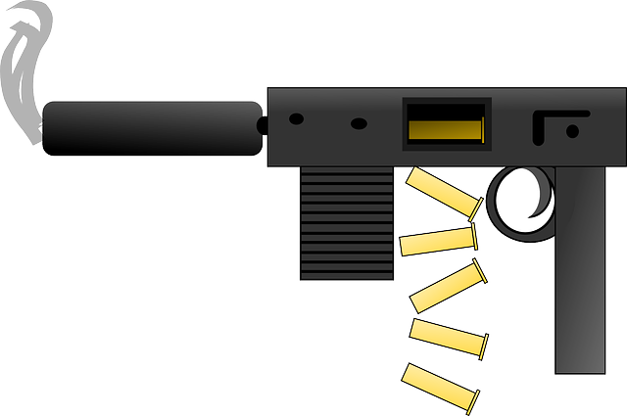
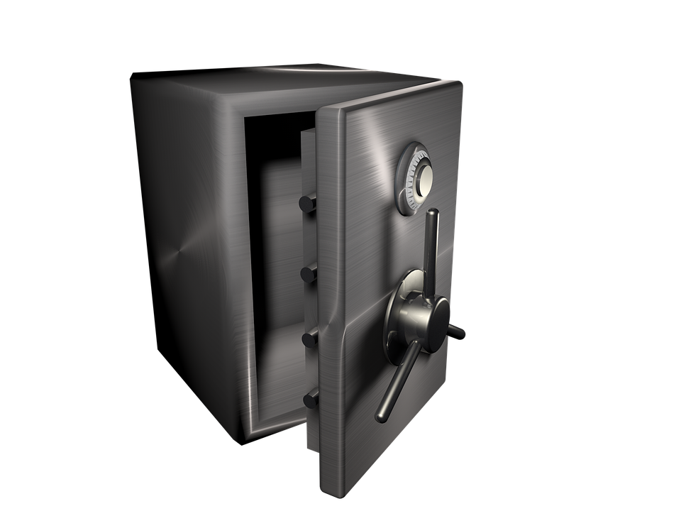
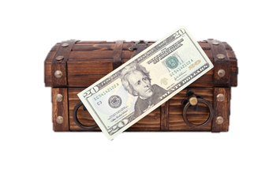
Admit it now …
When have you gone to great lengths to protect something of value?
You have probably often felt that God has intervened to protect your life.
We use everything from seat belts to home security systems.
All life is a gift from God we are to protect and preserve.

Slide 4
Listen for civil disobedience.
Exodus 1:15-17 (NIV) The king of Egypt said to the Hebrew midwives, whose names were Shiphrah and Puah, 16 "When you help the Hebrew women in childbirth and observe them on the delivery stool, if it is a boy, kill him; but if it is a girl, let her live." 17 The midwives, however, feared God and did not do what the king of Egypt had told them to do; they let the boys live.

Slide 5
Respect Human Life
What was the king’s plan? What did the king tell the midwives to do?
What did he hope to accomplish by taking the lives of male children but allowing the females to live?
What are some ways our culture devalues life?
How did the midwives respond, at least in practice?

Slide 6
Respect Human Life
What risks would be involved in disobeying the orders of a king?
Why does the Bible imply that this civil disobedience was acceptable?
What parallel does that have in our society today in America?

Slide 7
Respect Human Life
God does not condone violence to oppose such government policies … what other possibilities exist in taking stands against legal murder of unborn babies?
⇨ Inappropriate decisions by our government and our culture are the results of people’s need for Jesus in their lives
⇨ Communicating this truth and praying for revival may well do more to change the prevailing attitudes than only protesting.

Slide 8
Listen for more civil disobedience.
Exodus 1:22 – 2:3 (NIV) Then Pharaoh gave this order to all his people: "Every boy that is born you must throw into the Nile, but let every girl live." 1 Now a man of the house of Levi married a Levite woman, 2 and she became pregnant and gave birth to a son. When she saw that he was a fine child,

Slide 9
Listen for more civil disobedience.
she hid him for three months. 3 But when she could hide him no longer, she got a papyrus basket for him and coated it with tar and pitch. Then she placed the child in it and put it among the reeds along the bank of the Nile.

Slide 10
Do What You Can to Protect Others
His previous efforts having been ineffective, what was Pharaoh’s next plan?
What made this plan even worse than the previous plans?
What is the connection between Pharaoh’s latest command and the birth of a baby boy to a Hebrew couple from the tribe of Levi?

Slide 11
Do What You Can to Protect Others
What risky decisions did the mother take to protect her child? What action did she take?
How does God work in people’s hearts despite unjust and wicked laws against them?

Slide 12
Note some fascinating parallels between Moses and Jesus
Moses | Jesus
Israel needed a deliverer, God sent a baby: Moses | The world needed a Savior, God sent a baby: Jesus
Moses born in Egypt | Jesus spent part of His childhood in Egypt
Pharaoh killed baby boys | Herod killed baby boys
Moses spent 40 years in the wilderness | Jesus spent 40 days in the wilderness

Slide 13
Listen for Moses’ mother’s provision.
Exodus 2:4-9 (NIV) His sister stood at a distance to see what would happen to him. 5 Then Pharaoh's daughter went down to the Nile to bathe, and her attendants were walking along the river bank. She saw the basket among the reeds and sent her slave girl to get it. 6 She opened it and saw the baby. He was crying, and she felt sorry for him. "This is one of the Hebrew babies

Slide 14
Listen for Moses’ mother’s provision.
she said. 7 Then his sister asked Pharaoh's daughter, "Shall I go and get one of the Hebrew women to nurse the baby for you?" 8 "Yes, go," she answered. And the girl went and got the baby's mother. 9 Pharaoh's daughter said to her, "Take this baby and nurse him for me, and I will pay you." So the woman took the baby and nursed him.

Slide 15
Do What You Can to Provide for Others
What additional action does it appear the mother took to provide care for the baby boy?
Even if the mother anticipated that Pharaoh’s daughter would come to the river, what was the risk if the young woman discovered the child?

Slide 16
Do What You Can to Provide for Others
In what ways were the three females in this story—the mother, the sister, and Pharaoh’s daughter—able to provide care for the baby?
Where do you see God at work in this story?

Slide 17
Do What You Can to Provide for Others
Statistics:
On any given day, over 400,000 children are in foster care.
Over 100,000 of those in foster care are waiting to be adopted.
The average age of a child in foster care waiting to be adopted is 8.5 years old.
How can we support adoption and foster care as a means of providing for children?

Slide 18
Application
Pray.
Pray daily for the thousands of unborn babies who are at risk right now.
Pray for the women and families that have been impacted by abortion.
Pray for our politicians and officials to enact pro-life legislation.

Slide 19
Application
Discover.
Find out what ministries in your community support life and offer hope to those who feel helpless.

Slide 20
Application
Get involved.
Find others in your community— the unborn, the aged, or those with physical and/or mental challenges—and work to see that they are not forgotten or devalued by society.
Help them find their purpose and worth in Christ.

Slide 21
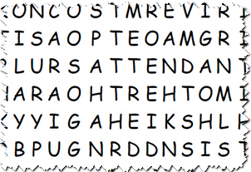
Family Activities
Help me find the mixed up words. There’s other fun Family Activities at https://tinyurl.com/yb24f7z8

Slide 22
When Life Is Expendable
January 20

