Slide 1
When Life Goes Terribly Wrong
October 26

Slide 2

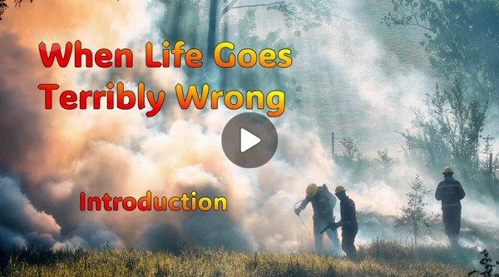
Video Introduction
View Video

Slide 3
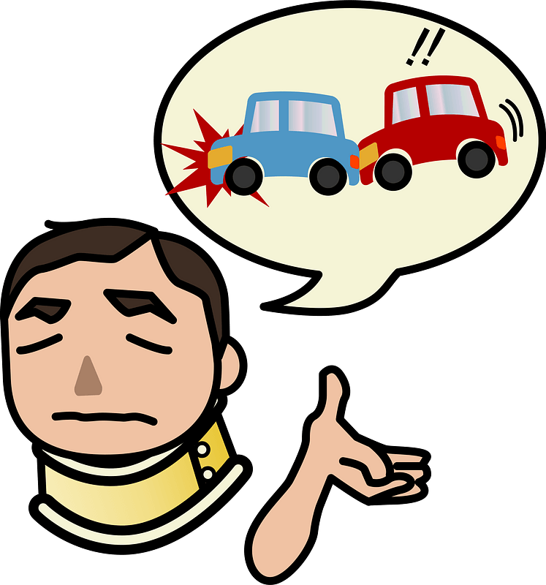
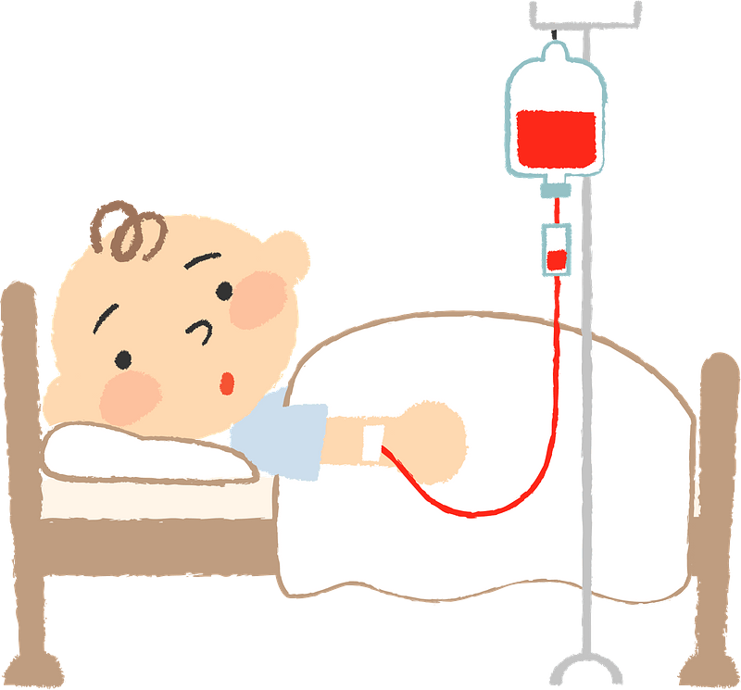

It was scary …
When have you been caught off guard by a “plot twist” in real life?
We all have occasional hard interruptions in life.
Today we consider the fact that hard interruptions place us where God can use us.

Slide 4
Listen for Joseph’s new job.
Genesis 39:21-23 (NIV) the LORD was with him; he showed him kindness and granted him favor in the eyes of the prison warden. 22 So the warden put Joseph in charge of all those held in the prison, and

Slide 5
Listen for Joseph’s new job.
he was made responsible for all that was done there. 23 The warden paid no attention to anything under Joseph's care, because the LORD was with Joseph and gave him success in whatever he did.

Slide 6
God’s Favor Is Not Hindered
In what ways does this episode parallel Joseph’s rise to success in Potiphar’s house?
What evidence suggests that Joseph made diligent effort even in dark circumstances?
When have you questioned God due to your circumstances?
What is your first reaction when someone acts unjustly towards you?

Slide 7
God’s Favor Is Not Hindered
Why do our circumstances affect our view of God’s love and loyalty to us?
What are the ways that God shows grace to you during setbacks in your life?
So, how do we remain faithful when we find ourselves where we didn’t expect to be?

Slide 8
Listen for two dreamers.
Genesis 40:5-8 (NIV) each of the two men--the cupbearer and the baker of the king of Egypt, who were being held in prison--had a dream the same night, and each dream had a meaning of its own. 6 When Joseph came to them the next morning, he saw that they were dejected. 7 So he

Slide 9
Listen for two dreamers.
asked Pharaoh's officials who were in custody with him in his master's house, "Why are your faces so sad today?" 8 "We both had dreams," they answered, "but there is no one to interpret them." Then Joseph said to them, "Do not interpretations belong to God? Tell me your dreams."

Slide 10
God Can Use Any Situation
What did Joseph ask Pharaoh’s officials, and what was their answer?
What did Joseph say about dreams?
How might Joseph have recognized that he was in prison for a purpose?

Slide 11
God Can Use Any Situation
Do you think the ability to interpret dreams a common spiritual gift or a limited, biblical experience?
What do you find most remarkable about Joseph’s faith?
What are some little ways that allow us to demonstrate God’s concern to others?

Slide 12
Listen for a twist in the plot.
Genesis 41:10-14 (NIV) Pharaoh was once angry with his servants, and he imprisoned me and the chief baker in the house of the captain of the guard. 11 Each of us had a dream the same night, and each dream had a meaning of its own. 12 Now a young Hebrew was there with us, a servant of the captain of the guard. We told him our dreams, and

Slide 13
Listen for a twist in the plot.
he interpreted them for us, giving each man the interpretation of his dream. 13 And things turned out exactly as he interpreted them to us: I was restored to my position, and the other man was hanged." 14 So Pharaoh sent for Joseph, and he was quickly brought from the dungeon. When he had shaved and changed his clothes, he came before Pharaoh.

Slide 14
Faithfulness to God
Who is the speaker in verses 10-13? What did he suddenly remember?
How did the butler’s remembrance of Joseph benefit Joseph and open the door for a greater opportunity?

Slide 15
Faithfulness to God
How can a difficult period in your life prepare you for a greater opportunity?
How has faithfulness in small situations opened the door for larger opportunities in your life?

Slide 16
Application
Pray about everything.
Develop the habit of conversing with God about your daily experiences and emotions.
Read 1 Thessalonians 5:17 and 1 Peter 5:7, then pray throughout the day.

Slide 17
Application
Fuel your faith.
God is bigger than your problems, pain, fears, and future.
Make a list of your current trials and difficulties.
Read and reflect on these verses this week with your list of troubles in hand: Job 42:2; Matthew 10:29-31; 19:26; 2 Corinthians 4:16-18; 1 Peter 1:6-7.

Slide 18
Application
Reconsider your perspective about suffering.
Life is hard and unfair. People can be thoughtless and cruel.
But God is good.
Meditate on what Joseph said to his brothers in Genesis 50:20.
How could that perspective help you?

Slide 19
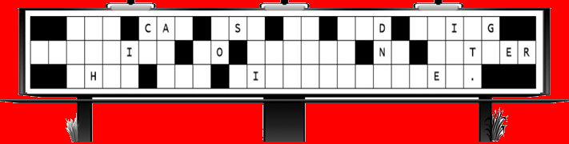



Family Activities
Help !! The letters got blown off the church sign. They fell straight down, but not in order. We need them back in place. Before you lose power, download the crossword puzzle.

Slide 20
When Life Goes Terribly Wrong
October 26

