Slide 1
Disciple Making
A Vision for Discipleship

Slide 2

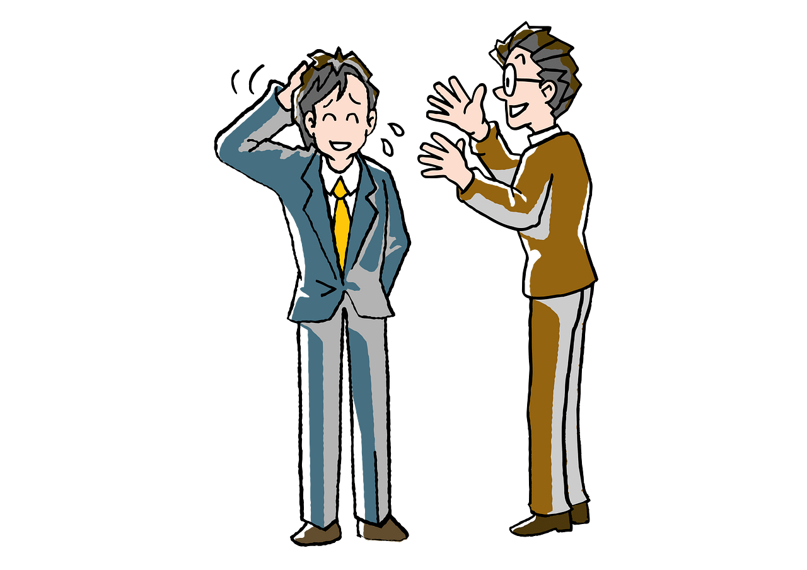
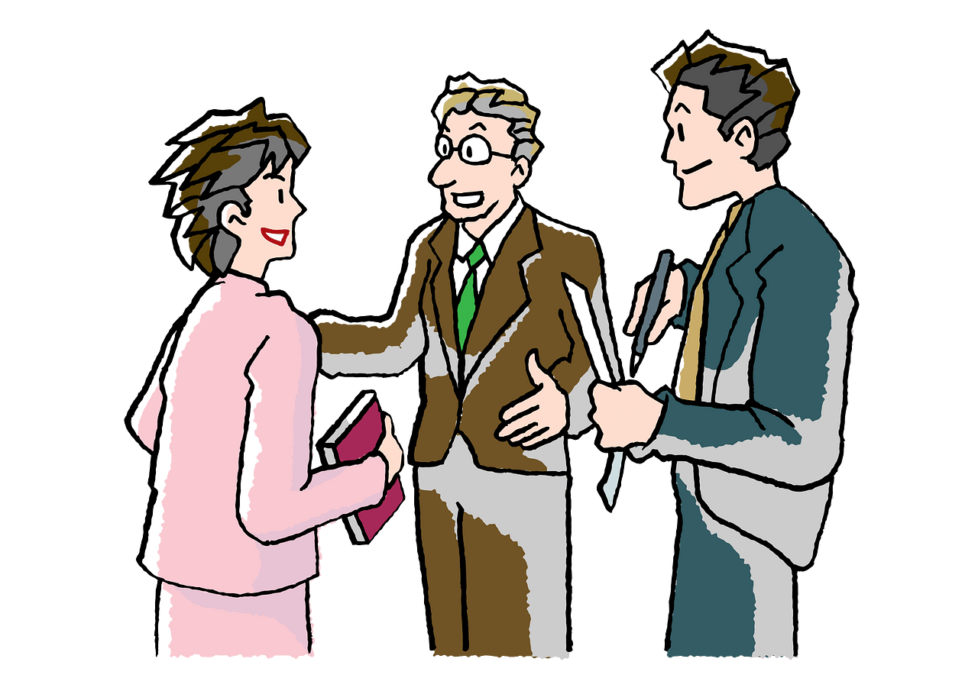
What to do ?
Think of a recent “impossibly busy day”. How do you make time for things that matter when demands of the day seem never ending?
Today we consider a spiritual priority.
Involvement in making disciples.

Slide 3
1. A vision for discipleship means seeing people the way Jesus sees them.

Slide 4
Listen for Jesus’ compassion.
Matthew 9:2-8 (NIV) Some men brought to him a paralytic, lying on a mat. When Jesus saw their faith, he said to the paralytic, "Take heart, son; your sins are forgiven." 3 At this, some of the teachers of the law said to themselves, "This fellow is blaspheming!" 4 Knowing their thoughts, Jesus said,

Slide 5
Listen for Jesus’ compassion.
"Why do you entertain evil thoughts in your hearts? 5 Which is easier: to say, 'Your sins are forgiven,' or to say, 'Get up and walk'? 6 But so that you may know that the Son of Man has authority on earth to forgive sins...." Then he said to the paralytic, "Get up, take your mat and go home."

Slide 6
See People as Jesus Sees Them
Knowing their thoughts, Jesus said, "Why do you entertain evil thoughts in your hearts? Which is easier: to say, 'Your sins are forgiven,' or to say, 'Get up and walk'? 6 But so that you may know that the Son of Man has authority on earth to forgive sins...."
Jesus implies the man needs two kinds of healing … spiritual as well as physical.
Why do you think Jesus declared the man’s forgiveness first?
What did Jesus show by responding to what the Pharisees were thinking?

Slide 7
See People as Jesus Sees Them
Why is it easier to say, “Your sins are forgiven” than to tell a paralyzed person, “You are healed”?
What was Jesus proving about Himself whenever He healed diseases and forgave sinners?
What difference does it make to us today that Jesus not only has power over sickness, but also the authority to forgive sins?

Slide 8
See People as Jesus Sees Them
How does this story help you understand the kinds of healing we all need?
What other kinds of healing might Jesus see and act upon in our culture today?

Slide 9
2. A vision for discipleship means seeing individuals who need Jesus.

Slide 10
Listen for how Jesus described the little girl’s condition.
Matthew 9:18-19, 23-26 (NIV) While he was saying this, a ruler came and knelt before him and said, "My daughter has just died. But come and put your hand on her, and she will live." [19] Jesus got up and went with him, and so did his disciples. … 23 When Jesus entered the ruler's

Slide 11
Listen for how Jesus described the little girl’s condition.
house and saw the flute players and the noisy crowd, [24] he said, "Go away. The girl is not dead but asleep." But they laughed at him. [25] After the crowd had been put outside, he went in and took the girl by the hand, and she got up. [26] News of this spread through all that region.

Slide 12
Seeing People Who Need Jesus
The man was an important person, a “ruler.” Why do you think he man asked Jesus to help him?
What did Jesus do that demonstrated that He prioritized the needs of this family?
My daughter has just died. But come and put your hand on her, and she will live." Jesus got up and went with him, and so did his disciples

Slide 13
Seeing People Who Need Jesus
In previous verses, we see that Jesus was busy answering questions, discussing with John’s disciples. Why do you think He cut off that conversation and immediately went with the man?

Slide 14
Seeing People Who Need Jesus
How can we demonstrate that we prioritize bringing needy people to Jesus?
Why is seeing and serving individuals, and not just the crowd, both the important and urgent work of the church?

Slide 15
3. A vision for discipleship means participating in Christ’s compassion for the masses by living on mission for Him.

Slide 16
Listen for a farming metaphor.
Matthew 9:35-38 Jesus went through all the towns and villages, teaching in their synagogues, preaching the good news of the kingdom and healing every disease and sickness. [36] When he saw the crowds, he had compassion on them, because they were

Slide 17
Listen for a farming metaphor.
harassed and helpless, like sheep without a shepherd. [37] Then he said to his disciples, "The harvest is plentiful but the workers are few. [38] Ask the Lord of the harvest, therefore, to send out workers into his harvest field."

Slide 18
Live on Mission for Jesus
What ministries was Jesus involved in?
Jesus went through all the towns and villages, teaching in their synagogues, preaching the good news of the kingdom and healing every disease and sickness.

Slide 19
Live on Mission for Jesus
What facts characterize the lost?
What kinds of situations would demonstrate those characterizations in people’s lives today?
When he saw the crowds, he had compassion on them, because they were harassed and helpless, like sheep without a shepherd.

Slide 20
Live on Mission for Jesus
The passage states that Jesus “had compassion” -- what is the difference between compassion and warm feelings? Between compassion and sympathy?
Warm Feelings & Sympathy | Compassion

Slide 21
Live on Mission for Jesus
Then he said to his disciples, "The harvest is plentiful but the workers are few. Ask the Lord of the harvest, therefore, to send out workers into his harvest field."
What kind of views, opinions, feelings do we have about witnessing when we see a crowd of people?
What did Jesus say about the opportunities to share the Good News?
What then, are we supposed to do about that?
Listen to a challenge from Charlie Kirk

Slide 22


Slide 23
Application
See people as Jesus saw them.
We see lots of physical needs and bring them to Jesus in prayer
See other needs – spiritual, relational, stewardship, addictions
Pray for and point people with all kinds of needs

Slide 24
Application
Become involved in ministry to others
Our church has many opportunities to serve
Surprise a staff member by offering to volunteer

Slide 25
Application
Become aware of opportunities to serve outside our church.
Volunteering in secular contexts – schools, sports, museums, …
Allow meeting people with different backgrounds and needs

Slide 26
Disciple Making
A Vision for Discipleship

