Slide 1
When God
Interrupts Your Life
October 19

Slide 2

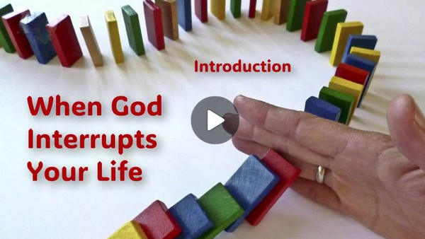
Video Introduction
View Video

Slide 3



It was surreal …
What are some good situations when you experienced an interruption?
Sometimes interruptions are OK, sometimes just rude.
  The best interruptions come from God!

Slide 4
Listen for phrases, “by faith”.
Hebrews 11:8-12 (NIV) By faith Abraham, when called to go to a place he would later receive as his inheritance, obeyed and went, even though he did not know where he was going. 9 By faith he made his home in the promised land like a stranger in a foreign country; he lived in tents, as did Isaac

Slide 5
Listen for phrases, “by faith”.
and Jacob, who were heirs with him of the same promise. 10 For he was looking forward to the city with foundations, whose architect and builder is God. 11 By faith Abraham, even though he was past age--and Sarah herself was barren--was enabled

Slide 6
Listen for phrases, “by faith”.
to become a father because he considered him faithful who had made the promise. 12 And so from this one man, and he as good as dead, came descendants as numerous as the stars in the sky and as countless as the sand on the seashore.

Slide 7
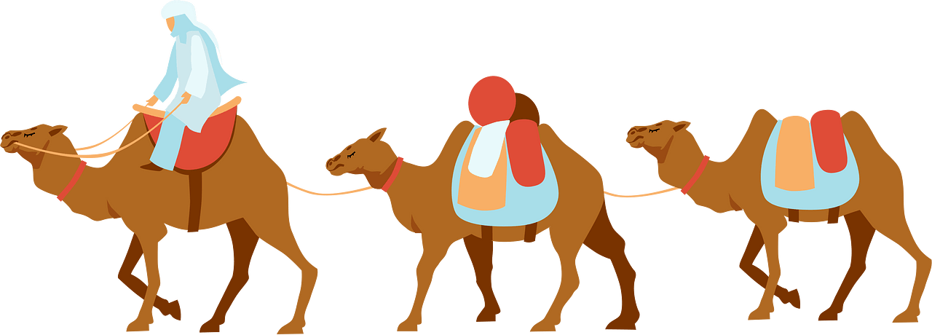
Trust the Changes God Makes
Who are the examples of faith in these verses?
How did Abraham demonstrate faith?
What risks were involved in leaving?

Slide 8
Trust the Changes God Makes
How do people often respond when life changes directions in a way they didn’t expect?
When might God interrupt what you are doing to point you in a different direction?

Slide 9
Listen for potential disappointment.
Hebrews 11:13-16 (NIV) All these people were still living by faith when they died. They did not receive the things promised; they only saw them and welcomed them from a distance. And they admitted that they were aliens and strangers on earth. 14 People who say such things show that they are

Slide 10
Listen for potential disappointment.
looking for a country of their own. 15 If they had been thinking of the country they had left, they would have had opportunity to return. 16 Instead, they were longing for a better country--a heavenly one. Therefore God is not ashamed to be called their God, for he has prepared a city for them.

Slide 11
Greater Purpose behind God’s Plan
Verse 13 says these people were still living by faith when they died, not receiving those things promise. Yet what evidence of their faith is described in that same verse?
What desire did these people of faith have?
How would God honor that desire?

Slide 12
Greater Purpose behind God’s Plan
The heroes of faith “did not receive the things promised” but only saw them from afar. How might that reality have felt like an interruption to their plans or expectations?
Why do you think God allowed them to live as “strangers and exiles” instead of giving them immediate fulfillment?

Slide 13
Greater Purpose behind God’s Plan
How might God use interruptions to redirect us toward His promises instead of our comfort zones?
What kinds of things do we trust the Lord for but might not see happen while we are still in this life?
How has helped you remain faithful while waiting for God to fulfill a promise?

Slide 14
Listen for a test.
Hebrews 11:17-19 (NIV) By faith Abraham, when God tested him, offered Isaac as a sacrifice. He who had received the promises was about to sacrifice his one and only son, 18 even though

Slide 15
Listen for a test.
God had said to him, "It is through Isaac that your offspring will be reckoned." 19 Abraham reasoned that God could raise the dead, and figuratively speaking, he did receive Isaac back from death.

Slide 16
Trust God’s Plan
What do you think Abraham might have felt when God told him to sacrifice Isaac—the very son of promise?
Why could Abraham have argued God’s request was unreasonable and irresponsible?

Slide 17
Trust God’s Plan
How does verse 19 (“Abraham reasoned that God could even raise the dead”) show the depth of his trust?
What are some modern-day “Isaacs”—things or people we might be tempted to hold back from God instead of trusting Him completely?

Slide 18
Application
Shift your focus.
  Meditate on Scriptures about heaven.
  (Matt. 6:19-21; John 14:1-4; Rev. 21:1-4,22-27; 22:1-5).
  Read Randy Alcorn’s book, Heaven.
  Sing songs about what it will be like when you are home with Him.

Slide 19
Application
Follow God’s leading.
  Train yourself to obey God immediately.
  When He urges you to pray with a friend, help someone financially, or share the gospel—don’t ignore Him.
  Obeying God’s leading opens doors to experiencing Him in wonderful ways.

Slide 20
Application
Learn to reason by faith.
  When challenges arose, Abraham considered what is unchangeable and true about God before deciding what to do.
  God’s Word, prayer, and wise counsel set godly guardrails when life gets confusing.

Slide 21
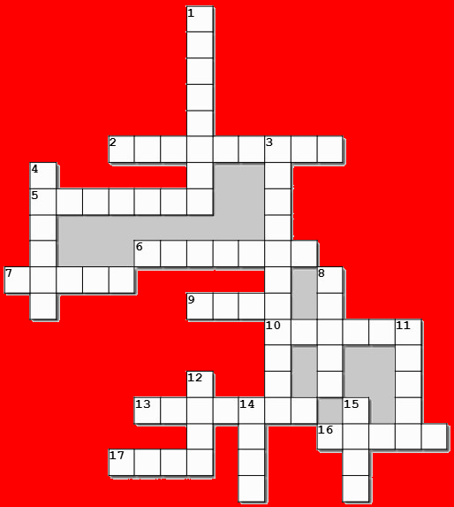
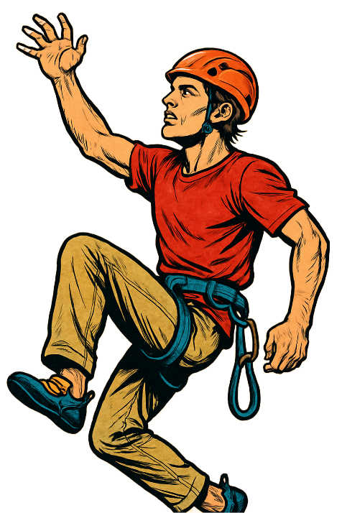

Family Activities
Not only did Sir Edmund Hillary conquer Everest. Here we observe him conquering this week’s Crossword. See if you can beat him to the summit. You can get help (and other challenges) at https://tinyurl.com/32wtytda

Slide 22
When God
Interrupts Your Life
October 19

