Slide 1
When Circumstances Overwhelm
January 27

Slide 2

Introduction
View Video

Slide 3

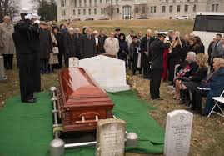
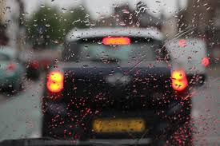
Admit it now …
When do you tend to get “the blues”?
Sometimes circumstances threaten to make us overwhelmed.
  Today we look at how the psalmist handled that feeling
  God lifts us up when circumstances pull us down.

Slide 4
Listen for emotions expressed.
Psalm 42:1-3 (NIV) As the deer pants for streams of water, so my soul pants for you, O God. 2 My soul thirsts for God, for the living God. When can I go and meet with God? 3 My tears have been my food day and night, while men say to me all day long, "Where is your God?"

Slide 5
Feeling Abandoned, Longing for God
What image did the psalmist used to describe his sense of despair?
What questions did the psalm writer ask?
How did he describe God?
What are gods or idols or deities that his description would exclude?

Slide 6
Feeling Abandoned, Longing for God
What are idols in our day and our culture that are not sufficient to console us or ultimately satisfy?
How can our circumstances make us feel abandoned, alone, or far from God?
What is the right attitude to have when venting your doubts and frustrations to the Lord in prayer?

Slide 7
Feeling Abandoned, Longing for God
How can we follow the psalm writer’s example in dealing with our doubts and depression?
How can we guard against a rebellious spirit?

Slide 8
Listen for confession and repentance.
Psalm 42:6-8 (NIV) 6 my God. My soul is downcast within me; therefore I will remember you from the land of the Jordan, the heights of Hermon--from Mount Mizar. 7 Deep calls to deep in the roar of your waterfalls; all your waves and breakers have swept over me. 8 By day the LORD directs his love, at night his song is with me-- a prayer to the God of my life.

Slide 9
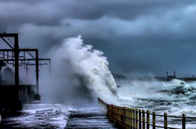
Overwhelmed? Remember God Is Here.
What imagery did the psalm writer use to describe God’s involvement in his suffering?
Note a modern paraphrase of the description of suffering
Chaos calls to chaos, to the tune of whitewater rapids. Your breaking surf, your thundering breakers crash and crush me.

Slide 10
Overwhelmed? Remember God Is Here.
Though in a great spiritual struggle, what does the psalmist determine to do?
What did he remember about God? What encouraged him? How did the psalm writer counter his depression

Slide 11
Overwhelmed? Remember God Is Here.
When you feel overwhelmed, what truths about God help you put one foot in front of the other?
What does this psalm teach us about prayer?

Slide 12
Listen for determination.
Psalm 43:3-5 (NIV) Send forth your light and your truth, let them guide me; let them bring me to your holy mountain, to the place where you dwell. 4 Then will I go to the altar of God, to God, my joy and my delight. I will praise you with the harp, O God, my God. 5 Why are you downcast, O my soul? Why so disturbed within me? Put your hope in God, for I will yet praise him, my Savior and my God.

Slide 13
Trust God’s Guidance, Hope in Him
What did the psalmist petition God to do?
What do you think is God’s "holy mountain"?
How does the world respond when trouble comes their way?

Slide 14
Trust God’s Guidance, Hope in Him
What alternative advice concludes the psalm?
So, what does it mean to "put your hope in the Lord"?

Slide 15

Application
View Video

Slide 16
Application
Talk to God.
  If you are hurt, angry, or disappointed with God because of your circumstances, talk to Him about it.
  The psalmist wrote honestly about his feelings and circumstances
  An honest prayer is the place to start in getting rightly focused on God.

Slide 17
Application
Worship.
  Make a concerted effort to worship God.
  Worship and praise during your private devotional life.
  Actively engage with others as you worship at church.

Slide 18
Application
Talk to someone.
  Do a serious personal evaluation about what causes depression in your life.
  Admit that it is real and it is serious.
  It might be time to talk with a close friend, pastor, or counselor about it.

Slide 19

Family Activities
I’m telling you, there’s more than just this lesson. You can engage your kids and grandkids, your in-laws and outlaws in some of these same topics by going to https://tinyurl.com/y9vmxy2x

Slide 20
When Circumstances Overwhelm
February 27

