Slide 1
What Should We Do Now?
July 1

Slide 2
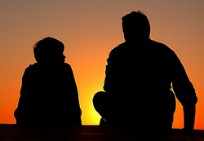
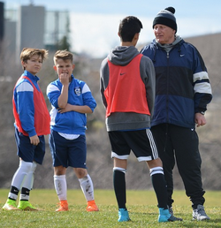
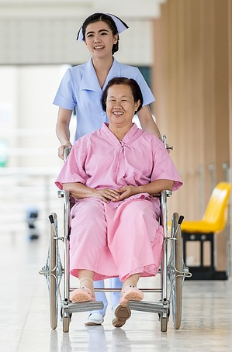
Remember the time …
What’s the most fun you’ve had serving others?
Serving others is much more than just fun.
We do not live for ourselves; we serve God by serving others.
Today we look at how the early church served one another

Slide 3
Listen for how the church grew.
Acts 2:37-42 (NIV) When the people heard this, they were cut to the heart and said to Peter and the other apostles, "Brothers, what shall we do?" 38 Peter replied, "Repent and be baptized, every one of you, in the name of Jesus Christ for the forgiveness of your sins. And you will receive the gift of the Holy Spirit. 39 The promise is for you and your children and for all who are far off--for all whom

Slide 4
Listen for how the church grew.
the Lord our God will call." 40 With many other words he warned them; and he pleaded with them, "Save yourselves from this corrupt generation." 41 Those who accepted his message were baptized, and about three thousand were added to their number that day. 42 They devoted themselves to the apostles' teaching and to the fellowship, to the breaking of bread and to prayer.

Slide 5
Faith and Growth in Christ
How did the hearers respond to Peter’s words?
What did Peter tell his audience to do?
What effect did Peter’s sermon have?
What were the four characteristic activities or practices of the early church?
What would the apostles have been teaching?

Slide 6
Faith and Growth in Christ
What should we be using for teaching today?
How and why is the preaching and teaching of God’s Word a powerful influence?
Verse 42 says they “devoted themselves” to these things. How can you tell when someone is devoted to something?
So what’s the difference between merely going to church and being devoted to the church?

Slide 7
Listen for an interesting lifestyle.
Acts 2:43-45 (NIV) Everyone was filled with awe, and many wonders and miraculous signs were done by the apostles. 44 All the believers were together and had everything in common. 45 Selling their possessions and goods, they gave to anyone as he had need.

Slide 8
Support and Help Fellow Believers
How did those outside the body of believers respond to what they saw in the church?
How did being a believer affect the believers’ relationships with one another? What radical action did they take to care for fellow believers?
What are the benefits of being part of a church family in our churches today?

Slide 9
Support and Help Fellow Believers
How do you think our church should be more like the early church?
In what ways will our church be different from the early church? Why?
How can we live with the tension of being generous while providing for your own needs?

Slide 10
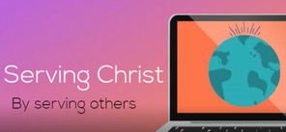
Support and Help Fellow Believers
(Optional) Discussion Video
https://tinyurl.com/yc63bnxs

Slide 11
Listen for what were their daily activities.
Acts 2:46-47 (NIV) Every day they continued to meet together in the temple courts. They broke bread in their homes and ate together with glad and sincere hearts, 47 praising God and enjoying the favor of all the people. And the Lord added to their number daily those who were being saved.

Slide 12
Lives That Honor God Point to Christ
What suggests that worship and fellowship were important to the believers?
How did their relationship with one another affect their witness to those outside the church?
Again we read of the “breaking of bread”. What do you think the early believers were actually doing when they "broke bread"?

Slide 13
Lives That Honor God Point to Christ
Why is it important for us to see and have fellowship with Christian friends?
How could a church’s spirit of fellowship be instrumental in reaching unsaved friends and family – to see people saved and added to our membership?

Slide 14
Application
Serve others with a simple act.
Being kind to others can be done through simple acts that don’t cost a lot of money.
Reach out to someone who needs a word of encouragement and perform an act of kindness.

Slide 15
Application
Serve others by sharing the gospel.
Sharing the truth of the gospel is one way to serve others.
Pray and look for an opportunity to share Christ with a friend, coworker, or family member.

Slide 16
Application
Serve others by opening your home.
Talk to your church leaders about starting a new Bible study group in your home.
A home group is a great way to include neighbors and coworkers.

Slide 17
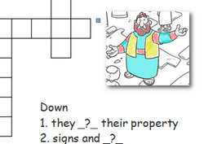
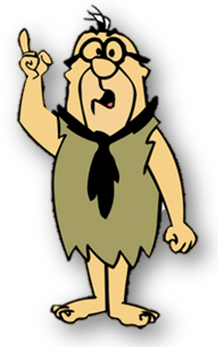
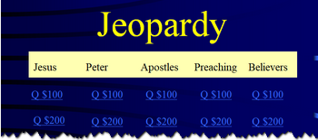
Family Activities
Crossword, Color page, Jeopardy … we’ve got it all on the Family Activity page. Check it out … something for each member of the family.
https://tinyurl.com/ycvrnnvx

Slide 18
What Should We Do Now?
July 1

