Slide 1
What Happens Next?
July 8

Slide 2
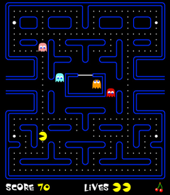

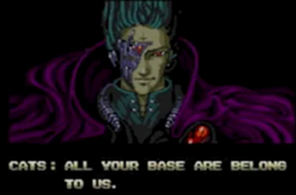
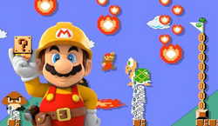
Be honest now …
What do you like best about a fresh start, a new “life” in a video game?
Our real lives are far more important than a “life” in a video game.
  Today we look at the new existence, the new life we receive when Jesus comes again
  One day we will fully experience who God created us to be

Slide 3
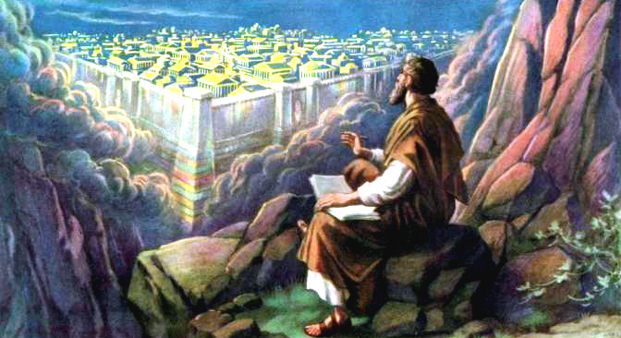
Visualized Scripture
(optional)
https://tinyurl.com/yaptzu8r

Slide 4
Listen for new things and old things.
Revelation 21:1-3 (NIV) Then I saw a new heaven and a new earth, for the first heaven and the first earth had passed away, and there was no longer any sea. 2 I saw the Holy City, the new Jerusalem, coming down out of heaven from God, prepared as a bride beautifully

Slide 5
Listen for new things and old things.
dressed for her husband. 3 And I heard a loud voice from the throne saying, "Now the dwelling of God is with men, and he will live with them. They will be his people, and God himself will be with them and be their God.

Slide 6
Living in God’s Presence
What did John see once all the judgments had taken place?
In his vision, what did John see coming down out of heaven from God?
What are implications for us that our present earth will pass away?

Slide 7
Living in God’s Presence
What do you think is the significance of the newness? Why is it important to understand that heaven is a place where everything is made new?
What does the voice from the throne say in verse 3?

Slide 8
Living in God’s Presence
What do you think it will be like living with the continual and direct presence of God?
How should we handle life until we do experience the direct presence of God?

Slide 9
Listen for what will be missing.
Revelation 21:4-5 (NIV) He will wipe every tear from their eyes. There will be no more death or mourning or crying or pain, for the old order of things has passed away." 5 He who was seated on the throne said, "I am making everything new!" Then he said, "Write this down, for these words are trustworthy and true."

Slide 10
Living in a Perfect Place
What other harsh realities did John identify that the inhabitants of the heavenly city would no longer face?
Why will those things not be there?
In what additional life situations will these verses give us comfort?
Certainly it is appropriate to grieve for suffering and for loss of loved ones we experience in this life
⇨ But we will be spared this in heaven

Slide 11
Living in a Perfect Place
How can this vision of heaven have a positive effect on your attitudes and actions regarding health and relationship issues?
What mandate was given to John?
What does it mean that the Lord sat on the throne?

Slide 12
Listen for an inheritance.
Revelation 21:6-8 (NIV) He said to me: "It is done. I am the Alpha and the Omega, the Beginning and the End. To him who is thirsty I will give to drink without cost from the spring of the water of life. 7 He who overcomes will inherit all this, and I will be his God and he will be my son.

Slide 13
Listen for an inheritance.
But the cowardly, the unbelieving, the vile, the murderers, the sexually immoral, those who practice magic arts, the idolaters and all liars--their place will be in the fiery lake of burning sulfur. This is the second death."

Slide 14
Eternity Based on
Knowing Jesus
What did the one on the throne promise to those who are thirsty?
What did the one on the throne promise to those who overcome?
What fate was assured for those who are evil?

Slide 15
Eternity Based on
Knowing Jesus
How do these promises reflect God’s character?
How did the Lord identify Himself and what does the phrase say about Him?
What are ways you can honor God whether you are still on earth or when you get to heaven?

Slide 16
Application
Pray a prayer of thanksgiving.
  If you are a believer, take a moment to thank the Lord for placing you in His “forever family.”
  Thank Him for the grace that saved you.

Slide 17
Application
Pray a prayer of salvation.
  If you are unsure if you are going to heaven, talk to your group leader or check out the inside front cover of your student learner guide
  God desires to make things “new” in your life through His forgiveness and grace.

Slide 18
Application
Share Christ with a friend or family member.
  Set a time to share the gospel with someone you believe is far from God.
  Help them understand that Jesus loves them, died for them, and is willing to save them from the penalty of sin.

Slide 19

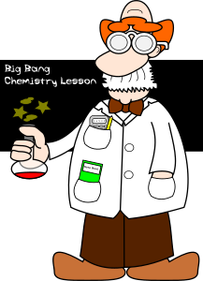
Family Activities
For some explosive Family Activities, Check out
https://tinyurl.com/ydy7zy38

Slide 20
What Happens Next?
July 8

