Slide 1
What Does Love
Look Like?
July 31

Slide 2


Video Introduction
View Video

Slide 3
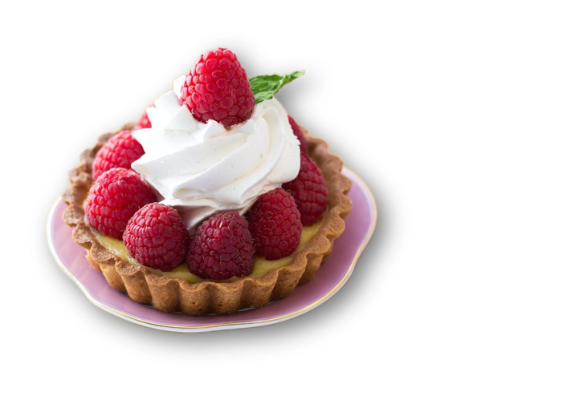
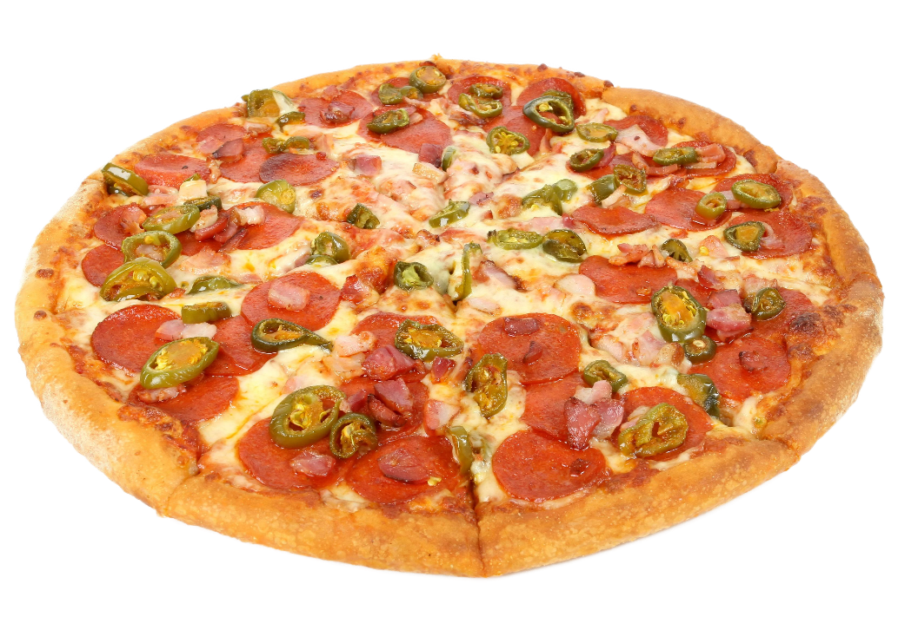

Think about it …
How many different ways might you complete the statement, “I love _______” ?

Slide 4
Think about it …
Note the different meanings of the word love:
  Preference for a particular flavor, activity, time, place
  Total dedication to someone
  This is an important part of your life
Today we investigate the kind of love God demonstrates
  We seek to learn ways to demonstrate that same kind of love for others

Slide 5
Listen for the necessity of love.
1 Corinthians 13:1-3 (NIV) If I speak in the tongues of men and of angels, but have not love, I am only a resounding gong or a clanging cymbal. 2 If I have the gift of prophecy and can fathom all mysteries and all

Slide 6

Listen for the necessity of love.
knowledge, and if I have a faith that can move mountains, but have not love, I am nothing. 3 If I give all I possess to the poor and surrender my body to the flames, but have not love, I gain nothing.

Slide 7
Love Sustains All
What hypothetical experiences or situations did Paul identify that could be an occasion for boasting about one’s spiritual gifts?
What results when I do these things with the wrong motive?
What kinds of wrong motives might we have?

Slide 8
Love Sustains All
Why might it be easy to use a spiritual gift without love?
How can using our resources and gifts without love minimize the value of their expression to others … to ourselves?
To Others | To Ourselves

Slide 9
Love Sustains All
The kind of love Paul is writing about here is that same love God has for us, agape love.
  Determined good will that has its object’s best interests at heart
  Self-giving (instead of self-serving)
  Expects nothing in return
  Goes on offering itself, even when rejected
  Acts on others’ behalf without considering their worthiness

Slide 10
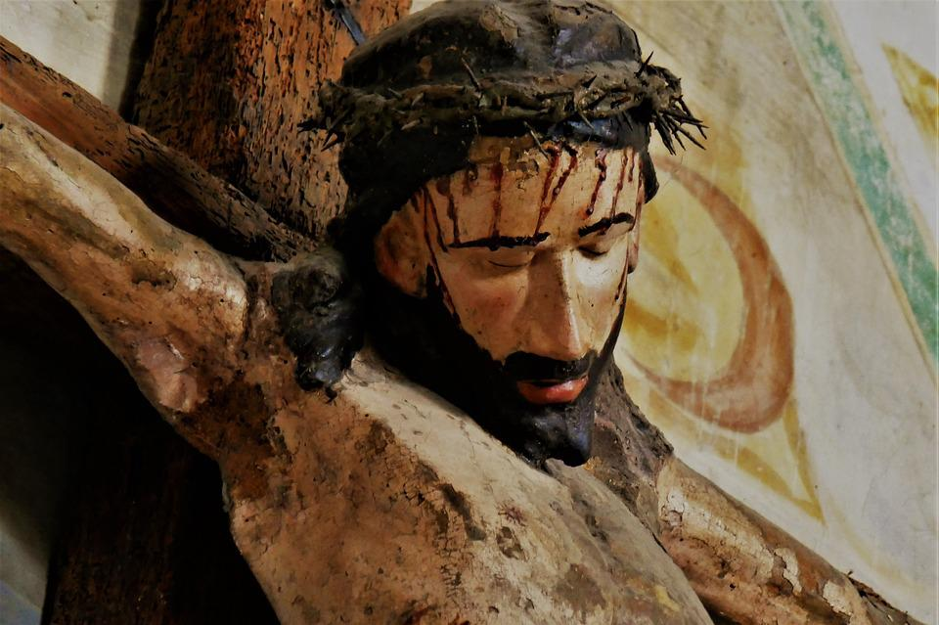
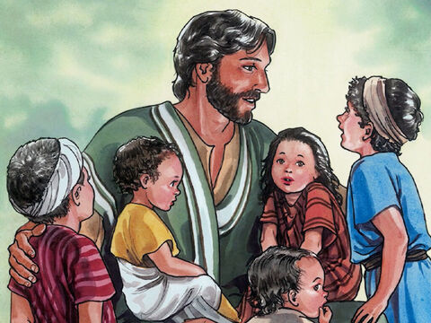
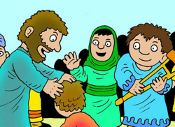
Love Sustains All
How did Jesus exemplify this kind of love?
Art by Good News Productions International
Art by Richard Gunther

Slide 11
Listen for how love reflects Christ’s character.
1 Corinthians 13:4-7 (NIV) Love is patient, love is kind. It does not envy, it does not boast, it is not proud. 5 It is not rude, it is not self-seeking, it is not easily angered, it keeps no record of wrongs. 6 Love does not delight in evil but rejoices with the truth. 7 It always protects, always trusts, always hopes, always perseveres.

Slide 12
Love Reflects Christ’s Character
What do you see that love is not or does not do?
Why are these things difficult not to do … or we could say too easy to do?
What words does Paul use to describe what love is or does?
How will agape love, as we’ve defined it, be demonstrated in some of these contexts?

Slide 13
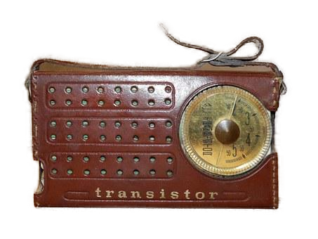

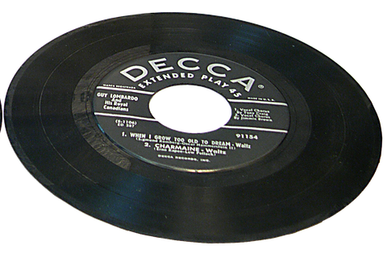
What do you remember?
Think of some things from your past that were “cutting edge” when you first had them but are obsolete now.

Slide 14
Listen for spiritual gifts that will become obsolete.
1 Corinthians 13:8-13 (NIV) Love never fails. But where there are prophecies, they will cease; where there are tongues, they will be stilled; where there is knowledge, it will pass away. 9 For we know in part and we prophesy in part, 10 but when perfection comes, the imperfect disappears. 11 When I was a child, I talked like a child, I thought

Slide 15
Listen for spiritual gifts that will become obsolete.
like a child, I reasoned like a child. When I became a man, I put childish ways behind me. 12 Now we see but a poor reflection as in a mirror; then we shall see face to face. Now I know in part; then I shall know fully, even as I am fully known.13 And now these three remain: faith, hope and love. But the greatest of these is love.

Slide 16
Love Does Not Fade Away
What gifts are listed that will cease to exist or become obsolete?
Why won’t prophecy, knowledge, and tongues be necessary when Jesus returns?
How do these verses affirm that love (charity) is permanent, perfect, and preeminent?

Slide 17
Love Does Not Fade Away
Why do you think Paul would say, “Love never fails”?
Why is love the greatest of these three—faith, hope, and love?

Slide 18
Application
Consider.
  Think about genuine vs. counterfeit love.
  Write down ways you may have been influenced by definitions of love that aren’t true.
  These could come from past or present relationships, entertainment, music, or culture.
  Choose to focus on the character of love as described in 1 Corinthians 13:4-7.

Slide 19
Application
Connect.
  Whom do you know that exhibits and expresses the genuine love of God?
  It could be a family member, someone in your church, or someone in your Bible study group.
  Take five minutes this week to share with that person how you see God’s love in his or her life and express appreciation for their example.

Slide 20
Application
Care.
  Determine to love others even as Christ loves you.
  You know someone who needs to know of God’s love.
  Ask God to show you ways to live out the love described in 1 Corinthians 13 before that person.
  Invest time in the individual and love them like Christ does.

Slide 21
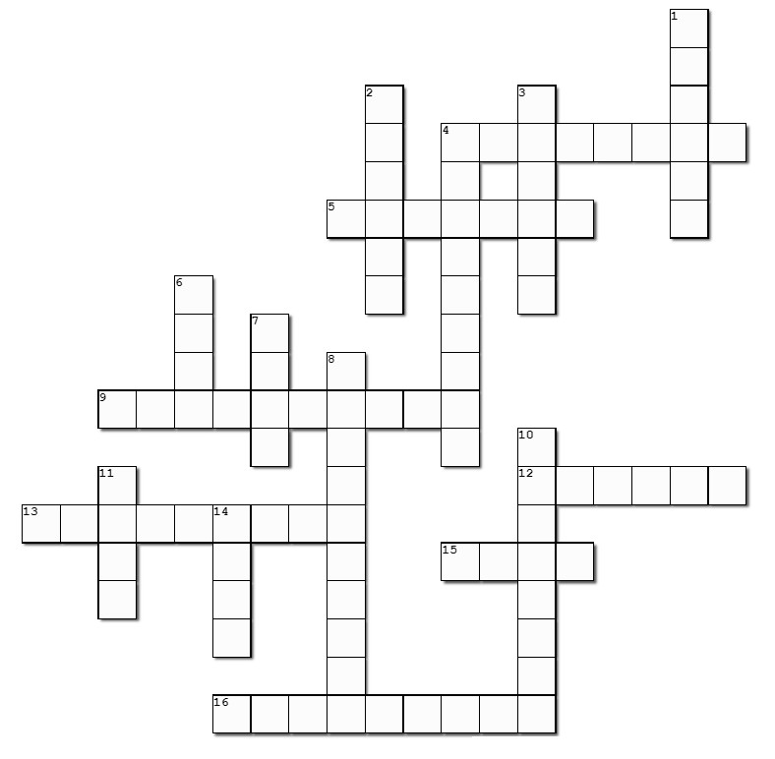

Family Activities
1 Corinthians 13 is my favorite chapter. This crossword has all the important points. Remember the words and clues come from this chapter. If you need help or want more Family Activities, go to https://tinyurl.com/mrcaeh7w

Slide 22
What Does Love
Look Like?
July 31

