Slide 1
We Support One Another
August 9

Slide 2
Introduction Video
View Video

Slide 3
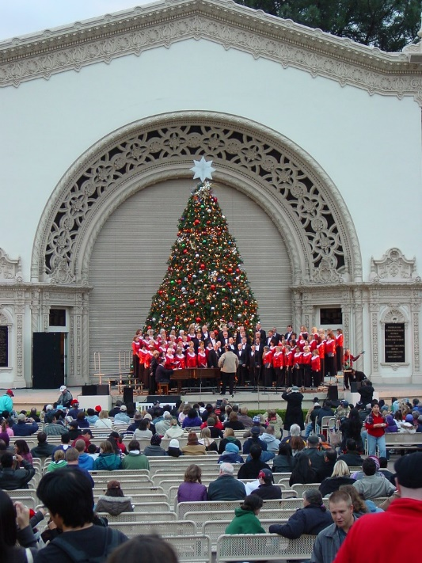
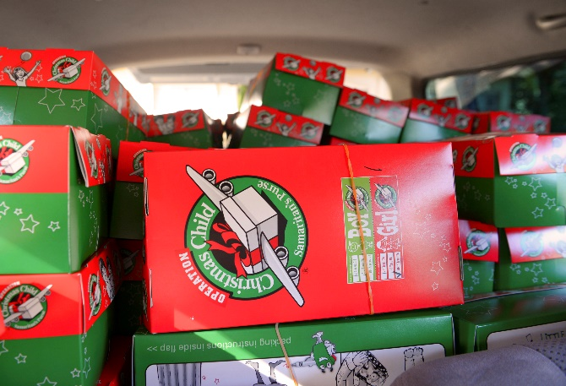
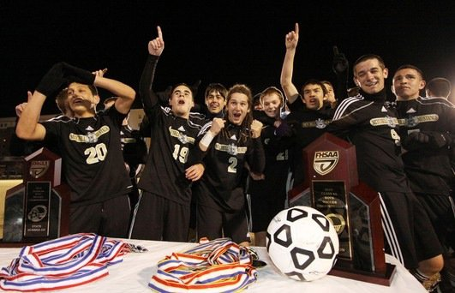
Remember that time …
When has being a part of a group helped you to accomplish something big?
As believers we are part of the Body of Christ … the Church.
We all join together to accomplish God’s mission of evangelism and discipleship.
God gives the church spiritual gifts to accomplish His work.

Slide 4
Listen for comments on unity.
Ephesians 4:1-7 (NIV) As a prisoner for the Lord, then, I urge you to live a life worthy of the calling you have received. 2 Be completely humble and gentle; be patient, bearing with one another in love. 3 Make every effort to keep the unity of the Spirit through the bond of peace.

Slide 5
Listen for comments on unity.
There is one body and one Spirit-- just as you were called to one hope when you were called-- 5 one Lord, one faith, one baptism; 6 one God and Father of all, who is over all and through all and in all. 7 But to each one of us grace has been given as Christ apportioned it.

Slide 6
Unity of the Church
According to this passage, what are actions and attitudes show that we walk worthy of our calling?
What kinds of habits or choices do believers sometimes make that shortchange God … times when we do not walk worthy of what He deserves?

Slide 7
Unity of the Church
Paul mentions unity. What keeps sports teams unified?
Identify factors Paul enumerated that make for unity in the church.
How does each contribute to the concept of unity among believers?

Slide 8
Unity of the Church
How does the Spirit help us maintain the "bond of peace" with one another in our church?
What attitudes and actions can we take that would build unity in our church?

Slide 9
Listen for purpose of spiritual gifts.
Ephesians 4:11-13 (NIV) It was he who gave some to be apostles, some to be prophets, some to be evangelists, and some to be pastors and teachers, 12 to prepare God's people for works of service,

Slide 10
Listen for purpose of spiritual gifts.
so that the body of Christ may be built up 13 until we all reach unity in the faith and in the knowledge of the Son of God and become mature, attaining to the whole measure of the fullness of Christ.

Slide 11
Gifted to Equip the Church
What specific skills do you see listed here that God gives?
What does Paul say is the purpose of these gifts?
The KJV uses the word “perfect” in verse 13 “Till we all come in the unity of the faith, and of the knowledge of the Son of God, unto a perfect man” What are some synonyms of this word?

Slide 12
Gifted to Equip the Church
So, what does it mean to be a “perfect” man or woman?
How have you seen church leaders equip the saints in a way that brought unity and growth towards perfection in the church? What are some ways you have been equipped by the church?

Slide 13
Listen for benefits of maturity and unity.
Ephesians 4:14-16 (NIV) Then we will no longer be infants, tossed back and forth by the waves, and blown here and there by every wind of teaching and by the cunning and craftiness of men in their deceitful scheming. 15 Instead, speaking

Slide 14
Listen for benefits of maturity and unity.
the truth in love, we will in all things grow up into him who is the Head, that is, Christ. 16 From him the whole body, joined and held together by every supporting ligament, grows and builds itself up in love, as each part does its work.

Slide 15
Growing in Christ
How does Paul describe spiritual “infants”?
What are we supposed to be doing, according to verse 15?
What should be happening to a healthy body, according to verse 16?

Slide 16
Growing in Christ
What imagery did Paul use to describe the relationship of Christ to the Church?
What advice would you give someone seeking to balance speaking truth and showing love?

Slide 17
Application
Reflect.
Consider the contrast between some of the cultural expectations of church with the biblical expectations studied in this session.
Confess and turn from any misconceptions about life in the church. Ask God to unite your heart with His regarding His church.

Slide 18
Application
Discover.
If you’re not sure what your spiritual gift is or how you can be of service in the church, ask other believers to help you.
Many times, people see our strengths before we do.
Discuss with a church leader your desire to serve.

Slide 19
Application
Serve.
If you’ve identified your spiritual gifts, look for opportunities to exercise them in your life and in your church.
Invest your time, passions, and strengths in building up others in the church.

Slide 20
Family Activities
This is not good … I’ve lost my secret message. If you find it, you’ll be able to decrypt it, I know. There’s even help at https://tinyurl.com/y3l3hzd5 Why don’t you go there for the other great family activities. Then I won’t loose my spy job.

Slide 21
We Support One Another
August 9

