Slide 1
We Stand Together in
Spiritual Battle
August 30

Slide 2
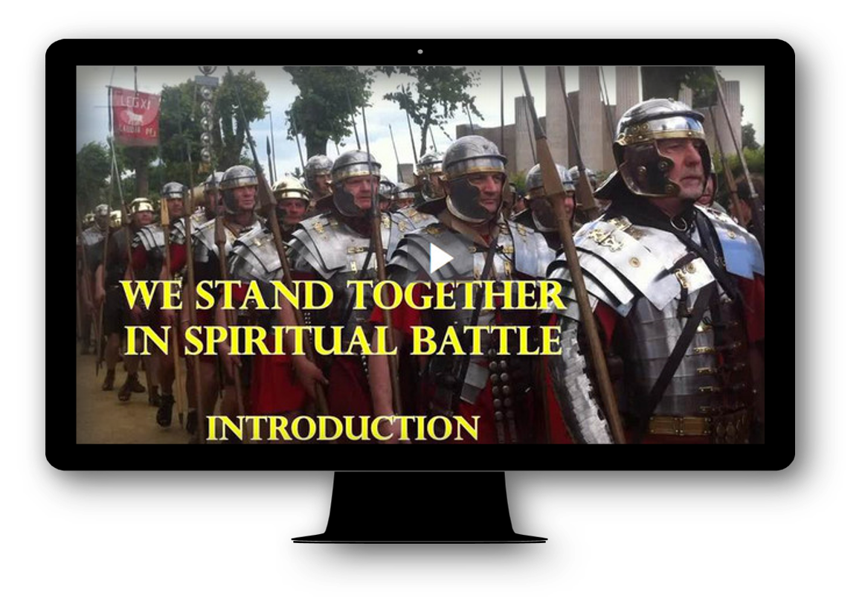
Video Introduction
View Video

Slide 3

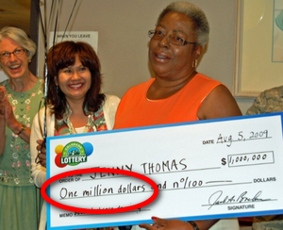
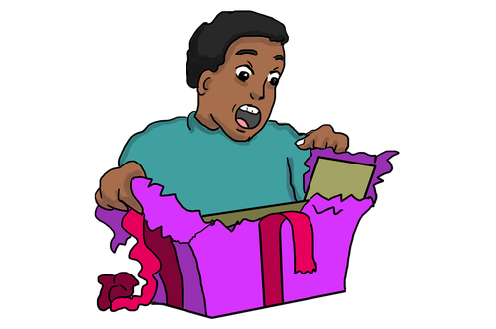
Remember the time …
When have you been surprised by the unexpected
We can easily be surprised by an unexpected problem.
  However, we need not be destroyed.
  We stand strong with God’s armor and the support of others.

Slide 4
Listen for who is the enemy.
Ephesians 6:10-13 (NIV) Finally, be strong in the Lord and in his mighty power. 11 Put on the full armor of God so that you can take your stand against the devil's schemes. 12 For our struggle is not against flesh and blood, but against the rulers, against the authorities, against the powers

Slide 5

Listen for who is the enemy.
of this dark world and against the spiritual forces of evil in the heavenly realms. 13 Therefore put on the full armor of God, so that when the day of evil comes, you may be able to stand your ground, and after you have done everything, to stand.

Slide 6
We Are in a Spiritual Battle
Who is our enemy?
What are some kinds of things that would be included in the devil’s schemes to draw us into sin?
What would have to be their source of strength if the Ephesians were to be victorious in spiritual battle?

Slide 7
We Are in a Spiritual Battle
What did Paul urge them to do?
What kinds of spiritual battles do believers face today?
What is the key to being “strong in the Lord and in his mighty power?”
What are some actions, words, attitudes that help you do this before or during spiritual warfare?

Slide 8
Listen for a description of spiritual armor.
Ephesians 6:14-17 (NIV) Stand firm then, with the belt of truth buckled around your waist, with the breastplate of righteousness in place, 15 and with your feet fitted with the readiness that comes from the gospel of peace. 16 In addition to all this,

Slide 9
Listen for a description of spiritual armor.
take up the shield of faith, with which you can extinguish all the flaming arrows of the evil one. 17 Take the helmet of salvation and the sword of the Spirit, which is the word of God.

Slide 10
God Equips and Protects
What defensive, offensive equipment do you see in the passage?
Defensive Equipment | Offensive Equipment

Slide 11
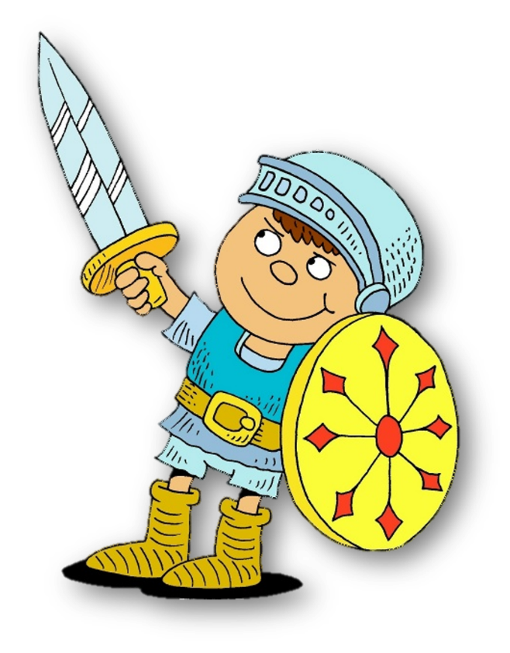
God Equips and Protects
For each of the pieces of equipment, what part of the body does it protect, what ability does it provide?
Armor | Area protected or capability provided | Spiritual protection or capability
Helmet of salvation
Breastplate of righteousness
Shoes of the gospel
Sword of the Spirit
Belt of Truth
Shield of faith

Slide 12
God Equips and Protects
What would happen if we left out one or more of the elements of spiritual armor?
How do we consciously “put on” this spiritual amor?
Spiritual Element | Problem when Missing
Truth/Scripture/Gospel
Faith
Righteousness
Salvation

Slide 13
Listen for the importance of prayer.
Ephesians 6:18-20 (NIV) And pray in the Spirit on all occasions with all kinds of prayers and requests. With this in mind, be alert and always keep on praying for all the saints. 19 Pray also for me, that whenever I open my mouth,

Slide 14
Listen for the importance of prayer.
words may be given me so that I will fearlessly make known the mystery of the gospel, 20 for which I am an ambassador in chains. Pray that I may declare it fearlessly, as I should.

Slide 15
Pray for One Another
What connections exist between these verses and the previous passage, verses 10-17?
For what needs did Paul ask the Ephesians to pray?
Why is prayer an important tool in spiritual battle?

Slide 16
Pray for One Another
What do you think it means to “pray in the Spirit?”
What are specific ways we can pray for one another as we engage in spiritual warfare?

Slide 17
Application
Take your stand.
  Through prayer, commit yourself anew to standing firm in the strength of the Lord in spiritual battle.

Slide 18
Application
Stand with your church.
  Take spiritual ownership of your church by praying regularly for your pastor(s), teacher(s), and fellow church members.
  Begin a prayer journal as a guide to help you pray.

Slide 19
Application
Stand with the nations.
  Research the global church including missionary needs, unreached people groups, and persecution.
  The following websites are valuable resources to help shape your mind and your prayers: imb.org, joshuaproject.net, and operationworld.org.

Slide 20

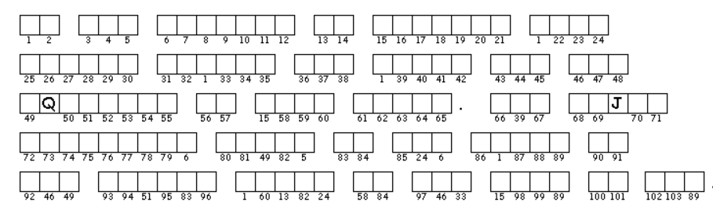
Family Activities
Me oui … one must diligently apply the little grey cells, n’est pas? These Double Puzzles are formidable! But if you get stuck, you can go to https://tinyurl.com/yyh86pmy for help. Also you will find other instructive and fun Family Activities

Slide 21
We Stand Together in
Spiritual Battle
August 30

