Slide 1
We Encourage
One Another
August 16

Slide 2
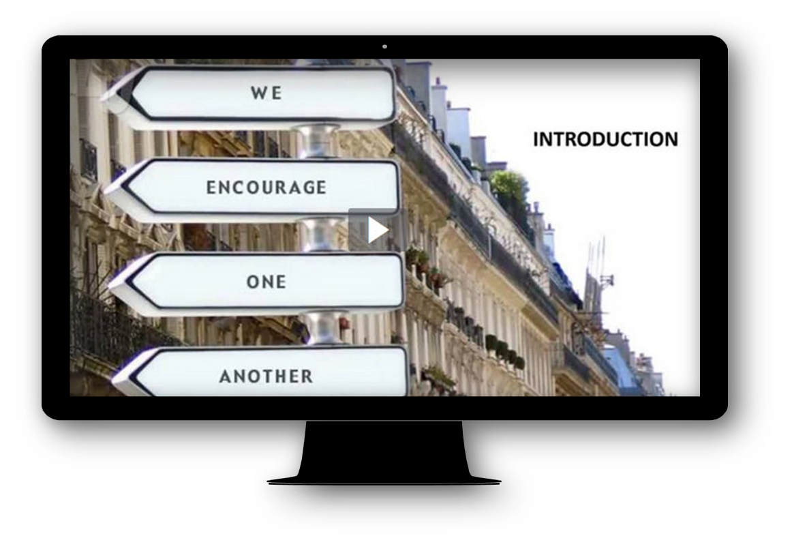
Video Introduction
View Video

Slide 3
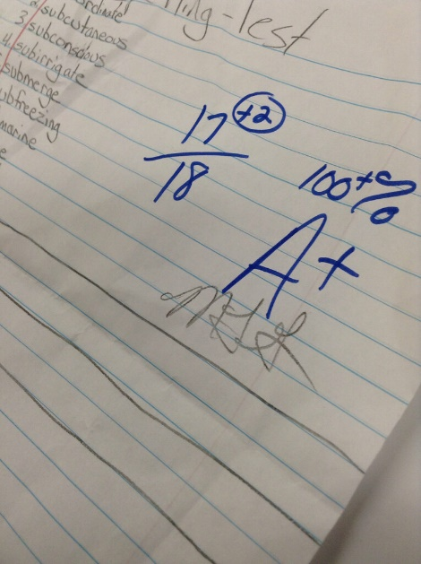


Think about it …
How have you experienced the power of encouragement in your life?
We need the encouragement of others—and they need ours.
  Today we study Paul’s comments on how that is especially true within the Body of Christ

Slide 4
Listen for Paul’s warning.
Ephesians 4:17-22 (NIV) So I tell you this, and insist on it in the Lord, that you must no longer live as the Gentiles do, in the futility of their thinking. 18 They are darkened in their understanding and separated from the life of God because of the ignorance that is in them due to the hardening of their hearts. 19 Having lost all sensitivity, they have given themselves over to

Slide 5
Listen for Paul’s warning.
sensuality so as to indulge in every kind of impurity, with a continual lust for more. 20 You, however, did not come to know Christ that way. 21 Surely you heard of him and were taught in him in accordance with the truth that is in Jesus. 22 You were taught, with regard to your former way of life, to put off your old self, which is being corrupted by its deceitful desires;

Slide 6
Put Away Sinful Habits
What warnings does Paul issue?
Let’s list words and phrases Paul used to characterize the Gentile (pagan) lifestyle.
How should the believer act differently?
What are some typical aspects of our old nature of which we struggle to rid ourselves?
What makes “taking off the old self” so difficult?

Slide 7
Listen for changes evident when following Christ.
Ephesians 4:23-28 (NIV) to be made new in the attitude of your minds; 24 and to put on the new self, created to be like God in true righteousness and holiness. 25 Therefore each of you must put off falsehood and speak truthfully to his neighbor, for we are all members of one body.

Slide 8
Listen for changes evident when following Christ.
"In your anger do not sin": Do not let the sun go down while you are still angry, 27 and do not give the devil a foothold. 28 He who has been stealing must steal no longer, but must work, doing something useful with his own hands, that he may have something to share with those in need.

Slide 9
Living Consistent with New Life in Christ
What analogy does Paul complete here to describe the change in behavior between the old person without Christ and the new person with Christ?
What are some specific changes in lifestyle addressed in these verses?

Slide 10
Living Consistent with New Life in Christ
The passage seems to say that it is possible to be angry without sin. What kinds of problems can anger lead to if it becomes uncontrolled / abusive (physical, verbal, emotional)?
What do you think is the key to being angry but avoiding sin?
What do you think is involved in being “made new in the attitude of your minds”?

Slide 11
Living Consistent with New Life in Christ
What do you think Paul meant by “deceitful desires”?
What steps does one take to leave the past behind?

Slide 12
Listen for important practices of the Christian life.
Ephesians 4:29-32 (NIV) Do not let any unwholesome talk come out of your mouths, but only what is helpful for building others up according to their needs, that it may benefit those who listen. 30 And do not grieve the Holy Spirit of God,

Slide 13
Listen for important practices of the Christian life.
with whom you were sealed for the day of redemption. 31 Get rid of all bitterness, rage and anger, brawling and slander, along with every form of malice. 32 Be kind and compassionate to one another, forgiving each other, just as in Christ God forgave you.

Slide 14
Encourage Others with Your Words
What purpose should our words serve?
The unwholesome or “rotten” talk mentioned in the passage refers to trees that produce bad fruit. What kinds of things might this mean besides profanity or obscenity?
How can unwholesome talk affect others negatively?

Slide 15
Encourage Others with Your Words
What are the positive commands Paul gives here?
What are some keys to putting into practice Paul’s alternative … speaking what is helpful, building others up?

Slide 16
Application
Talk to God.
  Through prayer, ask God to bring to light any words, phrases, or patterns of speech that you need to “put away.”
  Ask God for the grace needed to speak words of life and encouragement instead.

Slide 17
Application
Talk to yourself.
  One of the best ways to “talk to yourself” is speaking the Word of God to yourself.
  In that light, consider memorizing Ephesians 4:29: “No foul language should come from your mouth, but only what is good for building up someone in need, so that it gives grace to those who hear.”

Slide 18
Application
Talk to others.
  Identify three people who might be encouraged by your words.
  Write cards, craft emails, send texts, or meet with each of them face to face to encourage them in their walk with Jesus.

Slide 19
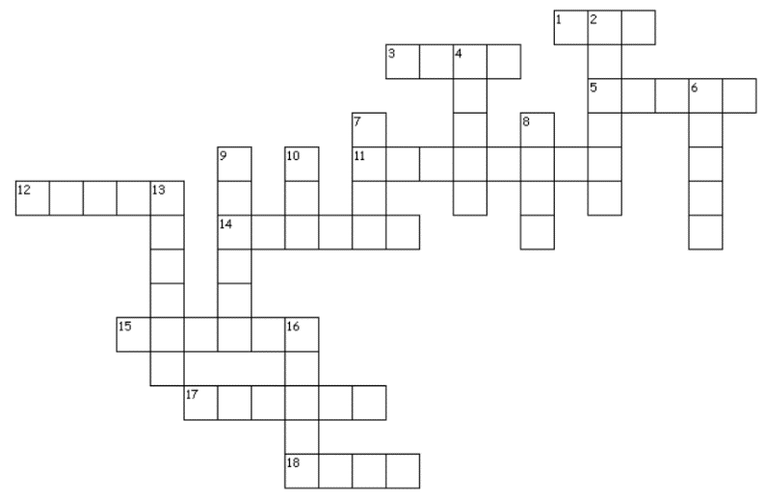

Family Activities
Well, I hope the clues are included in the crossword puzzle. Well, in any case … BE ENCOURAGED! You can do it. And you’ll want to check out the other Family Activities at https://tinyurl.com/y2gs4pen

Slide 20
We Encourage
One Another
August 16

