Slide 1
Watch for Christ’s Return
May 8

Slide 2

Video Introduction
View Video

Slide 3



Think about it …
What sound or voice can you recognize easily from a distance?
Some sounds or voices may puzzle you when you hear them.
  But when Christ returns, everyone will know it is Him

Slide 4

Listen for Jesus’ warning.
Matthew 24:23-25 (NIV) At that time if anyone says to you, 'Look, here is the Christ!' or, 'There he is!' do not believe it. 24 For false Christs and false prophets will appear and perform great signs and miracles to deceive even the elect--if that were possible. 25 See, I have told you ahead of time.

Slide 5
Guard Against Deception
Against what or whom does Jesus issue a warning?
What are false Christs and false prophets?
What devices might they use to deceive people in today’s world?

Slide 6
Present-day false prophets will …
Market political correctness, woke cancel culture,
Demonstrate open hostility to a biblical worldview of law, order, and justice,
Tout grand rebellious ideologies and economic or racial determinism,
Celebrate rebellion in the name of absolute freedom,
Sow chaos, madness.
Division and discord are their parallel tracks to power.

Slide 7
Guard Against Deception
Jesus said, “You will know the truth, and the truth will set you free.” Look up these verses which tell how to respond to untruth.
Eph 6:11
Phil 1:9
Eph 4:15
1 Peter 3:15
Eph 4:3

Slide 8

Guard Against Deception

Slide 9
Listen for natural phenomena events.
Matthew 24:26-29 (NIV) "So if anyone tells you, 'There he is, out in the desert,' do not go out; or, 'Here he is, in the inner rooms,' do not believe it. 27 For as lightning that comes from the east is visible even in the west, so will be the coming of the Son of Man.

Slide 10
Listen for natural phenomena events.
Wherever there is a carcass, there the vultures will gather. 29 "Immediately after the distress of those days "'the sun will be darkened, and the moon will not give its light; the stars will fall from the sky, and the heavenly bodies will be shaken.'

Slide 11
Creation’s Proclamations
What counsel does Jesus offer to those who claim to have special insight concerning the Christ?
Why will no one miss Christ’s return? What examples does Jesus use to illustrate the visibility of the return of Christ?
How does Jesus picture the spectacular nature of His coming? What natural phenomena does He describe?

Slide 12
Creation’s Proclamations
Consider Isaiah 13:9-10 (NIV) See, the day of the LORD is coming --a cruel day, with wrath and fierce anger-- to make the land desolate and destroy the sinners within it. The stars of heaven and their constellations will not show their light. The rising sun will be darkened and the moon will not give its light.
What are some ways creation announces truths about God today?

Slide 13
Creation’s Proclamations
Consider Isaiah 13:9-10 (NIV) See, the day of the LORD is coming --a cruel day, with wrath and fierce anger-- to make the land desolate and destroy the sinners within it. The stars of heaven and their constellations will not show their light. The rising sun will be darkened and the moon will not give its light.
In what ways will creation help us understand the return of its Creator?

Slide 14
Listen for clarity concerning Christ’s return.
Matthew 24:30-31 (NIV) "At that time the sign of the Son of Man will appear in the sky, and all the nations of the earth will mourn. They will see the Son of Man coming on the clouds of the sky,

Slide 15
Listen for clarity concerning Christ’s return.
with power and great glory. 31 And he will send his angels with a loud trumpet call, and they will gather his elect from the four winds, from one end of the heavens to the other.

Slide 16
Christ’s Return Will Be Unmistakable
What is meant by the sign of the “Son of Man”?
Why will some mourn at His coming?
In what way does Jesus emphasize that His coming will be a public event, not something secret or “spiritual” in nature?

Slide 17
Christ’s Return Will Be Unmistakable
How would you contrast Jesus’ first coming with His second coming?
How does Jesus’ imminent return give you hope?
First Coming | Second Coming

Slide 18
Application
Reflect
  Take a moment and reflect on your life.
  Ask yourself, “are you ready for Christ’s return?”
  Spend some time in prayer asking God how you can be more prepared for His return.

Slide 19
Application
Remember
  One way we can guard ourselves from false teachers is by knowing what the Bible says.
  Spend some time this week reading and memorizing scripture.

Slide 20
Application
Realize
  The return of Christ is joyfully anticipated by believers but it will be a day of judgment for non-believers.
  Who do you know that doesn’t know Christ?
  Pray for their salvation.

Slide 21

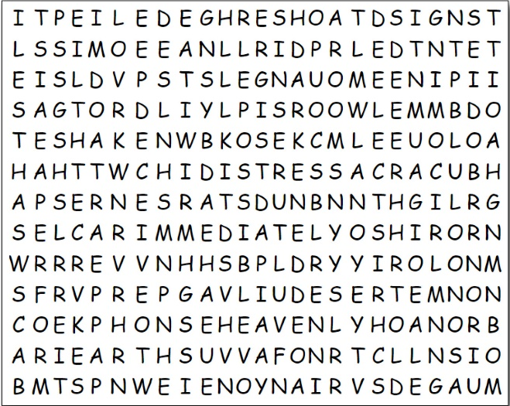


Family Activities
Color Page
Word Search
Crossword

Slide 22
Watch for Christ’s Return
May 8

