Slide 1
Walking with the Spirit
July 10

Slide 2

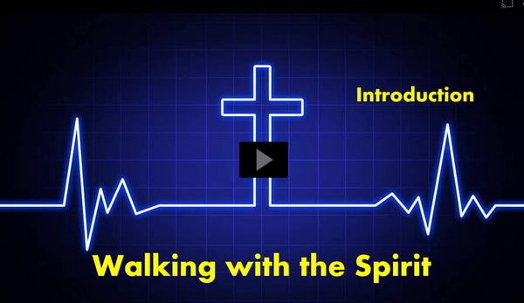
Video Introduction
View Video

Slide 3



Be honest, now …
If you could change one personality trait in yourself, what would you change?
We often wish we could change some of those traits, but we struggle.
  God can and will change our lives with His power.
  The Holy Spirit leads us to display the fruit of godly character.

Slide 4

Listen for a conflict.
Galatians 5:16-18 (NIV) So I say, live by the Spirit, and you will not gratify the desires of the sinful nature. 17 For the sinful nature desires what is contrary to the Spirit, and the Spirit what is contrary to the sinful nature. They are in conflict with each other, so that you do not do what you want. 18 But if you are led by the Spirit, you are not under law.

Slide 5
End Following Sinful Desires
What two admonitions does Paul give the Galatian readers?
What is the conflict he speaks of and what is the result?
Some translations use the word “flesh”. What does that word refer to?

Slide 6
End Following Sinful Desires
Consider how our flesh, our sinful nature enjoys indulging itself in sin.
  It pleases our flesh to vent off steam by complaining.
  It pleases our sinful nature to get revenge by shouting at someone we are angry with
  Sexual sins are pleasurable during the moment.
  Lazily sleeping late instead of working is very enjoyable

Slide 7

End Following Sinful Desires
These things give a temporary fun factor
  Later they bring guilt and shame
  They produce bad consequences.
  They show a distant or broken relationship with God

Slide 8
End Following Sinful Desires
Paul talks about “the law”. What were some of the laws the Jews lived by?
What do you think Paul means (or does not mean) about not being under the law?
What are some of the obstacles to our living “by the Spirit”?

Slide 9

End Following Sinful Desires
But … when God’s Spirit is ruling within our lives, we are set free from the power of sin over us.

Slide 10
Listen for the results of walking in the flesh.
Galatians 5:19-21 (NIV) The acts of the sinful nature are obvious: sexual immorality, impurity and debauchery; 20 idolatry and witchcraft; hatred, discord, jealousy, fits of rage, selfish ambition, dissensions, factions

Slide 11
Listen for the results of walking in the flesh.
and envy; drunkenness, orgies, and the like. I warn you, as I did before, that those who live like this will not inherit the kingdom of God.

Slide 12
Do Not Walk in the Flesh
How can a person be identified as living in the flesh?
Note the actions, attitudes, and behaviors Paul identified as works of the flesh?
  Sexual immorality, impurity, debauchery, idolatry, witchcraft, hatred, discord, jealousy …. and the like
How do we know Paul’s list not exhaustive?

Slide 13
Do Not Walk in the Flesh
Note the two sins that have to do with the spiritual realm – idolatry and witchcraft. Most of us don’t burn incense to ceramic images. So, how might even a Christian family get caught up in idols or witchcraft?
Why or how do acts of the sinful nature tend to entangle us?
Idols | Witchcraft

Slide 14
Listen for Christlike attributes.
Galatians 5:22-25 (NIV) But the fruit of the Spirit is love, joy, peace, patience, kindness, goodness, faithfulness, 23 gentleness and self-control. Against such things there is no law. 24 Those who belong to Christ Jesus have crucified the sinful nature with its passions and desires. 25 Since we live by the Spirit, let us keep in step with the Spirit.

Slide 15
Walking by the Spirit
How does the concept of the fruit of the Spirit differ from the concept of the “works” of the flesh?
If we have life in the Spirit, then what difference should that make in the way we live?

Slide 16
Walking by the Spirit
Paul says the sinful nature with its affections and lusts of the flesh has been crucified.
  Or don't you know that all of us who were baptized into Christ Jesus were baptized into his death? We were therefore buried with him through baptism into death in order that, just as Christ was raised from the dead through the glory of the Father, we too may live a new life. Romans 6:3,4 (NIV)

Slide 17
Walking by the Spirit
Our sinful nature died on the cross with Jesus.
We must appropriate that reality, that Truth as an act of faith.
We need not yield or pay attention to that old nature which is dead.
Instead, we have a new nature that God seeks to control, He wants to sit on the “throne” of your life

Slide 18
Walking by the Spirit
What are the benefits of God’s Spirit producing Christlike character one’s life?
How do you respond to a young person who has just heard a sermon on the Fruit of the Spirit and says, “This week I’ll work on being more loving, next week I’ll try to be more joyful, and after that, each week I’ll work hard of each of the other spiritual fruit.”

Slide 19
Walking by the Spirit
What are some practical ways believers can keep in step with the Spirit?

Slide 20
Application
Think.
  Every healthy relationship requires time spent together.
  How can you spend more time with the Lord?
  Ask God to reveal ways you can be more in touch with the Spirit.

Slide 21
Application
Decide.
  Pick a fruit of the Spirit for each day of the week and make a conscious effort to think about it throughout each day.
  Ask the Lord to develop this fruit more fully in your life.

Slide 22
Application
Act.
  Ask the Holy Spirit to guide you to a mature Christian who exhibits the fruit of the Spirit.
  Set up a time to speak with this person to ask about the most helpful things discovered in his or her life to help you to better walk with the Spirit

Slide 23
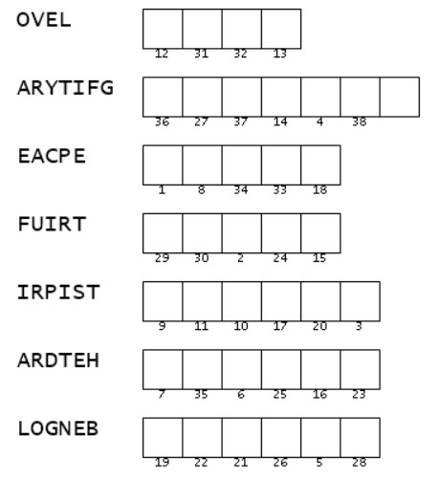

Family Activities
Hmm … I wish Uncle Kermit were here to help me. If I can unscramble these words which came from our Scripture passage, I can use the letters and numbers to figure out the message. I’ll try, but if I need help, I can always go to https://tinyurl.com/553c6bs9

Slide 24
Walking with the Spirit
July 10

