Slide 1
Walking in Grief
December 6

Slide 2
Video Introduction
View Video

Slide 3
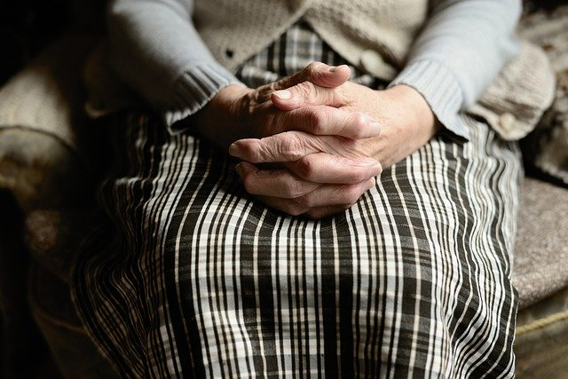
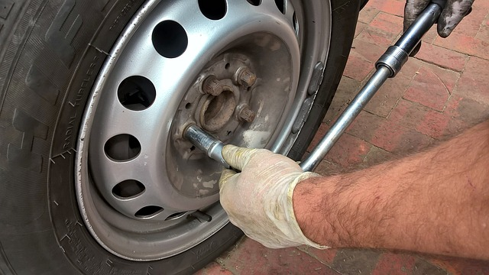
Remember that time …
When has a friend or family member helped you through a difficult experience?

Slide 4
The Point
It’s great to have folks we know we can depend on in a tough situation.
It’s especially true when we are confronted with a tragic loss.
How wonderful to know the assurance from God, who responds to our troubles and sorrows with grace and compassion

Slide 5
Listen for a cry for help.
Psalm 116:1-4 (NIV) I love the LORD, for he heard my voice; he heard my cry for mercy. 2 Because he turned his ear to me, I will call on him as long as I live. 3 The cords of death entangled me, the anguish of the grave came upon me; I was overcome by trouble and sorrow. 4 Then I called on the name of the LORD: "O LORD, save me!"

Slide 6
Call to God
The psalmist declared his love for God. What reason did he cite for his declaration of love?
What promise did the psalmist make?
What specific examples, what words and phrases did the psalmist relate to substantiate his claim about his problems?

Slide 7
Call to God
What are some of our typical first responses to sad news?
What kinds of things might keep us from taking our sorrows to God?
Why should prayer be such an important part of the grieving process?

Slide 8
Listen for God’s benevolence.
Psalm 116:5-9 (NIV) The LORD is gracious and righteous; our God is full of compassion. 6 The LORD protects the simplehearted; when I was in great need, he saved me. 7 Be at rest once more, O my soul,

Slide 9
Listen for God’s benevolence.
for the LORD has been good to you. 8 For you, O LORD, have delivered my soul from death, my eyes from tears, my feet from stumbling, 9 that I may walk before the LORD in the land of the living.

Slide 10
Rest in God
Identify three traits of the character of the Lord the psalmist highlighted in verse 5. What is the meaning and significance of each?
Character Trait | Meaning & Significance

Slide 11
Rest in God
What are some specific examples the psalmist gives of God’s love and compassion? Why could he feel at rest?
What does it mean to you to find rest in the sense used by the psalmist?
What hope is expressed in verse 9?

Slide 12
Rest in God
What attributes, characteristics about God can help you during times of sorrow?
What kinds of feelings and thoughts does a person have when physically or emotionally exhausted?
In light of these kinds of emotions, why was the writer able to rest in God? How does “resting in God” express thanks to Him?

Slide 13
Listen for God’s perspective on death.
Psalm 116:15-17 (NIV) Precious in the sight of the LORD is the death of his saints. 16 O LORD, truly I am your servant; I am your servant, the son of your maidservant; you have freed me from my chains. 17 I will sacrifice a thank offering to you and call on the name of the LORD.

Slide 14
Trust in God
What different perspective on death did the poet come to understand?
Why is worship important even while we are experiencing grief?
What are some benefits of trusting God during difficult circumstances?

Slide 15
Trust in God
What helps you trust God during difficult circumstances?
When facing a struggle, how do you come to a place of rest that enables you to press on because you know God loves you?

Slide 16
Application
Pray.
If you’re in a season of grief or sorrow, pray.
Talk to God about what you’re experiencing and feeling.
Read Psalm 116 as a prayer of trust.

Slide 17
Application
List.
Make a list of all the ways God has shown you grace and compassion.
When difficulties arise, pull out that list and reflect on the ways God has worked in your life.
Trust God to continue working in your life.

Slide 18
Application
Listen.
If you have a friend or relative going through grief, invest time to sit with him or her.
You don’t have to offer advice or try to talk them out of their grief.
Just sit, listen, and be the presence of Christ.

Slide 19
Family Activities
We need you to channel your word ninja skills to decrypt a message. Have your visitation leader pass the message on to NSA or the CIA, whichever you can get on the phone. Meanwhile the rest of you check out the strategic activities also available at https://tinyurl.com/y2vy4js3
d

Slide 20
Walking in Grief
December 6

