Slide 1
Vigilant Against Complacency
July 4

Slide 2

Video Introduction
View Video

Slide 3

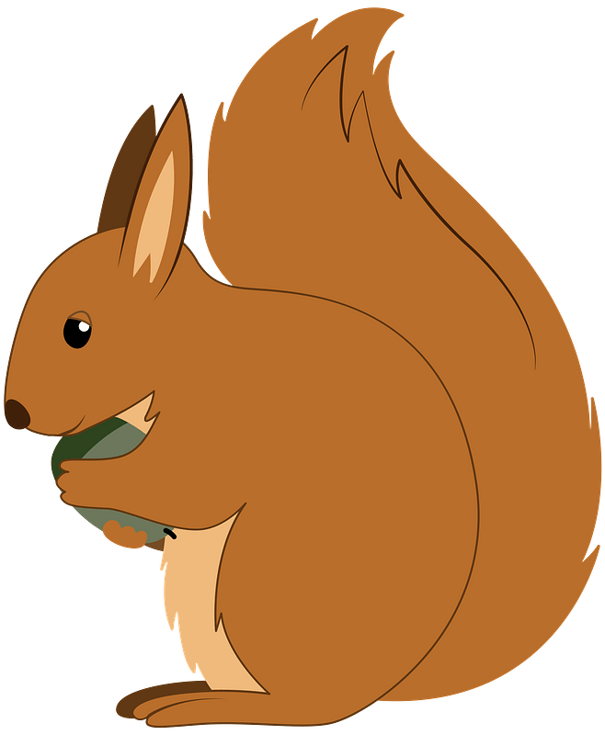


Be honest, now …
What are some things that easily distract us?
It seems that life is full of things that distract us from our priorities.
  Today we consider God’s call to stay alert and focused on our relationship to Him.

Slide 4
Listen for an exhortation.
Revelation 3:1-2 (NIV) "To the angel of the church in Sardis write: These are the words of him who holds the seven spirits of God and the seven stars. I know your deeds; you have a reputation of being alive, but you are dead. 2 Wake up! Strengthen what remains and is about to die, for I have not found your deeds complete in the sight of my God.

Slide 5
Guard Against Complacency
How did the Lord identify Himself to the believers in Sardis and what does it say about His character?
What was the reputation of the church to those who viewed it from outside?
What was the Lord’s assessment?

Slide 6
Guard Against Complacency
What was the two‑pronged appeal of the Lord if the church was to be more of what He expected it to be?
What are some symptoms of spiritual complacency in an individual?
What are some ways a church today may be demonstrating spiritual complacency?

Slide 7
Guard Against Complacency
How can a church appear to be alive and thriving and yet be dead?
Appear to Be Alive | Yet Actually Dead

Slide 8
Listen for Jesus’ warnings.
Revelation 3:3 (NIV) Remember, therefore, what you have received and heard; obey it, and repent. But if you do not wake up, I will come like a thief, and you will not know at what time I will come to you.

Slide 9
Maintain Vigilance
The Lord called for change in the church. What were the verbs used to exhort the church? (Note the different words used in different versions of the Bible.)
What warning is issued for failing to remember, obey, and repent?
God is not a thief; how does the “thief” analogy apply to the Lord’s coming?

Slide 10
Maintain Vigilance
What does that “thief” analogy mean for our disposition (our attitudes and actions) while we wait for Him?
What are some things we can do to keep our focus on Jesus? What advice would you give to a young Christian who asked, "How can I keep from sinning?"

Slide 11
Maintain Vigilance
What are some consequences of not being spiritually alert?

Slide 12
Listen for who is “awake” in Sardis.
Revelation 3:4-6 (NIV) Yet you have a few people in Sardis who have not soiled their clothes. They will walk with me, dressed in white, for they are worthy. 5 He who overcomes will, like them, be dressed in white. I will never blot

Slide 13
Listen for who is “awake” in Sardis.
out his name from the book of life, but will acknowledge his name before my Father and his angels. 6 He who has an ear, let him hear what the Spirit says to the churches.

Slide 14
Reflect the Worth Christ Gives
How do we know that not all the Christians in Sardis were "asleep"?
What imagery is used to describe the faithful?
What do white and white raiment symbolize?
What promise of assurance does the Lord offer to the faithful?

Slide 15
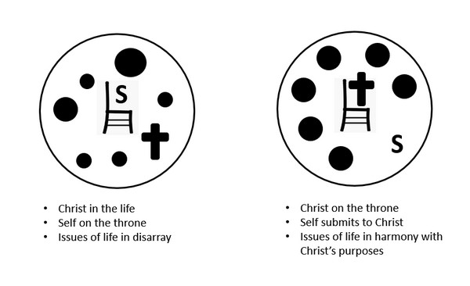
Reflect the Worth Christ Gives
What does it mean to "overcome" as a Christian?

Slide 16
Application
Celebrate.
  Thank God for salvation and the way He has worked in your life.
  Celebrate what He has done but ask God to keep you from resting on what He has done in the past.

Slide 17
Application
Create a timeline.
  Chart out your spiritual progress beginning with the moment you placed your trust in Christ.
  Note the high points and times you faltered in your walk with Christ.
  Use this to challenge yourself to continued growth in Christ.

Slide 18
Application
Stand together.
  God never meant for the Christian life to be lived alone.
  Partner with another Christian to help each other stay faithful and focused on Christ.
  Set aside specific times when you can meet, discuss victories and challenges, and pray for each other.

Slide 19
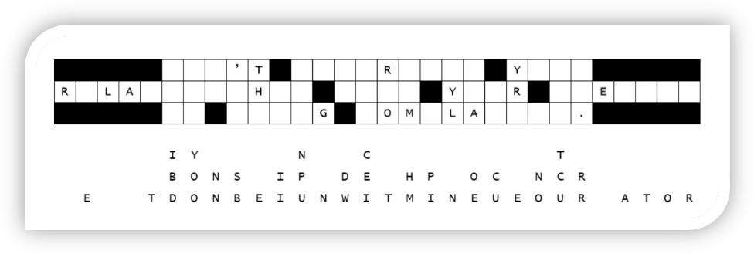

Family Activities
Hooligans, I’m tellin’ you sarge! The marquee is decimated. Send help. Contact https://tinyurl.com/2dev7b7p for assistance. And let folks know there’s further good clean fun and games for the whole family on that web sight.

Slide 20
Vigilant Against Complacency
July 4

