Slide 1
Valued by God
January 15

Slide 2
Video Introduction
View Video

Slide 3
Think about it …
When have you been surprised by what someone was able to accomplish?
Sometimes people we had doubts about turned out pretty good.
We shouldn’t write them off, but value their potential
God values all life and we should too.

Slide 4
Listen for how well God knew David.
Psalm 139:1-6 (NIV) O LORD, you have searched me and you know me. 2 You know when I sit and when I rise; you perceive my thoughts from afar. 3 You discern my going out and my lying down; you are familiar with all my

Slide 5
Listen for how well God knew David.
ways. 4 Before a word is on my tongue you know it completely, O LORD. 5 You hem me in--behind and before; you have laid your hand upon me. 6 Such knowledge is too wonderful for me, too lofty for me to attain.

Slide 6
God Values Us
What words and phrases did the psalmist use to describe the extent of God’s knowledge about him?
How did the psalmist respond to his awareness of the Lord’s vast knowledge about him?

Slide 7
God Values Us
How is it both frightening and comforting to realize how completely you are known by God?
⇨ What is most amazing is that with all He knows about you and me, He still loves us!!!
Frightening | Comforting

Slide 8
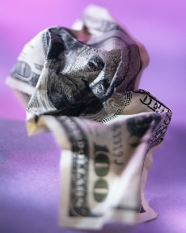
God Values Us
If you wad up and trample a $100 bill like a piece of paper trash, it is still valuable.
Even though crumpled, it is still worth $100
The government still says it has worth – no matter the condition.

Slide 9
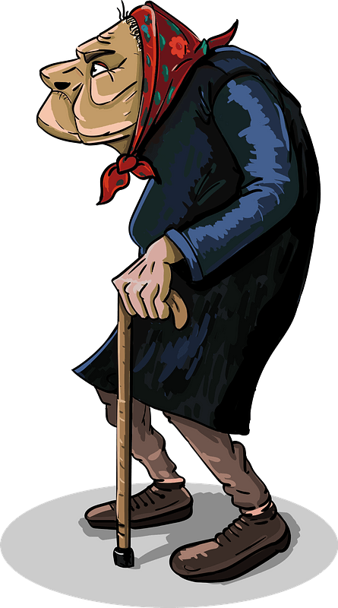
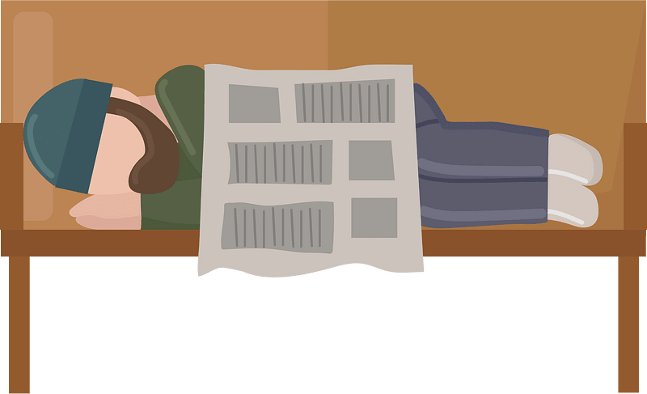
God Values Us
Consider that this concept can be applied to how our culture treats people that it considers expendable, worth throwing away. What kind of people do certain parts our culture feel are expendable; even wish they would just go away?

Slide 10
God Values Us
God sees and knows all these people just like He knew the Psalmist.
God considers them valuable! He loves them each.
God’s grace restores all who repent and seek His forgiveness.
God is always with us.
He is mindful of our daily schedules, activities, and thoughts.

Slide 11
Listen for the scope of God’s presence.
Psalm 139:7-10 (NIV) Where can I go from your Spirit? Where can I flee from your presence? 8 If I go up to the heavens, you are there; if I make my bed in the depths, you are there. 9 If I rise on the wings of the dawn, if I settle on the far side of the sea, 10 even there your hand will guide me, your right hand will hold me fast.

Slide 12
God Is with Us
With what extreme descriptors does he describe the omnipresence of the Lord?
What confidence does the psalmist express in the Lord who is ever present?
How does God's presence with you everywhere and at all times make a statement about how He views human life, about His regard for you?

Slide 13
God Is with Us
What were some times in your life when you especially needed to feel the presence of God?
Why is that assurance of God's presence sometimes hard to find?
What can you do to increase the awareness of God's constant presence in your life?

Slide 14
Listen for a hidden place where God is at work.
Psalm 139:13-16 (NIV) For you created my inmost being; you knit me together in my mother's womb. 14 I praise you because I am fearfully and wonderfully made; your works are wonderful, I know that full well. 15 My frame

Slide 15
Listen for a hidden place where God is at work.
was not hidden from you when I was made in the secret place. When I was woven together in the depths of the earth, 16 your eyes saw my unformed body. All the days ordained for me were written in your book before one of them came to be.

Slide 16
God Created Us, Has A Plan for Each of Us
How did the psalmist describe God’s involvement in human life?
How do these verses affirm and encourage us to see value in all human life?
So what should characterize our treatment of others … the unborn, the sick, poor, disabled, and elderly, in light of the fact that we are all fearfully and wonderfully made?

Slide 17
God Created Us, Has A Plan for Each of Us
What has our society lost in devaluing human life?
How can believers today embrace life's value in a world that devalues life?

Slide 18
Application
Confess
Ask the Lord to search your heart and reveal areas where you have thought less of others due to physical, intellectual, age, or social differences.
Confess this to the Lord who is ready to forgive.

Slide 19
Application
Encourage.
Encourage those around you who face physical or mental challenges, feel insignificant because of their age, or are slighted by others because of race or social status.
Remind them that God loves them and has a plan for their lives.
Spend time listening to their stories, and display the love of Christ.

Slide 20
Application
Speak Up.
Speak up for those who cannot speak up for themselves.
This is especially needed in our culture that condones abortion, the killing of unborn children.
Get involved by supporting a local crisis pregnancy center. Learn more at psalm139project.org

Slide 21
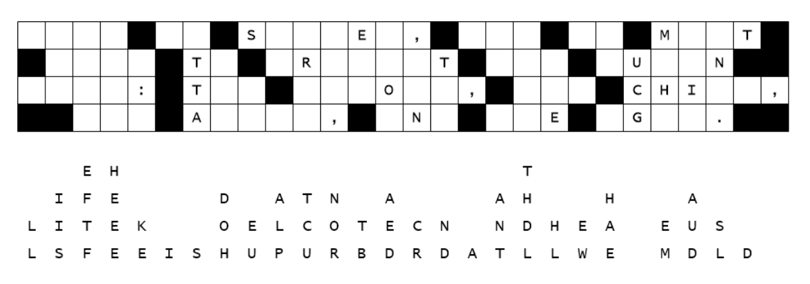
Family Activities
Oops … we used the wrong adhesive to paste in the letters. Can you help Spiros the Spy figure out the secret message from Ziboda? Help is available at https://tinyurl.com/859f5tdc along with other fun Family Activities

Slide 22
Valued by God
January 15

