Slide 1
United Through the Spirit
July 17

Slide 2

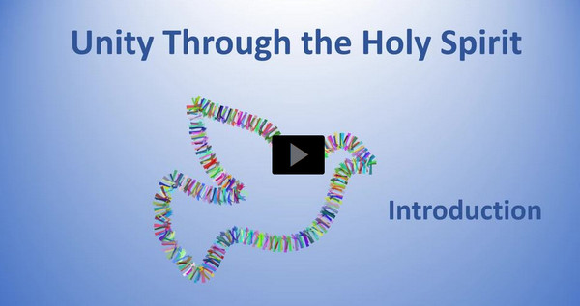
Video Introduction
View Video

Slide 3
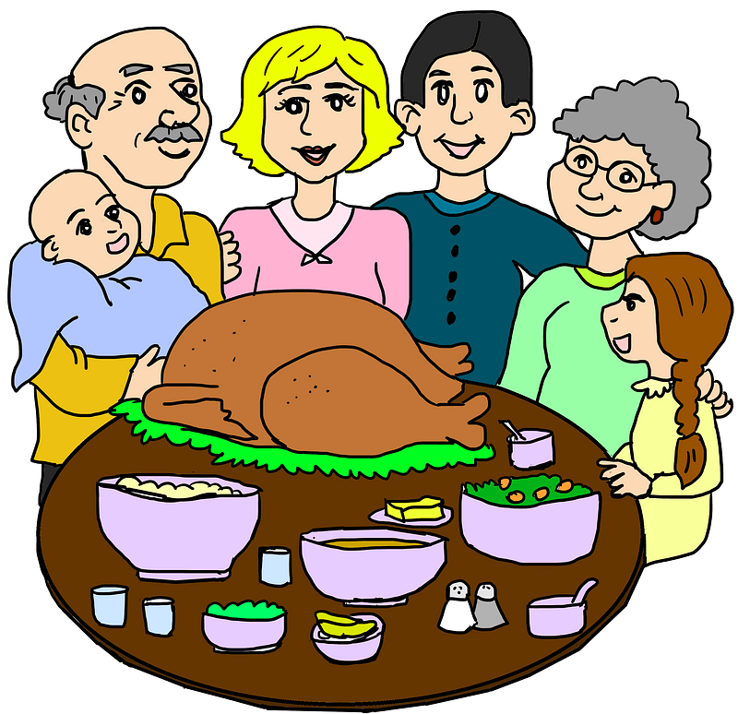
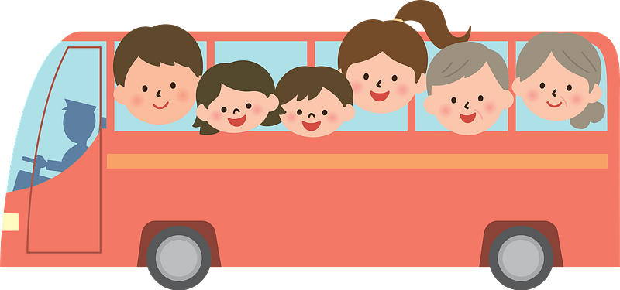
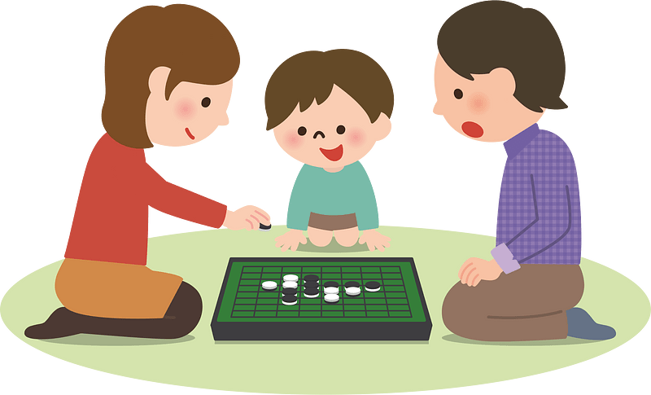
Consider …
What is the best thing about being a part of a group that has a “family feel” to it?
Believers do belong to a family … the Body of Christ, the Church
  We love and serve Christ when we love and serve His Body, the Church.
  The Holy Spirit brings us together as one church.

Slide 4
Listen for what is different, what is the same.
1 Corinthians 12:4-7 (NIV) There are different kinds of gifts, but the same Spirit. 5 There are different kinds of service, but the same Lord. 6 There are different kinds of working, but the same God works all of them in all men. 7 Now to each one the manifestation of the Spirit is given for the common good.

Slide 5
Spiritual Gifts for the Common Good
So what things were specified different, what things were the same?
Different | Same

Slide 6
Spiritual Gifts for the Common Good
Paul used different words to talk about something that is a “gift”? What does use of these different words have to say about the purpose of spiritual gifts?
How have you seen the principle in these verses play out in your church?
Why is a person in no position to boast about his or her spiritual gift?

Slide 7
Spiritual Gifts for the Common Good
What evidence do you see that Paul is addressing believers not only in Corinth but believers everywhere for all time?
What reasons exist that Christians today are ignorant about Spiritual gifts?
How would it affect a church, making it different if every believer understood and exercised his/her spiritual gift?

Slide 8
Listen for how Spiritual Gifts are vital.
1 Corinthians 12:8-11 (NIV) To one there is given through the Spirit the message of wisdom, to another the message of knowledge by means of the same Spirit, 9 to another faith by the same Spirit, to another gifts of healing by that one Spirit, 10 to another miraculous powers, to another

Slide 9
Listen for how Spiritual Gifts are vital.
prophecy, to another distinguishing between spirits, to another speaking in different kinds of tongues, and to still another the interpretation of tongues. 11 All these are the work of one and the same Spirit, and he gives them to each one, just as he determines.

Slide 10
Variety of Gifts for Common Good
Gift | Meaning
Message of wisdom | 1. Facts for wise decision
Message of knowledge | 2. New understanding from Scripture
Faith | 3. Trust God no matter what
Gifts of healing | 4. Powerful prayer over illness
Miraculous powers | 5. Show God’s supernatural power
Prophecy | 6. Speak God’s message to others
Distinguishing between spirits | 7. Recognize which spirits are present
Speaking in different languages | 8. Miraculous speech, good linguist
Interpretation of language | 9. Interpret public miraculous speaking

Slide 11

Variety of Gifts for Common Good
What could you say to someone who admits they are struggling with the feeling that they had nothing to offer to the ministry of their church?

Slide 12
Listen for how the Church is One Body
1 Corinthians 12:12-14 (NIV) The body is a unit, though it is made up of many parts; and though all its parts are many, they form one body. So it is with Christ. 13 For we were all baptized by one

Slide 13
Listen for how the Church is One Body
Spirit into one body--whether Jews or Greeks, slave or free--and we were all given the one Spirit to drink. 14 Now the body is not made up of one part but of many.

Slide 14
The Holy Spirit Makes Us One Body
In what way is the church similar to the human body?
What does this analogy tell us why every member of the church is important for its ability to function effectively?
Why should members not belittle the gift they have been given?

Slide 15
The Holy Spirit Makes Us One Body
Why do you think some of the gifts/ministries are (incorrectly) held in higher regard?
How can our group best use our gifts to serve Christ and His church?

Slide 16
Application
Think.
  Unfortunately, pride and jealousy are still present in our churches today regarding the administration of spiritual gifts.
  Pray for your church and ask the Spirit to empower and unify the members so that they can work together for the common good.

Slide 17
Application
Decide.
  Even if you’ve previously determined your spiritual gift or gifts, it never hurts to reaffirm it.
  Take a spiritual gifts inventory to assist you in determining how the Holy Spirit has gifted you. https://mintools.com/spiritual-gifts-test.htm
  Decide to find out or re-affirm your spiritual gift.

Slide 18
Application
Surveys and inventories are one way to determine your spiritual giftedness but another effective way is to talk to a trusted believer.
  Ask a mature believer who knows you well to share what they see in you regarding spiritual gifts.
  Then speak to your pastor or a church leader about ways you can use your giftedness.

Slide 19
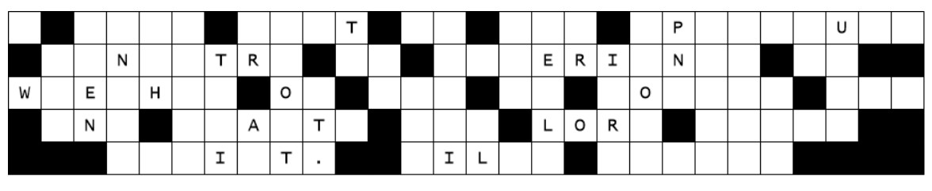
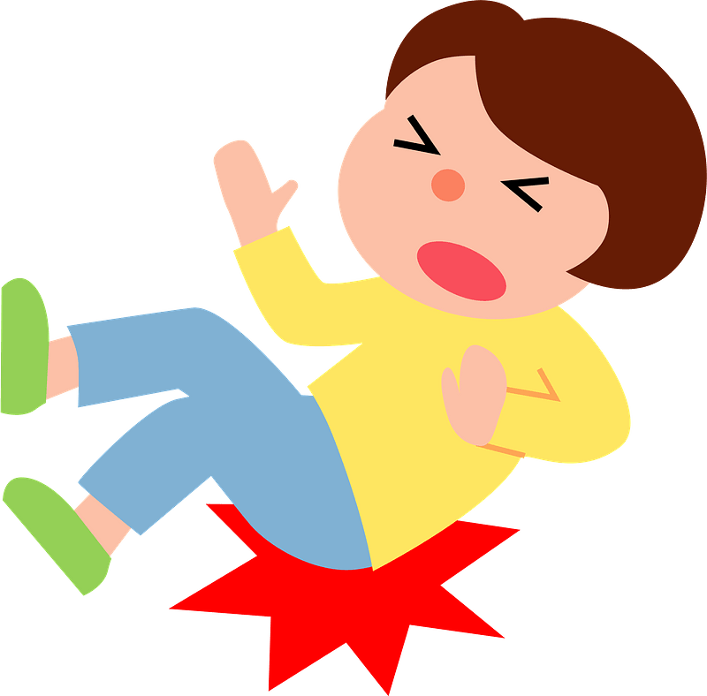
Family Activities
The letters – they’ve fallen, and I can’t get them up. Help me out … it’s an important message. Help and further Family Activities are available at https://tinyurl.com/5926yxne

Slide 20
United Through the Spirit
July 17

