Slide 1
Uncompromising with Truth
June 20

Slide 2
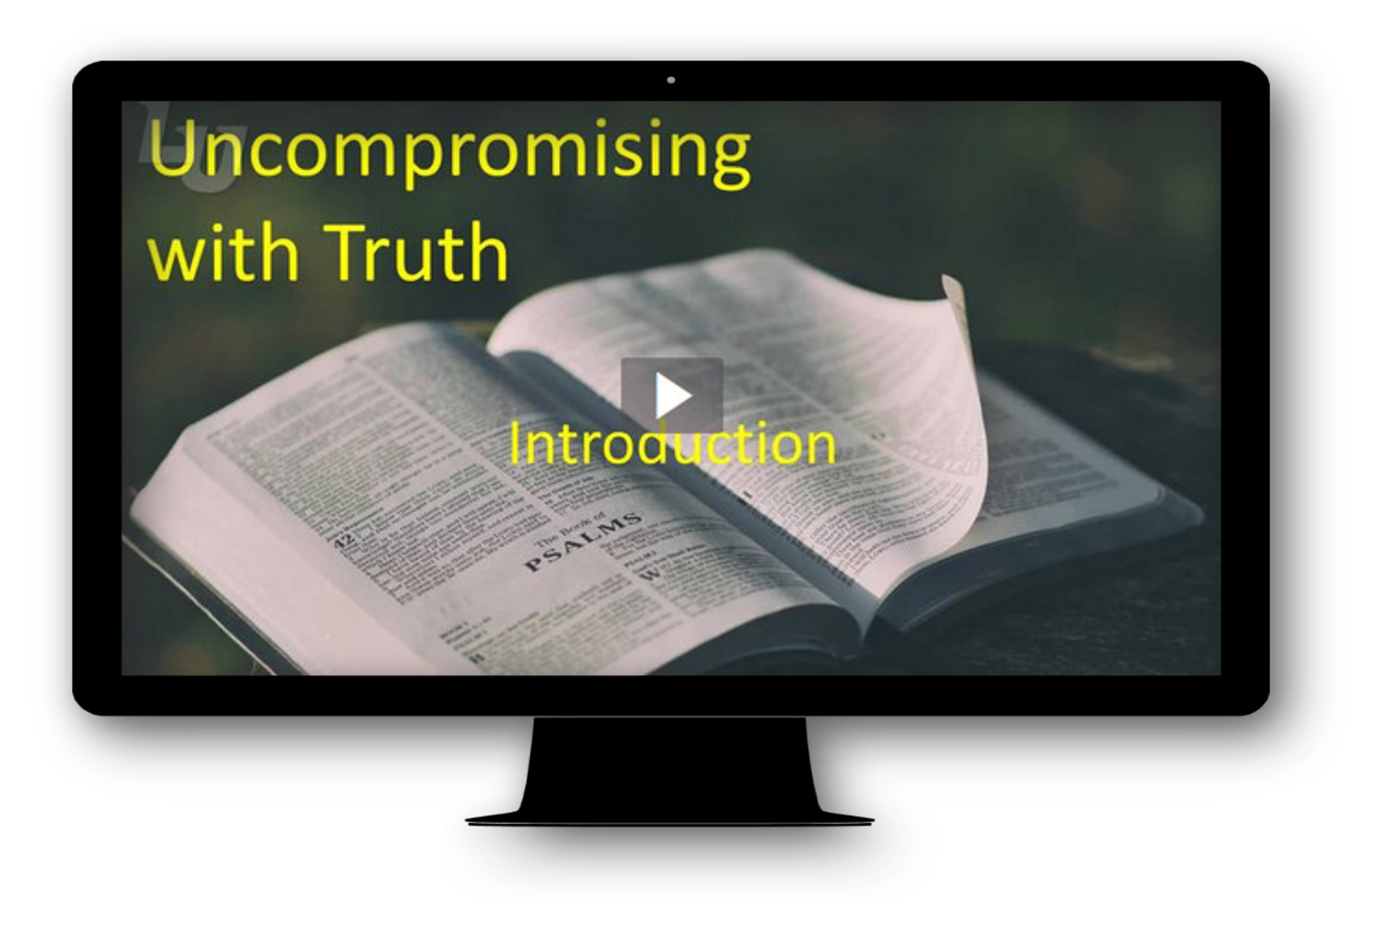
Video Introduction
View Video

Slide 3
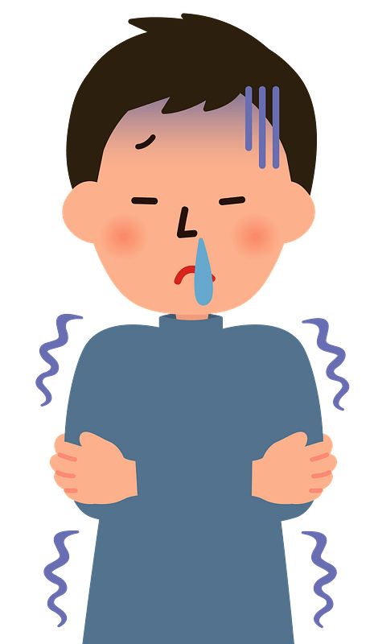


Really?
What strange philosophy or common misconception (urban myth, old wives’ tale, etc.) have you heard of?
Most of these concepts are puzzling … some are actually dangerous.
  There is little truth involved.
  Contrasted to biblical truth about Christ, where there is no room for compromise.

Slide 4
Listen for a commendation.
Revelation 2:12-13 (NIV) "To the angel of the church in Pergamum write: These are the words of him who has the sharp, double-edged sword. 13 I know where you live--where Satan has his throne.

Slide 5
Listen for a commendation.
Yet you remain true to my name. You did not renounce your faith in me, even in the days of Antipas, my faithful witness, who was put to death in your city--where Satan lives.

Slide 6
A Bold Witness for Christ
What does it mean that Christ has a "sharp, double-edged sword"?
For what did He commend them? What statements and what actions demonstrated the depth of their convictions about Him as the Christ?
How did He characterize the city?

Slide 7
A Bold Witness for Christ
In what ways could it be said that Satan lives in your city?
What are some temptations Christians face living in a non-Christian culture?

Slide 8
Listen for a condemnation.
Revelation 2:14-15 (NIV) Nevertheless, I have a few things against you: You have people there who hold to the teaching of Balaam, who taught Balak to entice the Israelites to sin by eating food sacrificed to idols and by committing sexual immorality. Likewise you also have those who hold to the teaching of the Nicolaitans.

Slide 9
Don’t Tolerate False Teaching
What complaint does the Lord have against the Christians at Pergamos? What two specific examples of their tolerance does He cite?
How can we determine whether a teaching or teacher is false?
What kinds of dangers or consequences arise from false teaching?

Slide 10
Don’t Tolerate False Teaching
What "little" sins do we tend to allow into our lifestyle and habits?
What is the best way to deal with Christians (whether real or false) who circulate unbiblical ideas?
What are some potential problems for churches that discipline members publicly?

Slide 11
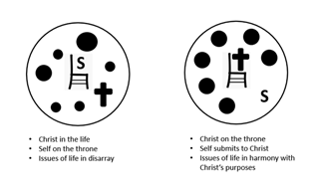
Don’t Tolerate False Teaching
What should it mean to us that Jesus doesn’t overlook sin, even if we are doing lots of good deeds?
Jesus will still be in
your life, but when
you disregard His
rule in your life,
things will go awry,
you become out of
fellowship with Him

Slide 12
Listen for a promise to overcomers.
Revelation 2:16-17 (NIV) Repent therefore! Otherwise, I will soon come to you and will fight against them with the sword of my mouth. 17 He who has an ear, let him hear what the Spirit says to the churches.

Slide 13
Listen for a promise to overcomers.
To him who overcomes, I will give some of the hidden manna. I will also give him a white stone with a new name written on it, known only to him who receives it.

Slide 14
Unwillingness to Compromise
What admonition did the Lord give to the church at Pergamos?
What does repentance have to do with following Christ?
What two objects are used to describe the promise of the Lord to those who overcome tolerance of evil and choose spiritual victory?

Slide 15
Unwillingness to Compromise
Note the possible meanings of the promises.
Hidden manna | White stone, new name written
God’s provision God’s bounty | Symbol of acquittal (opposite of being “black balled”) Symbol if invite to heavenly banquet Symbol of the new character of the believer

Slide 16
Unwillingness to Compromise
What does conquering or overcoming look like in our daily lives?
How can we resist the influence of the world around us?

Slide 17
Application
Pray.
  We live in a culture full of compromise.
  Pray, asking God to strengthen you to stand strong in the face of compromise.
  Pray also for your church to never compromise in matters of biblical truth.

Slide 18
Application
Evaluate.
  List ways people are tempted to compromise their faith or tolerate false teachings.
  Do a self-assessment to identify any ways you might have compromised on biblical teaching.
  Repent and determine to stand with Christ.

Slide 19
Application
Confront.
  Who might you know who is stepping into false teaching or compromise.
  Lovingly confront that person and urge him or her to come back to the truth of Christ.
  Let God use you in the life of another, but it’s important to do so by “speaking the truth in love” (Eph. 4:15).

Slide 20
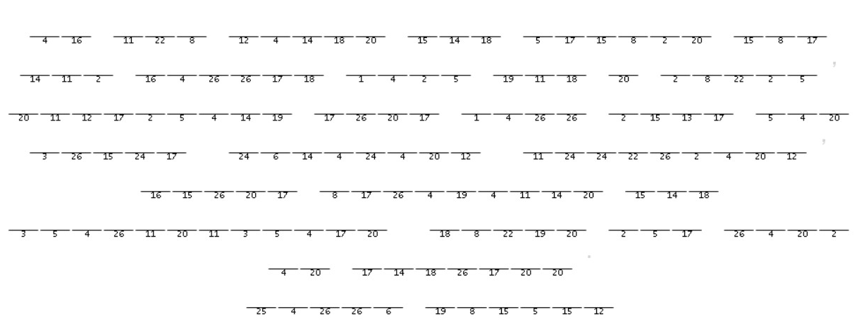
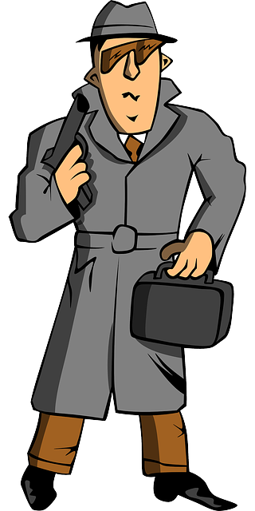
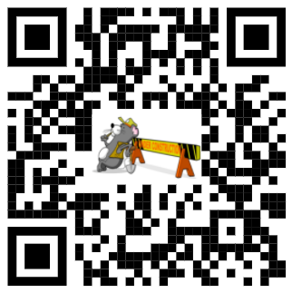
Family Activities
Our underground (literally) agent in Andslandsvir passed this message on to us. Only you have the key. Decode it and communicate it to your head deacon. If you get stuck, use the URL code to link to an assistance web page. Other family intrigues can also be found.

Slide 21
Uncompromising with Truth
June 20

