Slide 1
Uncomplicated Relationships
October 6

Slide 2
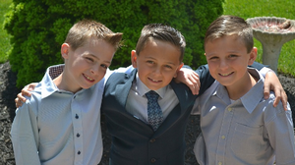
Think about it …
What are some key characteristics you look for in a good friend?
Paul wrote to the church at Thessalonica about relationships with others.
He wrote about purity and honor among friends.
Today we consider how we should let God’s love drive how we relate to others.

Slide 3
Listen for what is God’s will.
1 Thessalonians 4:3-5 (NIV) It is God's will that you should be sanctified: that you should avoid sexual immorality; 4 that each of you should learn to control his own body in a way that is holy and honorable, 5 not in passionate lust like the heathen, who do not know God;

Slide 4
Absolute Purity in Relationships
What are God’s desires for our sexuality? How is the Christian’s sexual conduct to be different from that of the non-Christian?
How would you respond to someone who says it is possible to be a good Christian while also being sexually immoral?
How do the media influence our attitudes about sex?

Slide 5
Absolute Purity in Relationships
What are some “relationship rules” you’ve seen work well?
Paul says to live a life that is “holy and honorable”. What is a “holy” life?

Slide 6
Listen for God’s intent.
1 Thessalonians 4:6-8 (NIV) and that in this matter no one should wrong his brother or take advantage of him. The Lord will punish men for all such sins, as we have already told you and warned you. 7 For God did not call us to be impure, but to live a holy life. 8 Therefore, he who rejects this instruction does not reject man but God, who gives you his Holy Spirit.

Slide 7
Don’t Take Advantage of Others
What are prominent cultural views and attitudes about the subject matter in verse 6a?
Identify reasons Paul gave for living holy lives?
In what way has God enabled believers to live according to His high standards of morality?

Slide 8
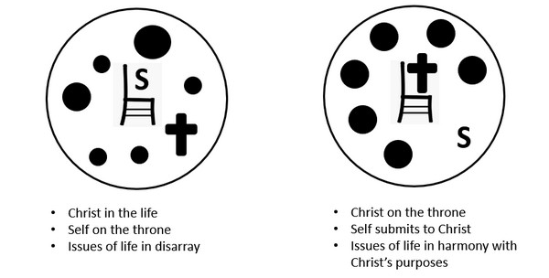
Don’t Take Advantage of Others
When people ignore or reject God’s instructions on sexual behavior, what are they rejecting?
How can someone wrong another person through sexual misbehavior?
Why do you think God places a high value on purity?

Slide 9
Listen for how to act towards others.
1 Thessalonians 4:9-12 (NIV) Now about brotherly love we do not need to write to you, for you yourselves have been taught by God to love each other. 10 And in fact, you do love all the brothers throughout Macedonia. Yet we urge you, brothers,

Slide 10
Listen for how to act towards others.
to do so more and more. 11 Make it your ambition to lead a quiet life, to mind your own business and to work with your hands, just as we told you, 12 so that your daily life may win the respect of outsiders and so that you will not be dependent on anybody.

Slide 11
Focus on Your Own Actions
For what does Paul commend the Thessalonian believers? What command of God were the Thessalonians known for obeying?
How did they learn about love?
What does it mean to “lead a quiet life”?

Slide 12
Focus on Your Own Actions
What is the result of living a quiet, respected, and responsible life? What reasons does Paul give for acting this way?
What influence on people and society can a hardworking, quiet person have?
What are some ways we can practice brotherly love as a family of believers?

Slide 13
Application
View Video

Slide 14
Application
Rest.
Take a day off from any work.
Rest your mind and body—and don’t convince yourself you are not being productive.
Proper rest will make you more productive.

Slide 15
Application
Refresh.
Spend time in prayer and worship, both by yourself and with others.
Let the things of God fill your mind and renew you.
Memorize Philippians 4:8: “Finally, brothers and sisters, whatever is true, whatever is noble, whatever is right, whatever is pure, whatever is lovely, whatever is admirable—if anything is excellent or praiseworthy—think about such things.”

Slide 16
Application
Reflect.
Use a journal and write down what God is teaching you.
Record your evaluation of the past day or week, because such reflection will spur you on to greater things.

Slide 17
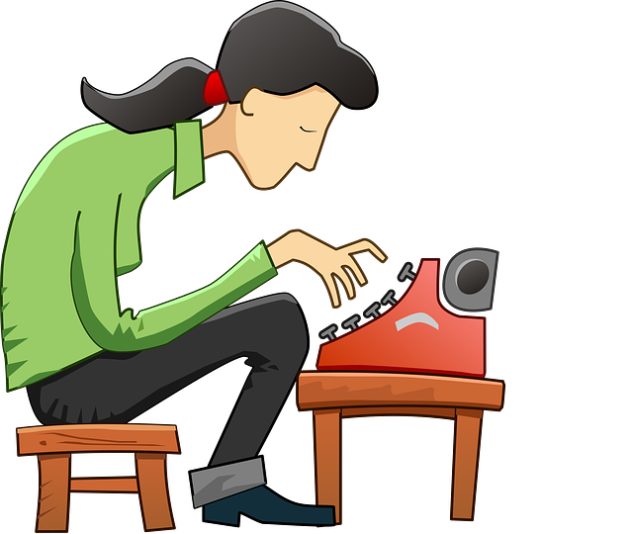
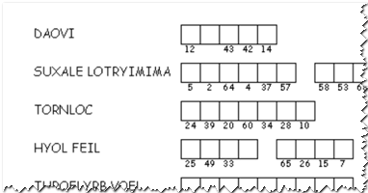
Family Activities
“DAOVI” … What kind of word is that? When you fix this and the other so-called words, I think there’s a good quote in there, somehow. If you need help, go to https://tinyurl.com/yya5zadc .
There’s other Family Activities there also.

Slide 18
Uncomplicated Relationships
October 6

