Slide 1
The Truth of the Resurrection
April 12

Slide 2
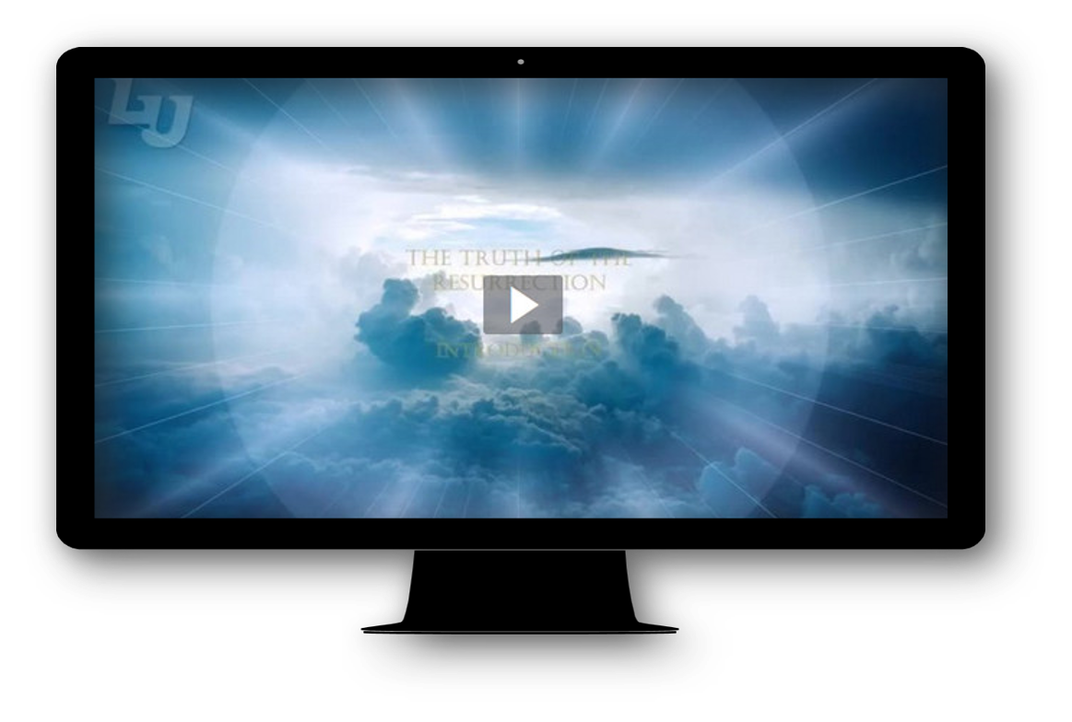
Introduction Video
View Video

Slide 3
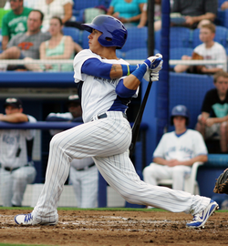
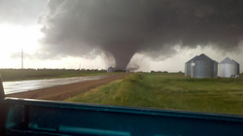
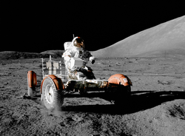
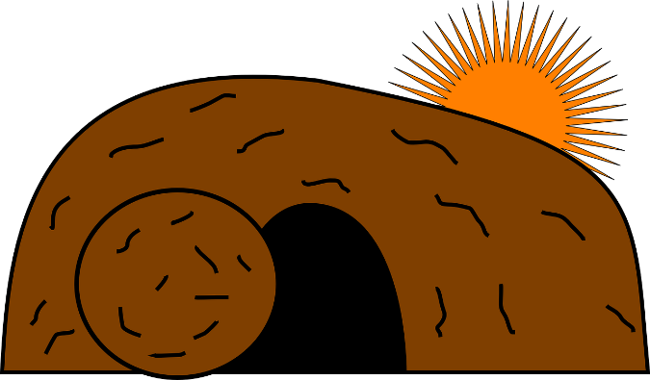
Remember that time …
When have you been an eyewitness to an exciting event?
None of us were able to be at this event … the resurrection of Christ.
  Even though we weren’t there it is an historical fact.
  There were many eyewitnesses.

Slide 4
Listen for why our faith is not in vain.
1 Corinthians 15:1-3 (NIV) Now, brothers, I want to remind you of the gospel I preached to you, which you received and on which you have taken your stand. 2 By this gospel you are saved, if you hold firmly to the word I preached to

Slide 5

Listen for why our faith is not in vain.
you. Otherwise, you have believed in vain. 3 For what I received I passed on to you as of first importance: that Christ died for our sins according to the Scriptures.

Slide 6
Christ Died
What verbs did Paul use in reference to the gospel that remind us of what we are to do with the message and what affect it has on others?
What is the primary element of the gospel Paul identified?
According to Paul, why is it important to “hold firmly to the word”?

Slide 7
Christ Died
What do you think it means for you to “hold firmly to the word”?
Why did Paul pass on what he had received?
How did Christ’s life fulfill the Scriptures?

Slide 8
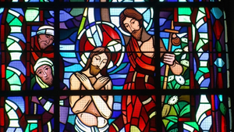
Christ Died
What makes the death of Jesus so significant?
What emotions do you experience when you consider that Jesus died for your sins?

Slide 9
Listen for the heart of our Christian faith.
1 Corinthians 15:4 (NIV) that he was buried, that he was raised on the third day according to the Scriptures,.

Slide 10
Christ Was Resurrected
What is the importance of saying Jesus was buried?
The death of Jesus is one major element of the gospel, but what is the second?
Why would it be disastrous for a person to believe only some of what is in verses 3 & 4?

Slide 11
Christ Was Resurrected
Why do you think Paul had to remind people of such basic truths? Why do people today need to be likewise reminded – especially at Easter?
How can we respond to someone who rejects the truth of Christ’s resurrection?

Slide 12
Listen for eyewitness experiences.
1 Corinthians 15:5-8 (NIV) and that he appeared to Peter, and then to the Twelve. 6 After that, he appeared to more than five hundred of the brothers at the same time, most of whom are still living, though some have fallen asleep. 7 Then he appeared to James, then to all the apostles, 8 and last of all he appeared to me also, as to one abnormally born.

Slide 13
Christ Seen Alive by Many
Make a list of the eyewitnesses Paul mentions.
Why do you think he provided a list of some who saw Jesus after the resurrection? What do you suppose influenced his choices?

Slide 14
Christ Seen Alive by Many
Note the choice of these eyewitnesses:
  People who did not expect to see Him
  Different people, different times, different places
  Peter (failed by denial), would not be expecting personal encounter
  The Twelve – not easily deceived – they knew Him
  James – half brother, previously a skeptic
  Paul – post ascension appearance, changed his life.

Slide 15
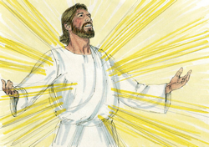
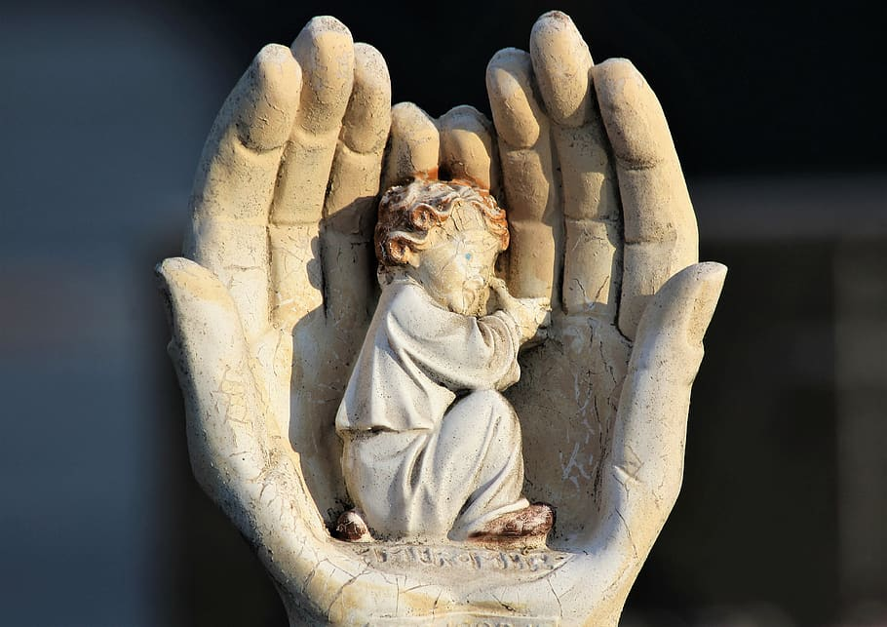
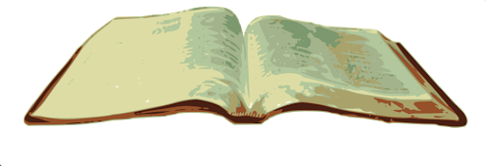
Christ Seen Alive by Many
How does Christ appear or make Himself known to us today?

Slide 16
Application
Trust.
  Commit your life to the risen Christ.
  “If you confess with your mouth, ‘Jesus is Lord,’ and believe in your heart that God raised him from the dead, you will be saved” (Rom. 10:9)
  Read the inside cover of your Bible Study book for more information.
  Talk with your Bible Study Leader

Slide 17
Application
Read.
  For alternative theories about the resurrection and replies to those theories, read Jim Warner Wallace, Cold-Case Christianity (Colorado Springs, CO: David C. Cook, 2013), 41-50.

Slide 18
Application
Share.
  Think of someone who needs to know the truth of the resurrection of Jesus. Write that individual’s name down and pray for the person.
  Pray also for an opportunity to share about Christ’s resurrection.
  Be ready and willing to engage in a conversation on the powerful truth of the resurrection, an event that changes everything for us!

Slide 19
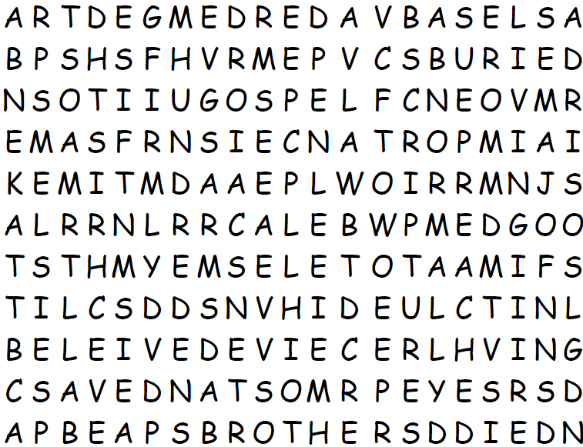
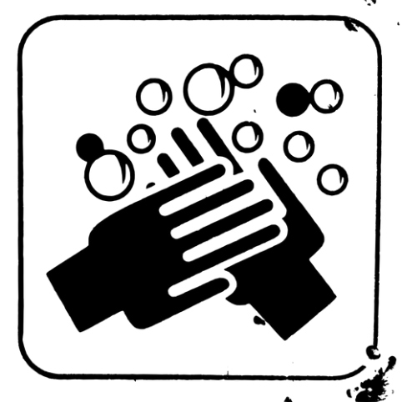
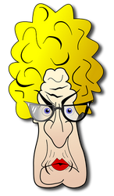
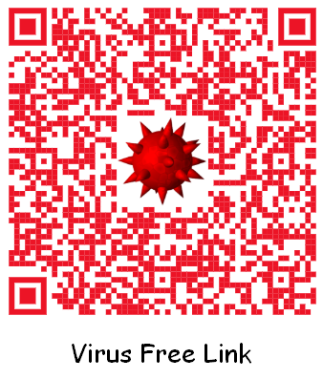
Family Activities
Make sure to wash your hands for at least 20 seconds before you work on this puzzle! Humph! I don’t want to catch anything when I grade them! Follow the virus free link to the solution and other socially safe distance activities.

Slide 20
The Truth of the Resurrection
April 12

