Slide 1
Truth Matters
January 25

Slide 2

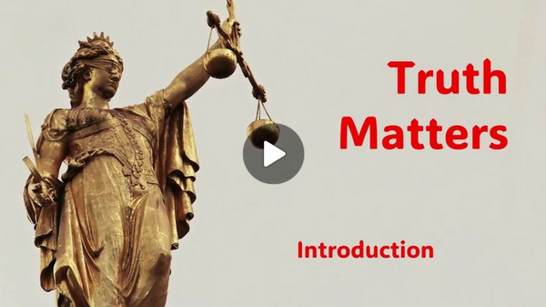
Video Introduction
View Video

Slide 3



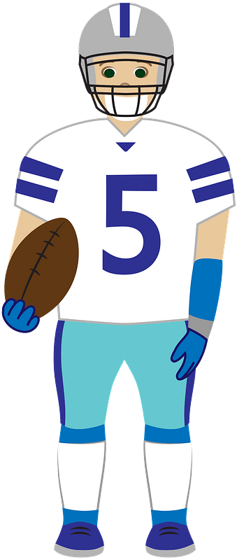



It was an eye opener …
When have you changed your opinion of something?
These choices are based on changing opinions.
  Truth does not reside in our own opinions and reasoning.
  Truth is established by God. It is Truth for all persons, for all situations.

Slide 4
Listen for the road to happiness.
Proverbs 16:20-25 (NIV) Whoever gives heed to instruction prospers, and blessed is he who trusts in the LORD. 21 The wise in heart are called discerning, and pleasant words promote instruction. 22 Understanding is a fountain of life to those who have it, but folly

Slide 5
Listen for the road to happiness.
brings punishment to fools. 23 A wise man's heart guides his mouth, and his lips promote instruction. 24 Pleasant words are a honeycomb, sweet to the soul and healing to the bones. 25 There is a way that seems right to a man, but in the end it leads to death.

Slide 6
Wisdom from God
According to this passage, what is the true way to happiness and blessing?
Verse 20 connects understanding the word with trusting the Lord. How are truth and trust linked here?
Whoever gives heed to instruction prospers, and blessed is he who trusts in the LORD. The wise in heart are called discerning,

Slide 7
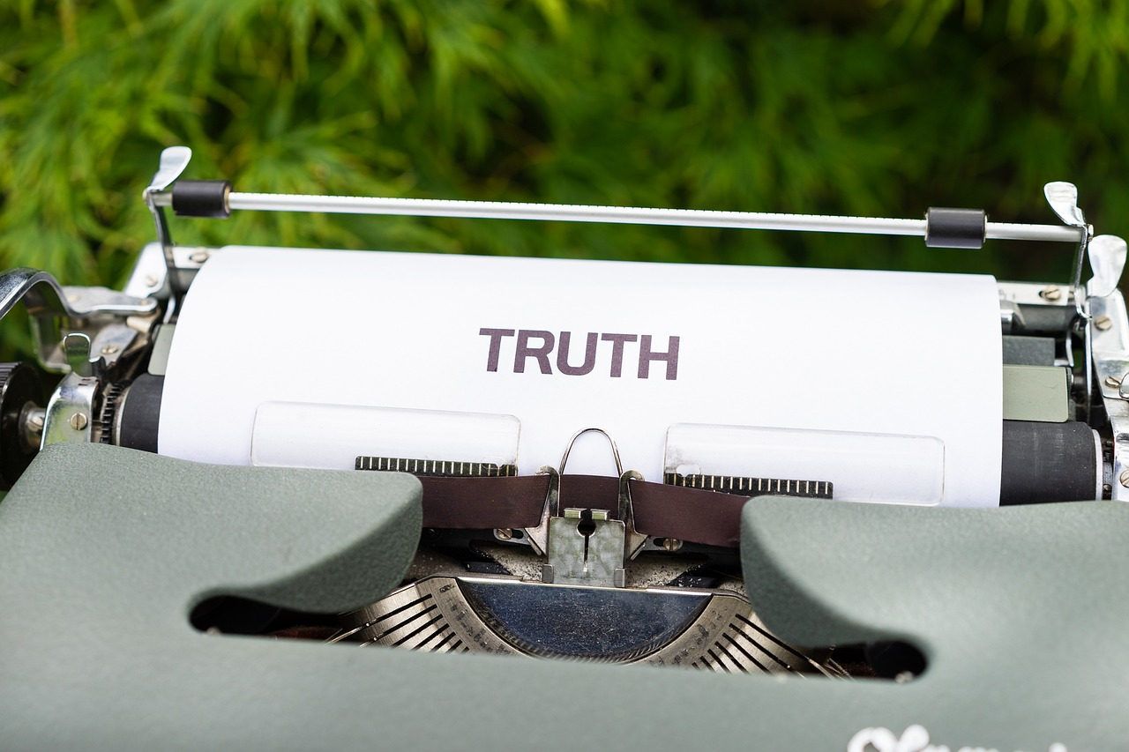
Wisdom from God
According to verses 21–24, how does truth affect the way we speak? What kind of speech flows from a truthful heart?
The wise in heart are called discerning, and pleasant words promote instruction. Understanding is a fountain of life to those who have it, but folly brings punishment to fools. A wise man's heart guides his mouth, and his lips promote instruction. Pleasant words are a honeycomb, sweet to the soul and healing to the bones.

Slide 8
Wisdom from God
Verse 25 warns that a way can seem right but lead to death. Why is “what seems right” not a reliable guide to truth?
What are some examples—personal, cultural, or biblical—where something felt right but turned out to be false or destructive?
How does this verse challenge the idea that sincerity alone is enough to please God?

Slide 9
Listen for an admission.
Proverbs 30:1-4 (NIV) The sayings of Agur son of Jakeh--an oracle: This man declared to Ithiel, to Ithiel and to Ucal: 2 "I am the most ignorant of men; I do not have a man's understanding. 3 I have not learned wisdom, nor have I knowledge of the Holy One.

Slide 10
Listen for an admission.
Who has gone up to heaven and come down? Who has gathered up the wind in the hollow of his hands? Who has wrapped up the waters in his cloak? Who has established all the ends of the earth? What is his name, and the name of his son? Tell me if you know!

Slide 11
Admit it … You Don’t Know It All
A man named Agur is writing to Ithiel and Ucal. What is his assessment of himself?
"I am the most ignorant of men; I do not have a man's understanding. I have not learned wisdom, nor have I knowledge of the Holy One.

Slide 12
Admit it … You Don’t Know It All
Why is this kind of humility an essential starting point for recognizing truth?
Why is it dangerous to assume we already understand truth well enough on our own?
What are some ways our culture often responds to ignorance or uncertainty?

Slide 13
Admit it … You Don’t Know It All
List the rhetorical questions in verse 4 which start with “Who has …”.
Who has gone up to heaven and come down? Who has gathered up the wind in the hollow of his hands? Who has wrapped up the waters in his cloak? Who has established all the ends of the earth? What is his name, and the name of his son? Tell me if you know!

Slide 14
Admit it … You Don’t Know It All
These are questions for which “God” is the only answer. What do these questions teach us about the source of ultimate truth?
Why is it important to believe that God’s truth is not just mostly true, but completely trustworthy?

Slide 15
Listen for a warning.
Proverbs 30:5-6 (NIV) "Every word of God is flawless; he is a shield to those who take refuge in him. 6 Do not add to his words, or he will rebuke you and prove you a liar.

Slide 16
Trust God’s Truth
Why is God’s word declared to be worthy of acceptance?
"Every word of God is flawless; he is a shield to those who take refuge in him.

Slide 17
Trust God’s Truth
God’s word is described as a shield. From what does God’s truth protect us?
  Personally?
  Mortally?
  Spiritually?
What are some modern ways God’s truth is distorted—either by adding human ideas or removing uncomfortable parts?

Slide 18
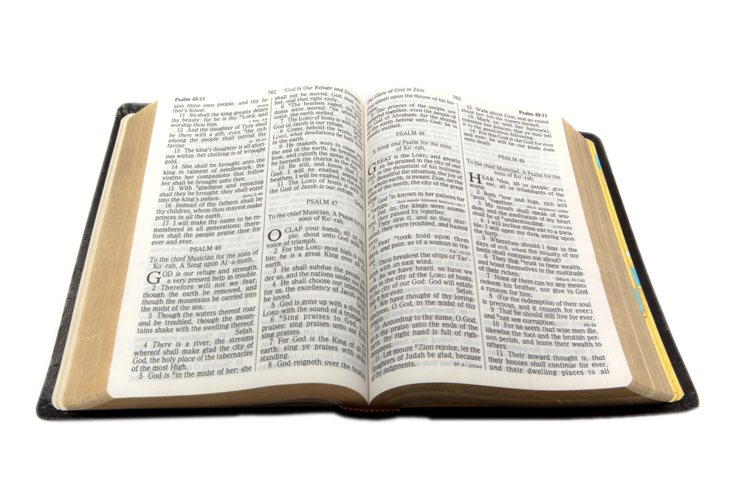
Trust God’s Truth
What practical steps can help us remain anchored in God’s word rather than cultural opinions or emotions?

Slide 19
Application
Accept
  Embrace God’s Truth as the foundation for your life.
  If you’ve not yet accepted Christ, this is the first step to discovering truth and experiencing freedom.

Slide 20
Application
Apply
  Apply God’s Truth to every area of your life.
  Commit to bringing every thought and decision in line with God’s truth,
  Let it guide your interactions, relationships, and personal choices.
  Make a list of truths you can apply this week.

Slide 21
Application
Affirm
  Acknowledge the truth with confidence and courage.
  Live it out boldly and confidently.
  Trust in God’s promises and protection.
  Find someone with whom you can share this message of truth.

Slide 22
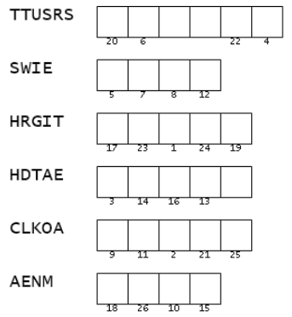

Double Puzzle
Ah, mes amis, permit me to explain—with order, precision, and the little grey cells fully engaged: This two-part secret message uses scrambled words from your Scripture passage. Put them in the correct order and use the numbers to place the letters in the second portion of the message. Observe carefully—some cells are punctuation marks. Help (and the ever popular crossword) can be found at https://tinyurl.com/bd7abhbt

Slide 23
Truth Matters
January 25

