Slide 1
Treasuring Who God Treasures
January 19

Slide 2
Video Introduction

Slide 3
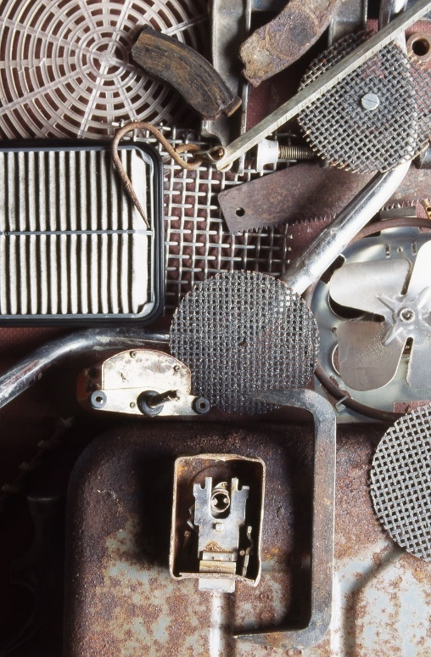
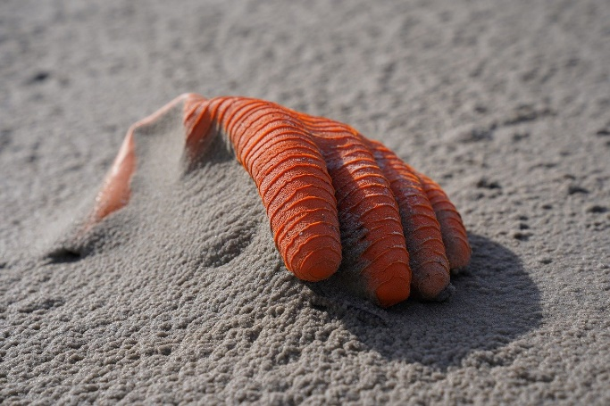
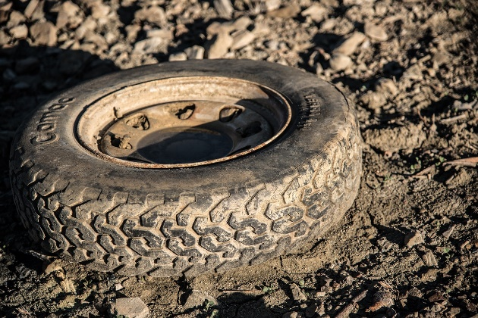
Remember what you saw …
When have you seen one person’s trash become another one’s treasure?
In today’s society some lives end up treated as “throw-away”
Reality is that life itself is a gift from God
God calls us to protect and preserve all lives

Slide 4
Listen for civil disobedience.
Exodus 1:16-17 (NIV) "When you help the Hebrew women in childbirth and observe them on the delivery stool, if it is a boy, kill him; but if it is a girl, let her live." 17 The midwives, however, feared God and did not do what the king of Egypt had told them to do; they let the boys live.

Slide 5
Fear of God
The king had a wicked plan to curb Hebrew population.
Issued a command to the Hebrew midwives
Kill all baby boy children – ok to keep the baby girls

Slide 6
Fear of God
What would devaluing male lives accomplish for Pharaoh?
What are some ways our culture devalues life?
How did the midwives respond, at least in practice?
What risks would be involved in disobeying the orders of a king?

Slide 7
Fear of God
Why does the Bible imply that this civil disobedience was acceptable?
What would be your options if an authority told you to do something within the law but against God’s law?
What parallel does that have in our society today in our culture?

Slide 8
Fear of God
What is the difference between “fearing” God and fearing people?
Fearing God | Fearing People

Slide 9
Fear of God
Inappropriate decisions by our government and our culture are the results of people’s need for Jesus in their lives
Communicating this truth and praying for revival may well do more to change the prevailing attitudes than only protesting.

Slide 10
Listen for more civil disobedience.
Exodus 1:22; 2:2-3 (NIV) Then Pharaoh gave this order to all his people: "Every boy that is born you must throw into the Nile, but let every girl live. … 2 and she became pregnant and gave birth to a son. When she saw that he

Slide 11
Listen for more civil disobedience.
was a fine child, she hid him for three months. 3 But when she could hide him no longer, she got a papyrus basket for him and coated it with tar and pitch. Then she placed the child in it and put it among the reeds along the bank of the Nile.

Slide 12
Action to Protect Others
Pharaoh increases infanticide policies.
Now the Egyptians were to be openly involved in the infanticide
Was not to be implemented on the sly by the midwives
Was to be carried out by “all his people”
Throw the baby boys in the Nile

Slide 13
Action to Protect Others
What is the connection between Pharaoh’s latest command and the birth of a baby boy to a Hebrew couple from the tribe of Levi?
What risky decisions did the mother take to protect her child? What action did she take?
How does God work in people’s hearts despite unjust and wicked laws against them?

Slide 14
Action to Protect Others
Note some fascinating parallels between Moses and Jesus
Moses | Jesus
Deliverer needed – God sends Moses Moses born in Egypt Pharaoh killed baby boys Moses – 40 years in the wilderness | World deliverer needed – God sends Jesus Jesus in Egypt part of childhood Herod killed baby boys Jesus – 40 days in the wilderness

Slide 15
Listen for intervention.
Exodus 2:4-10 (NIV) His sister stood at a distance to see what would happen to him. 5 Then Pharaoh's daughter went down to the Nile to bathe, and her attendants were walking along the river bank. She saw the basket among the reeds and sent her slave girl to get it. 6 She opened it and saw the baby.

Slide 16
Listen for intervention.
. He was crying, and she felt sorry for him. "This is one of the Hebrew babies," she said. 7 Then his sister asked Pharaoh's daughter, "Shall I go and get one of the Hebrew women to nurse the baby for you?" 8 "Yes, go," she answered. And the girl went and got the baby's mother. 9 Pharaoh's

Slide 17
Listen for intervention.
daughter said to her, "Take this baby and nurse him for me, and I will pay you." So the woman took the baby and nursed him. 10 When the child grew older, she took him to Pharaoh's daughter and he became her son. She named him Moses, saying, "I drew him out of the water."

Slide 18
Provide for Others
Even if the mother anticipated that Pharaoh’s daughter would come to the river, what was the risk if the young woman discovered the child?
In what ways were the three females in this story—the mother, the sister, and Pharaoh’s daughter—able to provide care for the baby?
Where do you see God at work in this story?

Slide 19
Provide for Others
Statistics:
On any given day, over 400,000 children are in foster care.
Over 100,000 of those in foster care are waiting to be adopted.
The average age of a child in foster care waiting to be adopted is 8.5 years old.
How can we support adoption and foster care as a means of providing for children?

Slide 20
Application
Pray.
Do you know of someone the world doesn’t value?
Place them on your daily prayer list.
Ask God to reveal to them how He views them.
Pray God would also impress upon them that He has a plan and purpose for them.

Slide 21
Application
Cultivate.
Spend some intentional time cultivating a relationship with a person who can do nothing for you in return.

Slide 22
Application
Seek God.
Seek God’s direction in how you could serve …
As a foster care family
A crisis pregnancy counselor
As a volunteer in a nursing home ministry.

Slide 23
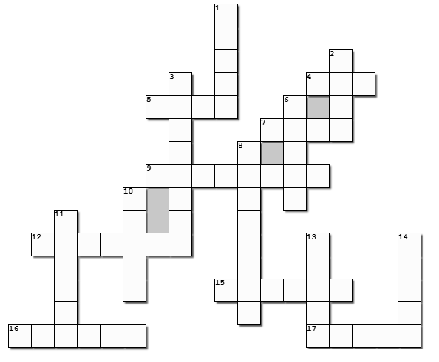
Family Activities
It’s true … the crossword is this week’s activity. All I can say is, it’s about time! Remember, clues and words come from Exodus 1:16-17, 22 – 2:10 (NIV). There’s help at https://tinyurl.com/mr22xnh4

Slide 24
Treasuring Who God Treasures
January 19

