Slide 1
Tithing: An Obedient
Response to a
Gracious God
July 15

Slide 2
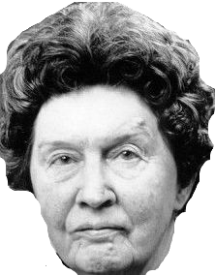
Quotes about Money
If all the rich people in the world divided up their money among themselves there wouldn't be enough to go around.
Christina Stead (1903 - 1983),
House of All Nations (1938) "Credo"

Slide 3
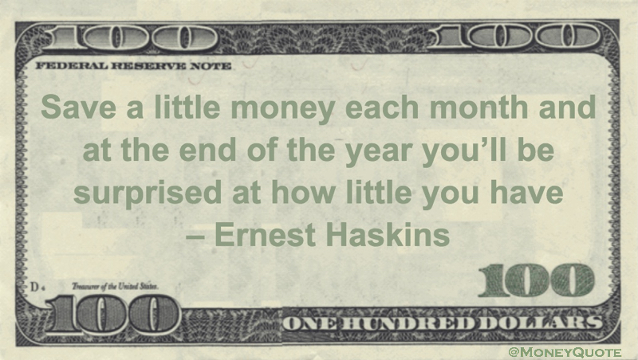
Quotes about Money

Slide 4
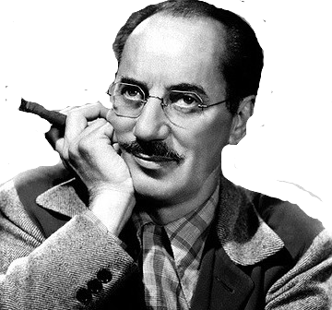
Quotes about Money
Money frees you from doing things you dislike. Since I dislike doing nearly everything, money is handy.
Groucho Marx

Slide 5
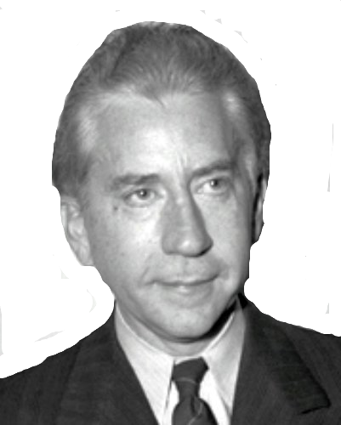
Quotes about Money
If you can count your money, you don't have a billion dollars.
J. Paul Getty

Slide 6
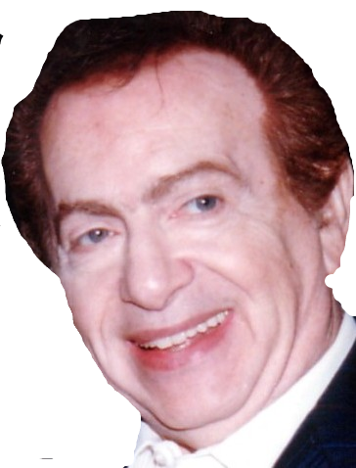
Quotes about Money
I have enough money to last me the rest of my life, unless I buy something.
Comedian Jackie Mason

Slide 7
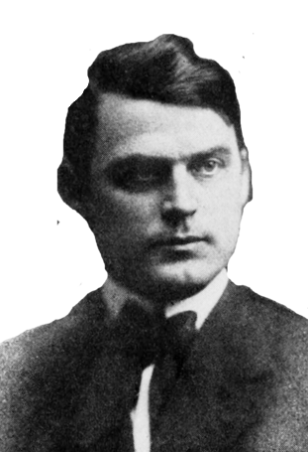
Quotes about Money
The safest way to double your money is to fold it over and put it in your pocket
Kin Hubbard

Slide 8
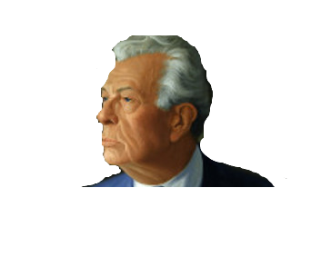
Quotes about Money
A billion here, a billion there, pretty soon it adds up to real money
Senator Everett Dirksen

Slide 9
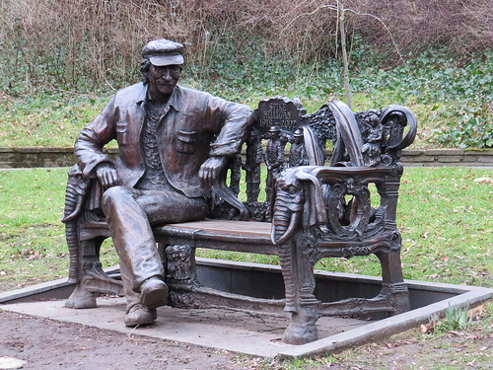
Quotes about Money
Money can't buy friends, but it can get you a better class of enemy.
Spike Miligan

Slide 10
Tithing: An Obedient Response
The way we use our money makes a statement about our views of God.
  Today we will look at the discipline of giving.
  We are called to respond to God’s goodness through a tithe of our incomes.

Slide 11

Malachi 3:7 – 12
Scripture Video
https://tinyurl.com/ybp9amv7

Slide 12

Listen for past rebellion.
Malachi 3:6-7 (NIV) "I the Lord do not change. So you, O descendants of Jacob, are not destroyed. [7] Ever since the time of your forefathers you have turned away from my decrees and have not kept them. Return to me, and I will return to you," says the Lord Almighty. "But you ask, 'How are we to return?'

Slide 13
Rejecting God
What was the basis for hope in God?
How had Israel sinned against God in the past?
What kinds of things cause believers to stray from God?

Slide 14


Rejecting God
Picture all of us in a circle around a Bible setting on a table. One by one we symbolically turn our backs on God’s Word. How would actually turning away from Scripture make a person feel alone?
God tells His people to return to Him. Now we all turn back towards the Bible on the table. Regardless of what you do, you can turn back to God and to obeying Him. How does it this knowledge make you feel?

Slide 15

Listen for who was robbed.
Malachi 3:8-10a (NIV) “Will a man rob God? Yet you rob me. "But you ask, 'How do we rob you?' "In tithes and offerings. 9 You are under a curse--the whole nation of you--because you are robbing me. 10 Bring the whole tithe into the storehouse, that there may be food in my house.

Slide 16
Obedience to God
What was one overt manifestation of their defiance of God’s instructions?
What exhortation and instruction did He give concerning the tithes and offerings?
Why is obedience in the area of giving so challenging?

Slide 17
Obedience to God
How is the way we use our money a thermostat for our spiritual lives?
How is tithing a demonstration of faith?
Why does this (or any) demonstration of faith please God?

Slide 18
Listen for a promise.
Malachi 3:10b-12 (NIV). Test me in this," says the LORD Almighty, "and see if I will not throw open the floodgates of heaven and pour out so much blessing that you will not have room enough for it. 11 I will prevent pests from devouring your crops, and the vines in your fields will not cast their fruit," says the LORD Almighty. 12 "Then all the nations will call you blessed, for yours will be a delightful land," says the LORD Almighty.

Slide 19
Obedience Is Blessed by God
In the bringing of the tithe, what did the Lord challenge the people to do in relationship to Him?
What do you think God meant by "Test me in this"?
What did the Lord promise to do?

Slide 20
Obedience Is Blessed by God
Why are we sometimes reluctant to put God to this kind of test?
What would you think of a church that offered a money back guarantee on tithing for a 3 month period? God actually says “Test me on this” in the passage. Check out https://tinyurl.com/ycvwlkyu
⇨ The point is, we should respond in faith to God’s goodness through a tithe of our incomes.
Good Idea | Bad Idea

Slide 21
Application
Start.
  Begin now to return a full ten percent of your income to God’s work.
  Experience the blessings that come from obedience to God’s Word.
  Trust Jesus with this decision.

Slide 22
Application
Stick.
  If you are already a tither, determine to stay the course and dedicate your obedience to God’s continued blessing.
  Share your conviction with others and encourage them to begin tithing.

Slide 23
Application
Strengthen.
  Pray about giving beyond a tithe, increasing your generosity to others and for the work of the kingdom of God.
  A greater offering provides a greater blessing for others.
  Take the challenge.

Slide 24
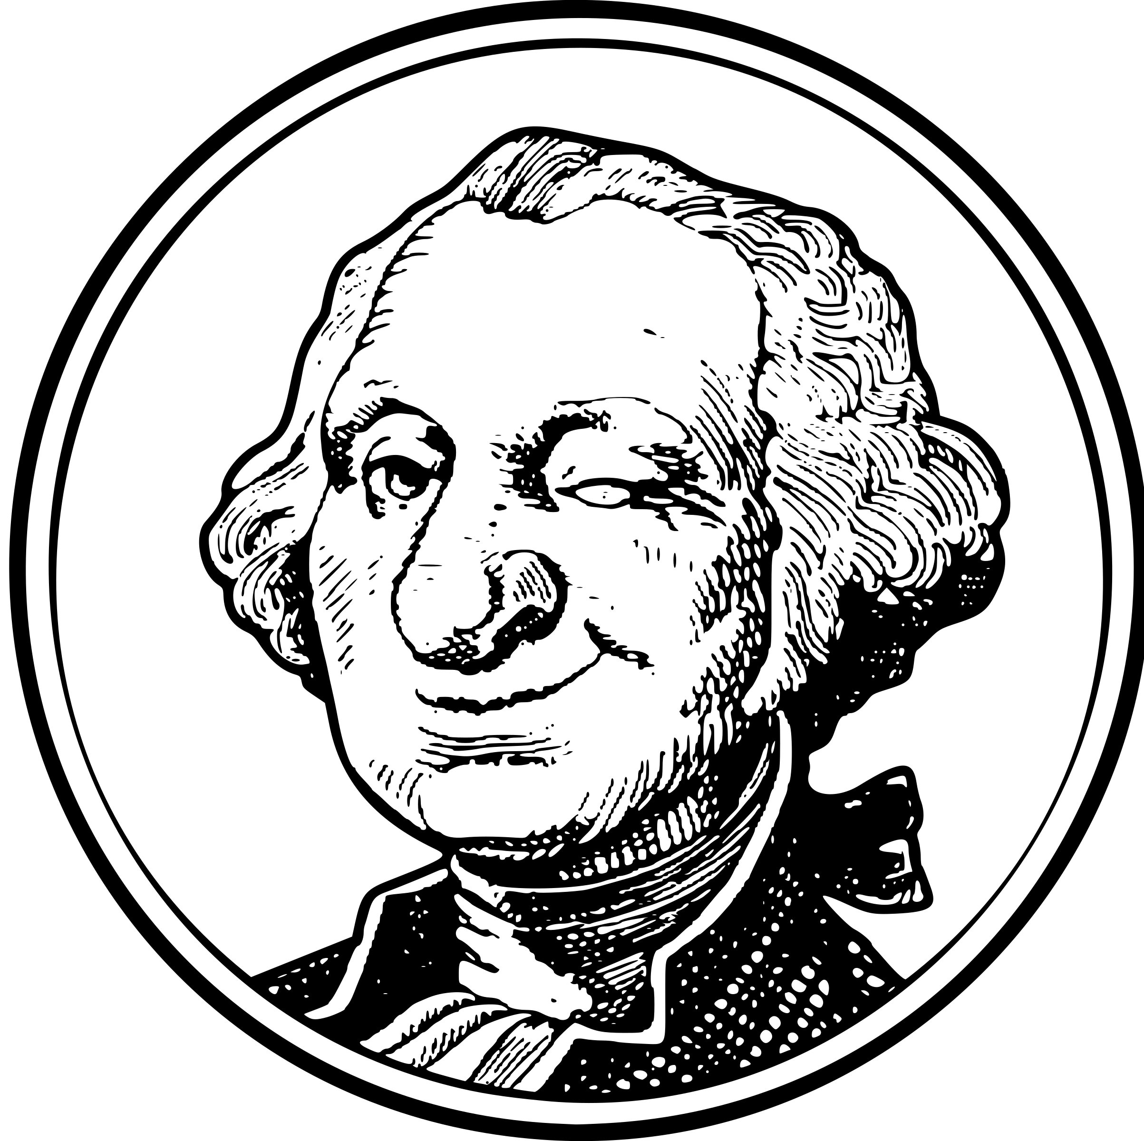
Family Activities
Hope to see more of my friends Lincoln, Hamilton, Jackson, Grant, and Franklin in the offering plate! Seriously, folks … for some cool Family Activities about giving, check out
https://tinyurl.com/y8utwqsq

Slide 25
Tithing: An Obedient
Response to a
Gracious God
July 15

