Slide 1
The Object of Our Prayer
October 14

Slide 2
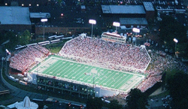
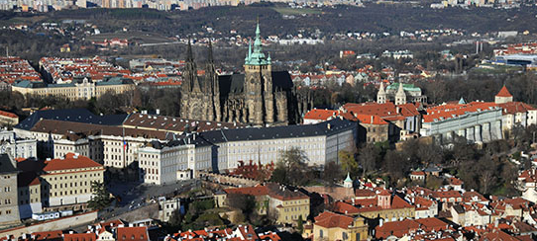
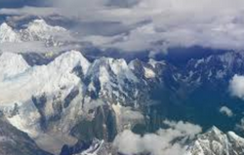
Think about it …
What is something you would like to have a birds-eye view of?
One’s viewpoint gives a unique perspective to a place or an event.
  Today we look at how we view God, in the context of prayer.
  A right view of God fuels how we pray.

Slide 3
Listen for who is blessed.
Matt. 6:9a (NIV) “This, then, is how you should pray: “ ‘Our Father in heaven, ,,, Ps. 103:1- 5 Praise the Lord, my soul; all my inmost being, praise his holy name. 2 Praise the Lord, my soul, and forget not all his benefits— 3 who forgives all your sins and heals all your diseases,

Slide 4

Listen for who is blessed.
who redeems your life from the pit and crowns you with love and compassion, 5 who satisfies your desires with good things so that your youth is renewed like the eagle’s.

Slide 5
God Desires Good for Us
What relationship does Jesus use in that first verse of His model prayer to show how His followers are to approach God?
What challenge does the psalmist issue to himself in relation to the Lord?
What does it mean to “bless the Lord”?
What were some benefits for which the psalmist was thankful and praised God?

Slide 6
God Desires Good for Us
We don’t deserve these things … so why does God do them?
Why are God’s benefits unforgettable?
So why do we sometimes forget them anyway?
How can we keep these benefits at the forefront of our memory?

Slide 7
Listen for expressions of infinity.
Psalm 103:11-13 (NIV) For as high as the heavens are above the earth, so great is his love for those who fear him; 12 as far as the east is from the west, so far has he removed our transgressions from us. 13 As a father has compassion on his children, so the LORD has compassion on those who fear him;

Slide 8
God Is Our
Compassionate Father
How is God’s love and forgiveness depicted?
Verse 12 speaks of how far God removes our transgressions. Why is this important?
Then what is our role in this process?
What are some synonyms for the word “compassion”

Slide 9
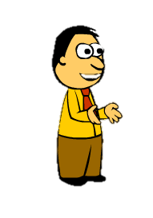
God Is Our
Compassionate Father
What are some ways that God has demonstrated His compassion in your life?
What do the images in these verses teach us about the attributes of God? What can we learn from this psalm about God’s character?
As you pray, you can focus on these attributes and more readily believe in the God who answers prayer.

Slide 10
Listen for who else should praise God.
Psalm 103:19-22 (NIV) The LORD has established his throne in heaven, and his kingdom rules over all. 20 Praise the LORD, you his angels, you mighty ones who do his bidding, who obey his word. 21 Praise the LORD

Slide 11
Listen for who else should praise God.
all his heavenly hosts, you his servants who do his will. 22 Praise the LORD, all his works everywhere in his dominion. Praise the LORD, O my soul.

Slide 12
We Pray to Almighty God
What image does David use to affirm that the Lord is the Almighty King?
What specific instructions conclude the psalm?

Slide 13
We Pray to Almighty God
How does our view of God’s power and sovereignty influence the way we pray?
How can we improve our prayer life as a group?

Slide 14
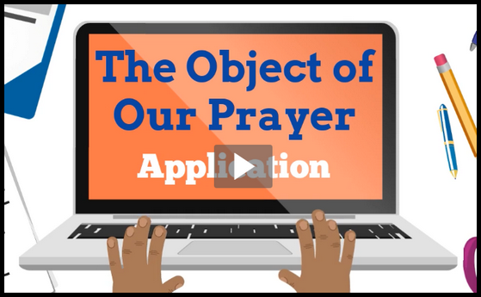
Application
Watch the Video

Slide 15
Application
Focus on the Father.
  Consider the traits of God as our perfect Father.
  As you begin each day with prayer, focus on those traits
  Thank God for being your heavenly Father.

Slide 16
Application
Humble yourself.
  Reflect on the holiness (uniqueness, distinctness) and greatness of God.
  Humble yourself before Him and acknowledge that He is the Lord who is all-powerful and capable of handling what you bring to Him.

Slide 17
Application
Pray together.
  Tell another Christian what you’ve learned or are practicing in your prayer life as a result of this study.
  Challenge that person to do the same.
  Commit yourselves to prayer.

Slide 18

Family Activities
Yes, the crossword puzzle is on the handout this week. But, there’s lots of other good stuff, including a video and a color page for the kids. Check out https://tinyurl.com/y9umsdzj

Slide 19
The Object of Our Prayer
October 14

