Slide 1
The Ultimate Sign
April 20

Slide 2
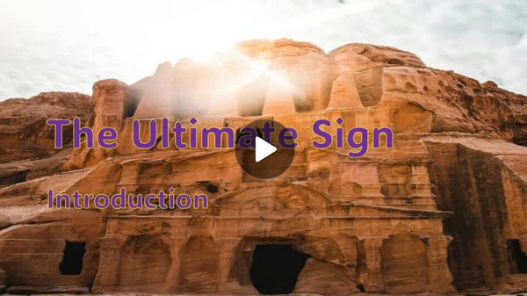
Video Introduction
View Video

Slide 3
What about it?
About what sort of news would you get excited right now?
Jesus’ friends and disciples got some news that excited them !
Jesus, who died on the cross, was alive!
We can be excited because Jesus’ resurrection makes eternal life possible.

Slide 4
Listen for a surprise.
John 20:1-2 (NIV) Early on the first day of the week, while it was still dark, Mary Magdalene went to the tomb and saw that the stone had been removed from the entrance. [2] So she came

Slide 5
Listen for a surprise.
running to Simon Peter and the other disciple, the one Jesus loved, and said, "They have taken the Lord out of the tomb, and we don't know where they have put him!"

Slide 6
The Tomb Was Empty!
Suppose you are a news writer … fill in the who, what, where, etc.
What does the fact that Mary went to a tomb where Jesus had been buried indicate?
Mary found the tomb empty … what thoughts would have run through your mind if you unexpectedly discovered the empty tomb?

Slide 7
The Tomb Was Empty!
Why do you think Mary assumed someone had taken the body?
What part to you think Mary’s emotions related to Jesus’ death play in her reaction to the empty tomb?

Slide 8
The Tomb Was Empty!
How do our emotions in a crisis prevent us from seeing the truth of a situation clearly?
Mary was searching for Jesus’ remains in the tomb, but not finding them. Where do you see people searching for Jesus, searching for God but not finding Him?

Slide 9
Listen for mistaken identity.
John 20:11-16 (NIV) but Mary stood outside the tomb crying. As she wept, she bent over to look into the tomb 12 and saw two angels in white, seated where Jesus' body had been, one at the head and the other at the foot. 13 They asked her, "Woman, why are you crying?"

Slide 10
Listen for mistaken identity.
They have taken my Lord away," she said, "and I don't know where they have put him." 14 At this, she turned around and saw Jesus standing there, but she did not realize that it was Jesus. 15 "Woman," he said, "why are you crying? Who is it you are looking for?"

Slide 11
Listen for mistaken identity.
Thinking he was the gardener, she said, "Sir, if you have carried him away, tell me where you have put him, and I will get him." 16 Jesus said to her, "Mary." She turned toward him and cried out in Aramaic, "Rabboni!" (which means Teacher).

Slide 12
He’s Alive !
What different things did Mary see?
More importantly was what she did not see!
The tomb was empty of Jesus’ body!
Why do you think she didn’t recognize the person she saw who turned out to be Jesus?
What became a point of revelation or realization for her?

Slide 13
He’s Alive !
When might we have an encounter with God that we fail to recognize Him?
What are some reasons we might fail to see Jesus’ presence at work in our lives?
What can we do to better recognize God’s presence at work in our lives and in the world around us?

Slide 14
Listen for a mission given.
John 20:17-18 (NIV) Jesus said, "Do not hold on to me, for I have not yet returned to the Father. Go instead to my brothers and tell them, 'I am returning to my

Slide 15
Listen for a mission given.
Father and your Father, to my God and your God.'" 18 Mary Magdalene went to the disciples with the news: "I have seen the Lord!" And she told them that he had said these things to her.

Slide 16
Shout It Out!
Why would Mary have wanted to cling to Jesus?
Why do we sometimes want to “cling” to Jesus?
A baby or young child sometimes goes through a “clingy” stage. How might that be true about our relationship with the Lord?

Slide 17
Shout It Out!
Jesus told Mary to go tell the disciples of His resurrection. This was also part of the “don’t cling to me” command. What has God called us to do?
Why is the resurrection the central message of all Christianity?

Slide 18
Application
Connect.
Spend some time with a couple of others from the group reflecting upon all the barriers that Jesus took down so that you could hear the gospel message.
Consider what barriers still exist today for people and how you can be a part of taking those misconceptions down.

Slide 19
Application
Go.
Reread Mary’s message to the disciples. (See John 20:17-18.)
Take a moment to write down or memorize how to share the gospel.
Begin praying about someone you can share this message with this week.

Slide 20
Application
Worship.
Take a moment to read the prophecies about Jesus in the Old Testament and how the signs point to Jesus fulfilling them completely.
A good study Bible is a great place to start.
Spend time in personal worship for who Jesus is.

Slide 21
Family Activities
That’s exactly how that message you have came into our consulate courtyard in Elof Monorger. We need your help to decrypt the message. Tech help is found at https://tinyurl.com/3kfm5z4p

Slide 22
The Ultimate Sign
April 20

