Slide 1
The Testimony of Our Hope
June 21

Slide 2
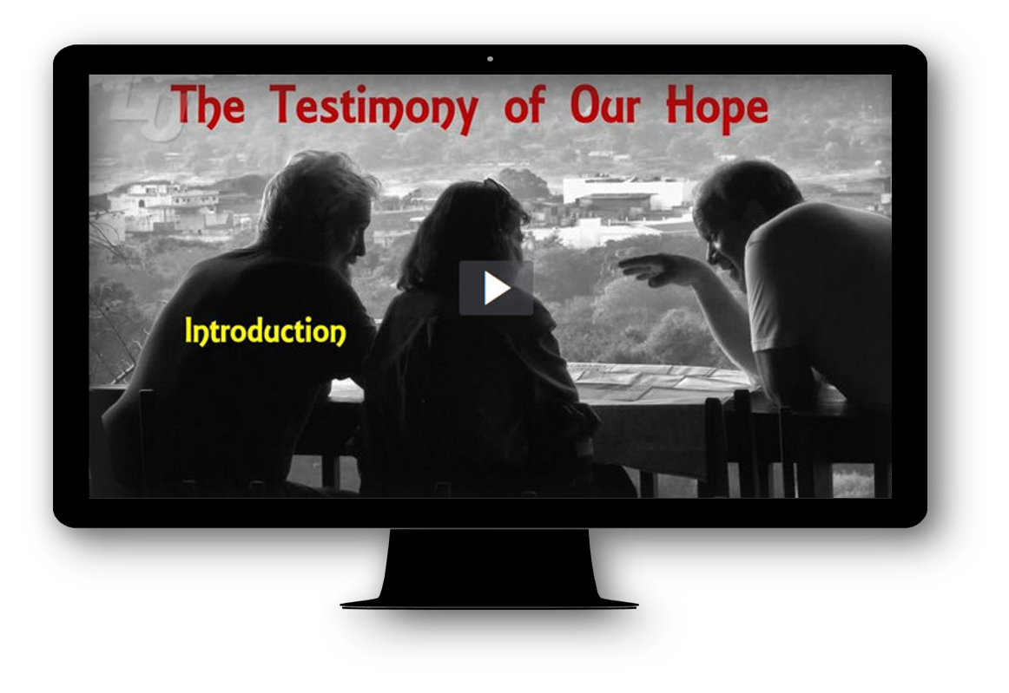
Video Introduction
View Video

Slide 3
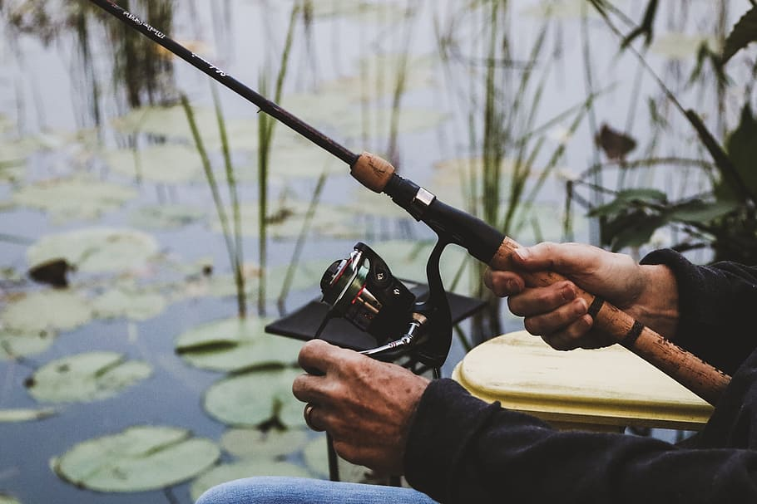
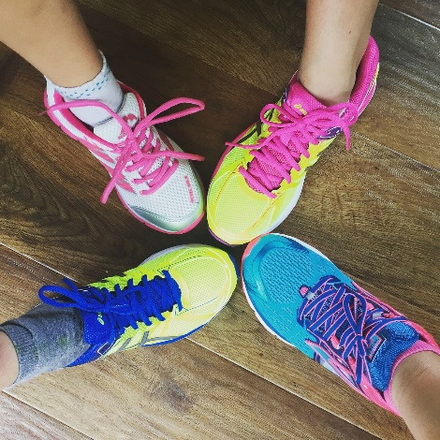
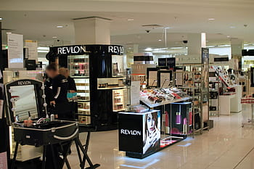
Think about it …
When have you bought something based on a friend’s recommendation?
As believers, we also are called to “recommend” Jesus to others.
  Our hope in Christ points others to Him.
  We share that hope by our words and actions.

Slide 4
Listen for metaphors, figures of speech.
1 Peter 2:4-6 (NIV) As you come to him, the living Stone--rejected by men but chosen by God and precious to him-- 5 you also, like living stones, are being built into a spiritual house to be a holy priesthood,

Slide 5
Listen for metaphors, figures of speech.
offering spiritual sacrifices acceptable to God through Jesus Christ. 6 For in Scripture it says: "See, I lay a stone in Zion, a chosen and precious cornerstone, and the one who trusts in him will never be put to shame."

Slide 6
Never Put to Shame
Contrast how Jesus was received by some people with how He was affirmed by God.
How is Christ still being rejected by people today? Why?
Who are the lively or living stones?
What are some foundations people build their lives upon?
Received by Some | Affirmed by God

Slide 7
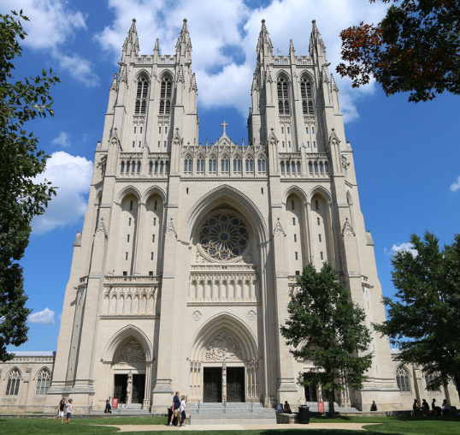
Never Put to Shame
What will happen to those who trust in the "Cornerstone", those who build their lives on Him?
What are different kinds
or shapes of stones used
in constructing a beautiful
building, a cathedral, for instance?

Slide 8
Never Put to Shame
If we are “stones” which form the “building” of the church, what are different kinds of “stones” needed for God’s church – both the local congregation and the church universal?

Slide 9
Listen for who we are as believers.
1 Peter 2:7-10 (NIV) Now to you who believe, this stone is precious. But to those who do not believe, "The stone the builders rejected has become the capstone, 8 and, "A stone that causes men to stumble and a rock that makes them fall." They stumble because they disobey the message--which is also what they were destined for.

Slide 10
Listen for who we are as believers.
But you are a chosen people, a royal priesthood, a holy nation, a people belonging to God, that you may declare the praises of him who called you out of darkness into his wonderful light. 10 Once you were not a people, but now you are the people of God; once you had not received mercy, but now you have received mercy.

Slide 11
Who We Are in Christ
What benefits comes to those who believe in Jesus? What images did Peter use to describe what those who believe in Christ have become?
Contrast the past and present condition of believers.
Past Condition | Present Condition

Slide 12
Who We Are in Christ
For what purpose were they called?
What changed about their lives?
In what ways will God change a believer’s life?

Slide 13
Listen for how believers are to live.
1 Peter 2:11-15 (NIV) Dear friends, I urge you, as aliens and strangers in the world, to abstain from sinful desires, which war against your soul. 12 Live such good lives among the pagans that, though they accuse you of doing wrong, they may see your good deeds and glorify God on the day he visits us. 13 Submit yourselves

Slide 14
Listen for how believers are to live.
for the Lord's sake to every authority instituted among men: whether to the king, as the supreme authority, 14 or to governors, who are sent by him to punish those who do wrong and to commend those who do right. 15 For it is God's will that by doing good you should silence the ignorant talk of foolish men.

Slide 15
Lead Others to Glorify God
What terms describe who believers are in relationship to this world?
When you observe someone who is foreign, what gives them away … how can you tell?
What does that suggest about the practical implications of believers living as strangers and exiles (aliens)?

Slide 16
Lead Others to Glorify God
In what manner are believers to live before unbelievers?
Why is that so often a challenge?
What is to be our response before our government even in harsh or sinful situations?
What is the goal of godly living before others?

Slide 17
Application
Be honorable. .
  Start your day by asking the Lord to make you mindful of ways you can honor Him as you go through your day, no matter how simple or insignificant you may think the task is.
  Small steps of obedience lead to a long path of godliness.

Slide 18
Application
Be submissive.
  Is there a person or agency of authority that you’ve not lovingly submitted yourself to as unto the Lord?
  Confess this to the Lord and seek to make it right with that person as soon as possible.

Slide 19
Application
Be outspoken.
  Someone in your circle of influence needs to know of your hope in Christ.
  Think of a tangible good that you can do for someone who may be ignorant or critical toward the gospel.
  Show the love of Christ to them with no strings attached!

Slide 20
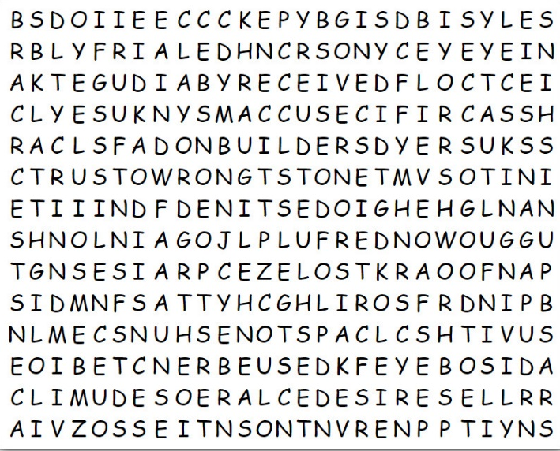
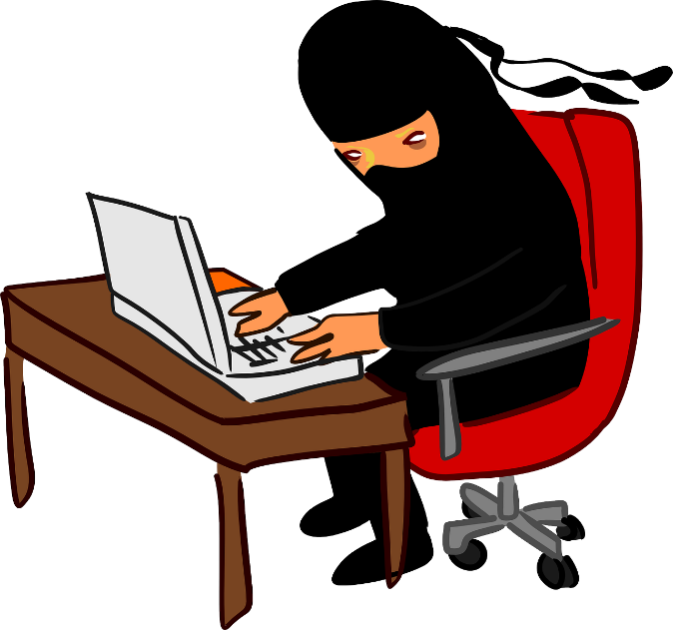
Ninja Family Activities
Taijin-Jutsu, Ninja mind control does not work on the Word Search Lady. I still must do her book report. Can you help me find the words? If you need Ninja help, go to https://tinyurl.com/y73nccjk And you can find other Ninja Family Activities as well.

Slide 21
The Testimony of Our Hope
June 21

