Slide 1
The Temptation to Test God
April 30

Slide 2


Video Introduction
View Video

Slide 3
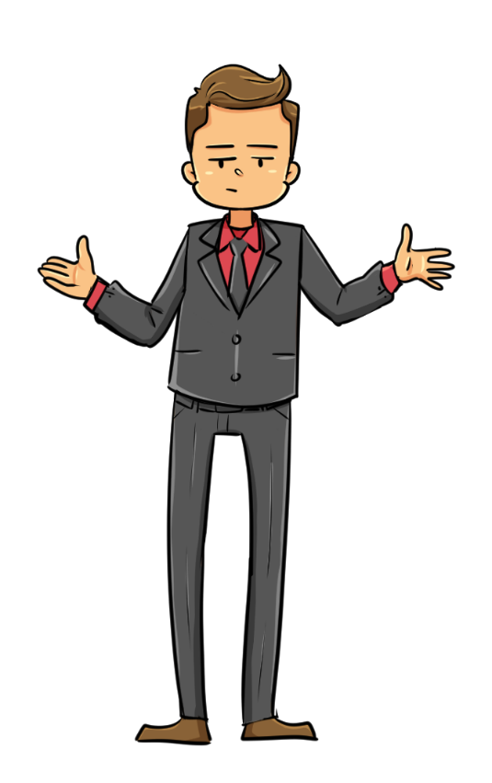
Admit it, now …
OK, God … If you want me to take that job in Texas, let the doorbell ring in the next five minutes
When have you realized “looking for a sign” to guide a decision was not such a great idea?
Looking for a “sign” is a poor strategy.
Instead, trust God without putting Him to the test.

Slide 4
Listen for misuse of Scripture.
Matthew 4:5-7 (NIV) Then the devil took him to the holy city and had him stand on the highest point of the temple. 6 "If you are the Son of God," he said, "throw yourself down. For it is written: "'He will command his angels

Slide 5
Listen for misuse of Scripture.
concerning you, and they will lift you up in their hands, so that you will not strike your foot against a stone.'" 7 Jesus answered him, "It is also written: 'Do not put the Lord your God to the test.'"

Slide 6
Testing God for Your Own Purposes
The second temptation
  Satan and Jesus in the Holy City, Jerusalem
  Climb to the highest point of the Temple
What did the devil suggest Jesus do and how did he misuse Scripture in an effort to justify the temptation?
What would have been appealing to Christ about the devil’s second temptation?

Slide 7
Testing God for Your Own Purposes
How did Jesus respond?
What does this incident say about Jesus’s commitment to His messianic mission?
What does this passage reveal about Satan’s tactics to entice us to temptation?

Slide 8
Testing God for Your Own Purposes
When might we be most tempted to test God?
How can we avoid being deceived by things even when they appear to be religious or have scriptural support?

Slide 9
Listen for the context of Jesus’ response.
Deuteronomy 6:16-19 (NIV) Do not test the LORD your God as you did at Massah. 17 Be sure to keep the commands of the LORD your God and the stipulations and decrees he has given you. 18 Do what is right and good

Slide 10
Listen for the context of Jesus’ response.
in the LORD's sight, so that it may go well with you and you may go in and take over the good land that the LORD promised on oath to your forefathers, 19 thrusting out all your enemies before you, as the LORD said.

Slide 11
Trust and Obey God’s Word
Note the episode from Israel’s history Moses cited as an example of a time when the people tested God rather than trusted Him.
  Events at the location called Massah during wilderness wandering
  Complained about lack of water
  What they did find was undrinkable
  Murmured against Moses, even after God fixed the water
  Complained about food, then about water again
  So mad they were ready to stone Moses

Slide 12
Trust and Obey God’s Word
What would the people have to do to prove they were indeed God’s people? What responsibility did the people have as far as possessing the land was concerned?
What is the standard for right and good behavior?
What benefits would come their way by being diligent in keeping God’s Word?

Slide 13
Trust and Obey God’s Word
How can we overcome lack of faith and the sense of uncertainty when our faith is tested?
How does obedience keep us from testing God?

Slide 14
Listen for why to share your faith story.
Deuteronomy 6:20-25 (NIV) 0 In the future, when your son asks you, "What is the meaning of the stipulations, decrees and laws the LORD our God has commanded you?" 21 tell him: "We were slaves of Pharaoh in Egypt, but the LORD brought us out of Egypt with a mighty hand.

Slide 15
Listen for why to share your faith story.
Before our eyes the LORD sent miraculous signs and wonders--great and terrible--upon Egypt and Pharaoh and his whole household. 23 But he brought us out from there to bring us in and give us the land that he promised on oath to our forefathers. 24 The LORD commanded us to

Slide 16
Listen for why to share your faith story.
obey all these decrees and to fear the LORD our God, so that we might always prosper and be kept alive, as is the case today. 25 And if we are careful to obey all this law before the LORD our God, as he has commanded us, that will be our righteousness."

Slide 17
God’s Goodness and Faithfulness
What would be the question raised by the children in the future?
How were the fathers to answer in affirming the meaning and purpose of God’s commandments to His people?

Slide 18
God’s Goodness and Faithfulness
How can you tell the next generation about what God has done for you?
What methods can you use to model your faith to others, especially your children?

Slide 19
Application
Confess.
  If there are areas where you live with uncertainty and are tempted to put God to the test, confess that as wrong.
  Acknowledge that you do not need to attempt to force God to act the way you want Him to act.
  Ask God to help you simply trust Him.

Slide 20
Application
Memorize.
  Choose a verse or two that emphasizes the value of trusting God and memorize them.
  Here are two passages to consider:
  “Trust in the Lord with all your heart, and do not rely on your own understanding; in all your ways know him, and he will make your paths straight” (Prov. 3:5-6);
  “You will keep the mind that is dependent on you in perfect peace, for it is trusting in you” (Isa. 26:3).

Slide 21
Application
Challenge.
  Do you know someone who is presuming upon God to act in a way that justifies his or her actions?
  Challenge this person to see why Jesus wouldn’t put God to such a test.
  Encourage this individual to trust God to work in His perfect way and timing.

Slide 22


Family Activities
I hope there’s clues for this crossword. I’ve heard the words and the clues (if they exist) are from your Bible passage. If you need help or would rather do the Word Search, go to
https://tinyurl.com/2f9hk3sf

Slide 23
The Temptation to Test God
April 30

