Slide 1
The Temptation to Rely on Myself Instead of God
April 23

Slide 2
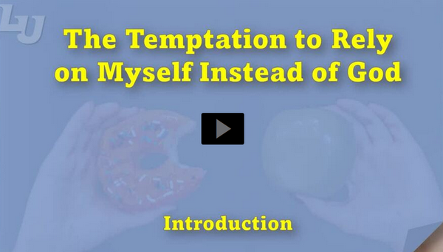
Video Introduction
View Video

Slide 3
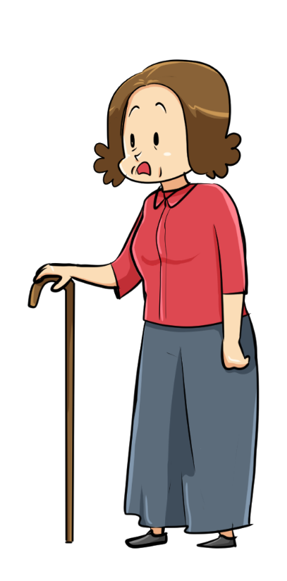
Think about it …
Why do different people struggle with different types of temptations?
Though temptations may be different for different people …
You need to know, whatever tempts you, God has something better.
Today we look at how to follow Jesus’ example in defeating spiritual attacks.

Slide 4
Listen for why Jesus was vulnerable.
Matthew 4:1-4 (NIV) Then Jesus was led by the Spirit into the desert to be tempted by the devil. 2 After fasting forty days and forty nights, he was hungry. 3 The tempter came to him and said, "If you are

Slide 5
Listen for why Jesus was vulnerable.
the Son of God, tell these stones to become bread." 4 Jesus answered, "It is written: 'Man does not live on bread alone, but on every word that comes from the mouth of God.'"

Slide 6
God-given Desires
Jesus had been without food. Why would someone be more susceptible to temptation when physically tired and hungry?
Why did Satan preface his temptation with “If you are the Son of God …”?
This temptation was in the physical realm. What are some ways we face temptation through our physical appetites?

Slide 7
God-given Desires
How do we justify decisions to satisfy God-given desires in the wrong way?
When have you been tempted to doubt God’s provision?
How did Jesus respond to this temptation?

Slide 8
God-given Desires
How can memorizing Scripture help us combat temptation? What role does the Word of God play in resisting temptation?
Thy Word have I hid in my heart …

Slide 9
Listen for how God provided.
Deuteronomy 8:2-5 (NIV) Remember how the LORD your God led you all the way in the desert these forty years, to humble you and to test you in order to know what was in your heart, whether or not you would keep his commands. 3 He humbled you,

Slide 10
Listen for how God provided.
causing you to hunger and then feeding you with manna, which neither you nor your fathers had known, to teach you that man does not live on bread alone but on every word that comes from the

Slide 11
Listen for how God provided.
mouth of the LORD. 4 Your clothes did not wear out and your feet did not swell during these forty years. 5 Know then in your heart that as a man disciplines his son, so the LORD your God disciplines you.

Slide 12
God’s Provision
What purpose did these forty years in the wilderness serve?
What lesson did the manna, the Lord’s total care of clothing, and strengthening of feet teach?
How can remembering God’s past actions help us resist the temptation to doubt His provision for today?

Slide 13
God’s Provision
Why do we tend to question God when we experience severe need?
We are spiritual people … what we need most is spiritual food. In what ways does God’s word “feed” us?

Slide 14
Listen for amazing promises.
Deuteronomy 8:6-10 (NIV) Observe the commands of the LORD your God, walking in his ways and revering him. 7 For the LORD your God is bringing you into a good land--a land with streams and pools of water, with springs flowing in the valleys and hills; 8 a land

Slide 15
Listen for amazing promises.
with wheat and barley, vines and fig trees, pomegranates, olive oil and honey; 9 a land where bread will not be scarce and you will lack nothing; a land

Slide 16
Listen for amazing promises.
where the rocks are iron and you can dig copper out of the hills. 10 When you have eaten and are satisfied, praise the LORD your God for the good land he has given you.

Slide 17
Trust and Obey
What promises did Moses make to faithful Israelites?
Upon enjoying all that the Lord had given, how were the people to respond?
What phrases describe the requirements of faithfulness that would make these promises happen?
God has been good to us … praise Him … give God the glory … be in awe of His love

Slide 18
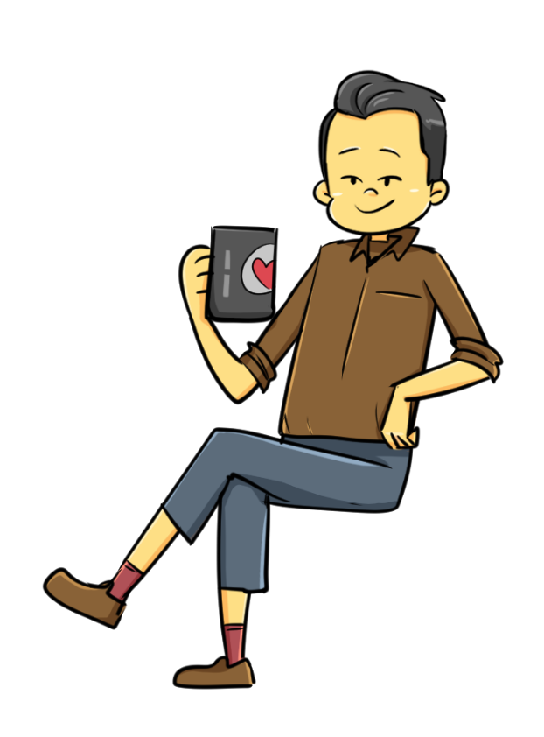
Trust and Obey
So how does knowledge of what God will do for you in the future affect how you act in the present?
“God is bringing you into a good land … “

Slide 19
Application
A grateful heart.
One of the ways we can battle when Satan tempts us to doubt God’s provision is to give thanks for all God has provided for us.
Take a moment to count your blessings and give thanks for His provision.

Slide 20
Application
A trusting heart.
God will provide as we trust Him.
Between now and the time He provides, wait and trust.
God will provide what you need in His perfect timing. Trust Him to strengthen your faith as you wait.

Slide 21
Application
A generous heart.
When we doubt God’s provision, we wish we had what others have.
We can also be drawn to materialism. Generosity is the key to battling covetousness and materialism.
As you trust God to provide what you need, be willing to give and be a conduit of His provision to others.

Slide 22
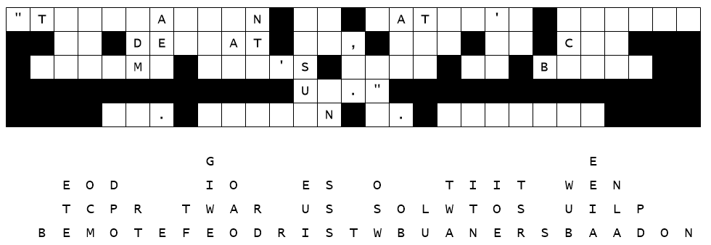
Family Activities
This discarded message form was retrieved from the trash of the Walirianew Secret Police. Apparently, they were unable to reconstruct the secret code. You can do this. Technical assistance is available at https://tinyurl.com/ktwft9kf

Slide 23
The Temptation to Rely on Myself Instead of God
April 23

