Slide 1
The Strength to Stand Against Temptation
May 21

Slide 2

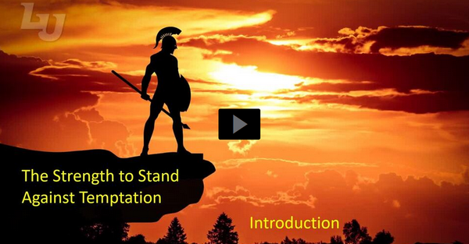
Video Introduction
View Video

Slide 3
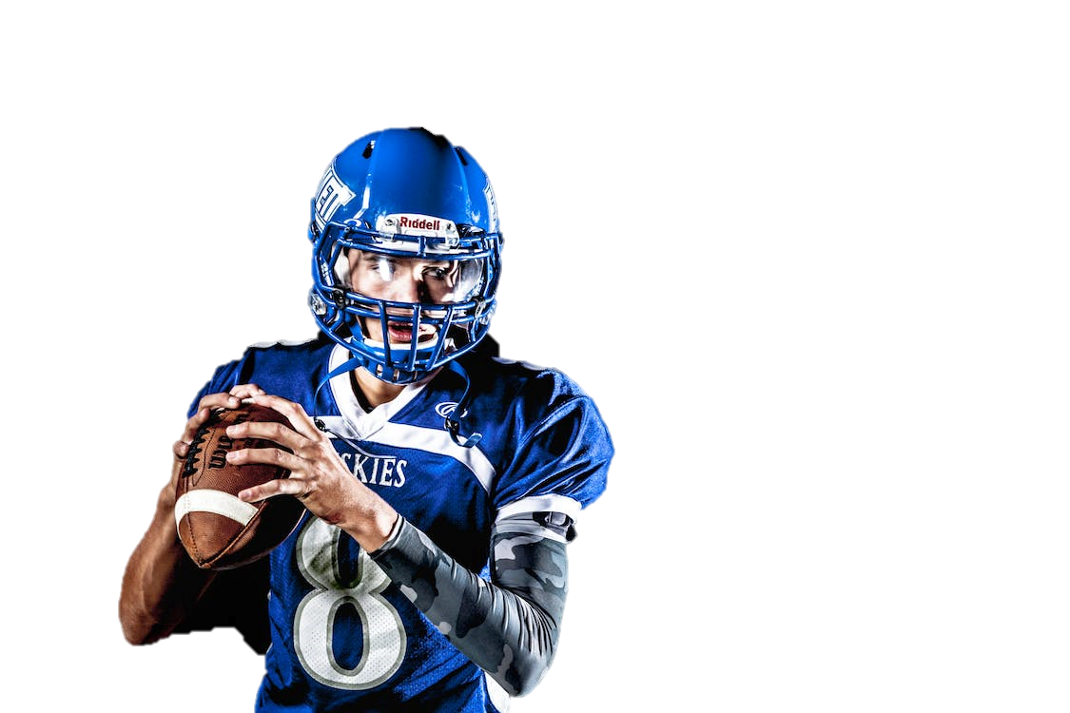
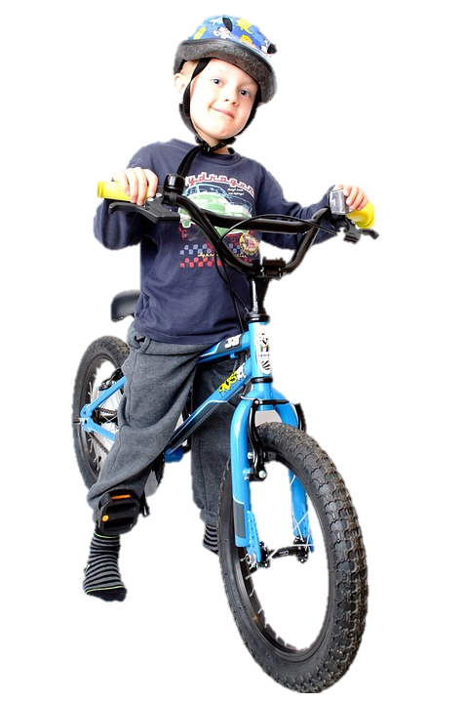
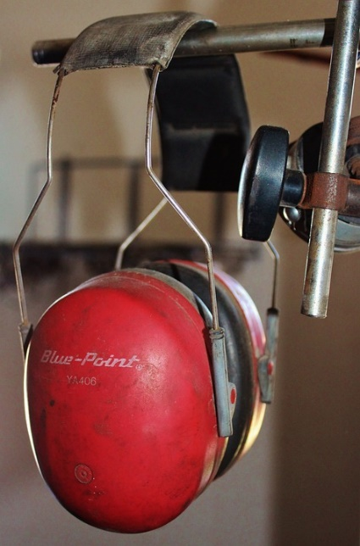
Good call …
When have you had to wear protective gear?
Today we consider spiritual protective gear provided by God.
  God equips us to stand our ground against temptation.

Slide 4
Listen for how we are at war.
Ephesians 6:10-13 (NIV) Finally, be strong in the Lord and in his mighty power. 11 Put on the full armor of God so that you can take your stand against the devil's schemes. 12 For our struggle is not against flesh and blood, but against the rulers, against the authorities,

Slide 5
Listen for how we are at war.
against the powers of this dark world and against the spiritual forces of evil in the heavenly realms. 13 Therefore put on the full armor of God, so that when the day of evil comes, you may be able to stand your ground, and after you have done everything, to stand.

Slide 6
Spiritual Battle
What would have to be their source of strength if the Ephesians were to be victorious in spiritual battle?
Who was (and was not) their and our enemy?
Not the Enemy | The Spiritual Enemy

Slide 7
Spiritual Battle
When might you experience a battle in your Christian life?
What is the key to being “strong in the Lord and in his mighty power”?
What are some actions, words, attitudes that help you “be strong in the Lord and in His mighty power” before or during spiritual warfare?

Slide 8
Listen for specific equipment.
Ephesians 6:14-17 (NIV) Stand firm then, with the belt of truth buckled around your waist, with the breastplate of righteousness in place, 15 and with your feet fitted with the readiness that comes from the gospel of peace.

Slide 9
Listen for specific equipment.
16 In addition to all this, take up the shield of faith, with which you can extinguish all the flaming arrows of the evil one. 17 Take the helmet of salvation and the sword of the Spirit, which is the word of God.

Slide 10
God Given Armor and Weapons
What defensive and offensive equipment do you see in the passage?
Defensive | Offensive

Slide 11
God Given Armor and Weapons
For each of the pieces of equipment, what part of the body does it protect, what spiritual ability does it provide?
Armor | Physical Protection or Capability Provided | Spiritual Protection or Capability Provided
Helmet of Salvation
Breastplate of Righteousness
Shoes of the Gospel
Sword of the Spirit
Belt of Truth

Slide 12
God Given Armor and Weapons
You would not want to leave out any one piece of physical armor. What would happen if we left out one or more of the elements of spiritual armor?
Spiritual Armor Element | Problem When Missing
Truth / Scripture / Gospel
Faith
Righteousness
Salvation

Slide 13
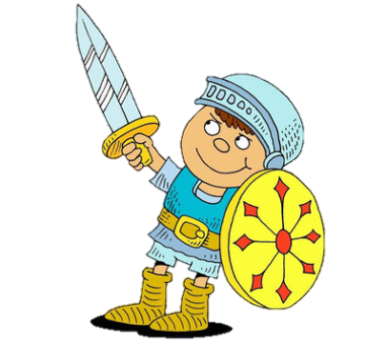
God Given Armor and Weapons
How do we consciously
“put on” this spiritual
armor?
Art by Richard Gunther

Slide 14
Listen for how to communicate.
Ephesians 6:18-20 (NIV) 18 And pray in the Spirit on all occasions with all kinds of prayers and requests. With this in mind, be alert and always keep on praying for all the saints. 19 Pray also for me,

Slide 15
Listen for how to communicate.
that whenever I open my mouth, words may be given me so that I will fearlessly make known the mystery of the gospel, 20 for which I am an ambassador in chains. Pray that I may declare it fearlessly, as I should.

Slide 16
Prayer Is Communication
What connections exist between these verses and verses 10-17?
What characteristics of prayer does Paul give us? How should we pray?
What do you think it means to “pray in the Spirit?”

Slide 17
Prayer Is Communication
How does prayer help you stand against temptations?
What kinds of things could we pray about for other people, praying in the Spirit?

Slide 18
Application
Take your stand.
  Through prayer, commit yourself anew to standing firm in the strength of the Lord in spiritual battle.

Slide 19
Application
Identify.
  Make a list of temptations Satan often uses against you.
  Identify Scripture passages that will help you do battle against these specific temptations.
  Over the next few weeks, commit these verses to memory.

Slide 20
Application
Stand together.
  Even as Roman soldiers would often stand back-to-back in battle, you can do the same with other believers.
  Discuss ways to support and encourage each other in the spiritual battles you face.

Slide 21
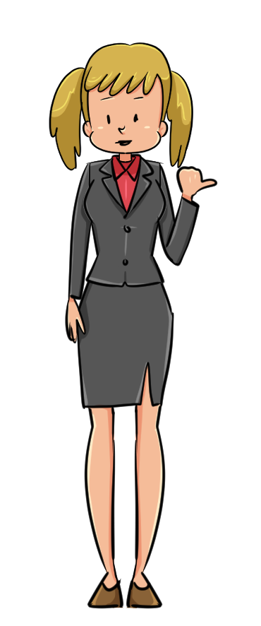
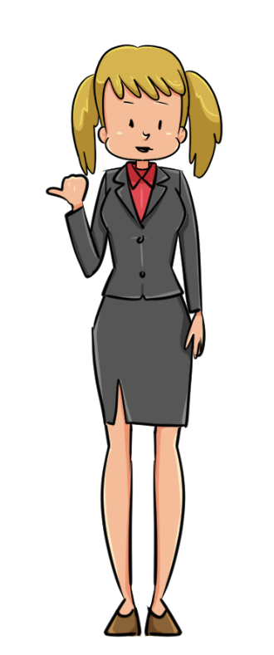
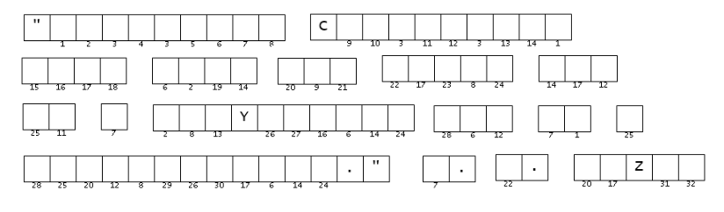
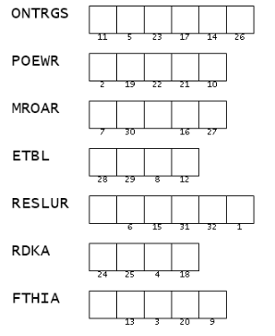
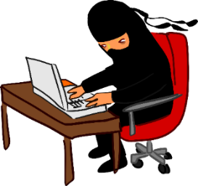
Family Activities
Double Puzzle
If you unscramble these words they give you the numbers to decode the message.
It’s a secret message from Christians in Bulswenanonpit
The scrambled words are from your Bible Study passage

Slide 22
The Strength to Stand Against Temptation
May 21

